Slide 1
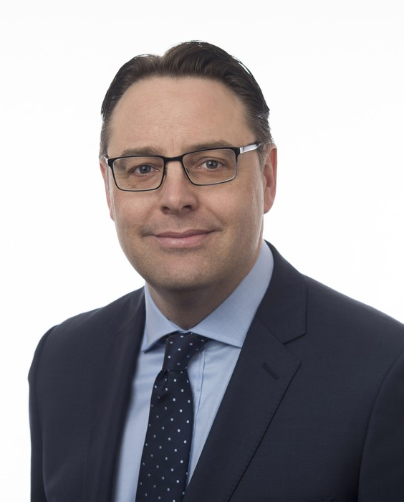
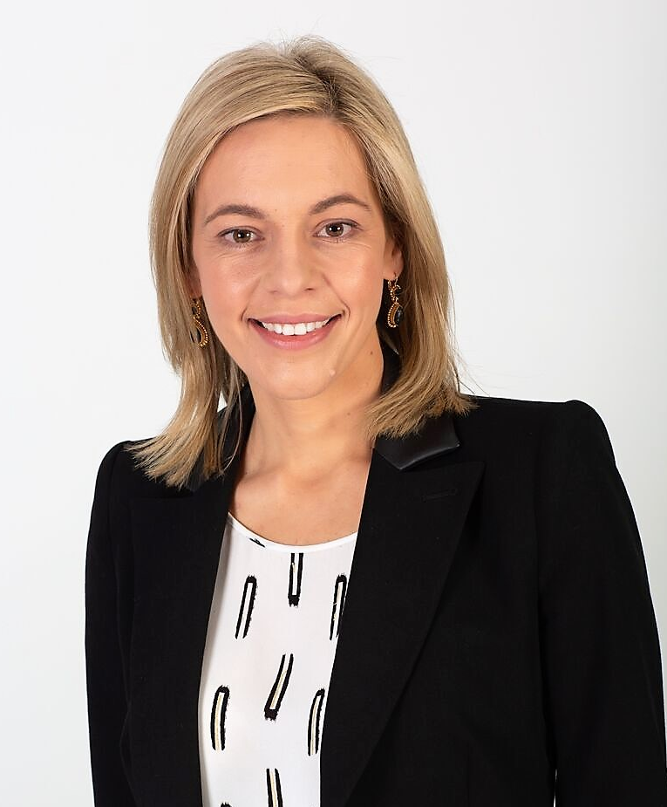
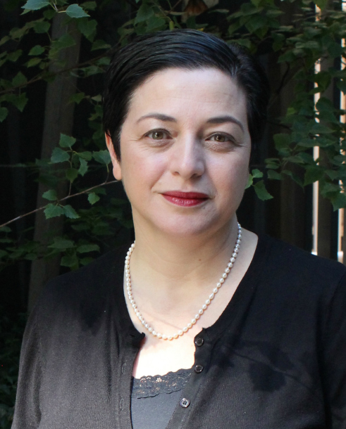
More than a one-trick pony - why practising across industries is good for your career and great for business
Matthew Lamb
Special Counsel – Corporate
AURIZON
Joanne Moss
General Counsel & Chief Corporate Affairs Officer
PIZZA HUT AUSTRALIA
Annette Musolino
Chief Counsel
DEPARTMENT OF HUMAN SERVICES

Slide 2










QSR – Fast Food
FMCG
(Private equity ownership)
General Counsel
Chief Corporate Affairs Officer
Leadership Team
Executive
Board Advisor
Petroleum Refining Transport Fuel Supplier Convenience Retailer
Senior Corporate Counsel
Corporate Commercial Litigation Associate
Construction & Infrastructure Senior
Associate
Energy & Resources Senior
Associate
Franchising FMCG
Senior Associate
Commercial Advisory Associate
BREAK
SECONDMENT FROM NORTON ROSE FULBRIGHT AUSTRALIA

