Slide 1
Mediation Skills for the Modern General Counsel
Settling Disputes In-House
Cecily Zhu The Accord Group 16 November 2018

Slide 2
HELLO!
I am Cecily Zhu
I am here because I am a mediator and I like sharing my experience with lawyers.

Slide 3
3
3

Slide 4
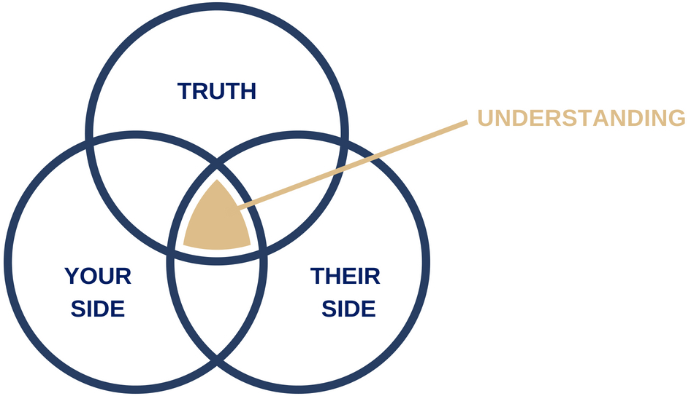
“There are three sides to every story: your side, my side, and the truth. And no one is lying. Memories shared serve each differently.”
– Robert Evans

Slide 5
DISPUTES ICEBERG
Issues (Agenda)
Underlying issues
Why they need a mediator
Needs, goals, objectives for the future
Misunderstanding

Slide 6
MEDIATION TIMELINE
MUTUAL ACKNOWLEDGEMENT
PREPARATION
UNDERSTANDING
OPTION GENERATION
AGREEMENT
History
Emotions
Relationship
Contract
Technical
Rights
Needs, Goals, Objectives

Slide 7
Open Questions
Closed Questions
How….
What….
Which…
Can you tell us about...
Why…
Get a yes, no or fixed answer

Slide 8
REFRAMING
NEGATIVE
NEUTRAL /
POSITIVE
e.g. “He never listens to me.”
“Communication is important to you.”

Slide 10
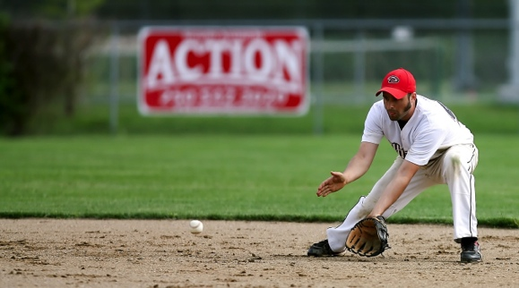
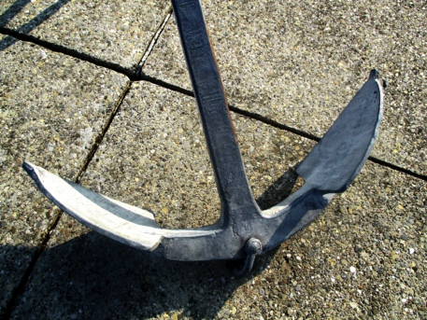
NEGOTIATION TACTICS
Bad intentions
Good cop / Bad cop
Low ball / High ball
Refusal to negotiate
Anchoring

Slide 11
11

Slide 12
REALITY TESTING
Is it realistic?
Does it satisfy our concerns and interests well enough - can we live with it?
Is it a long-term solution - will it last?
Does it contain a way of dealing with any problems in the future?
Is it consistent with the law, fairness to all and any objective standards?
Does it have the support of the company, authority or group I represent?

Slide 13
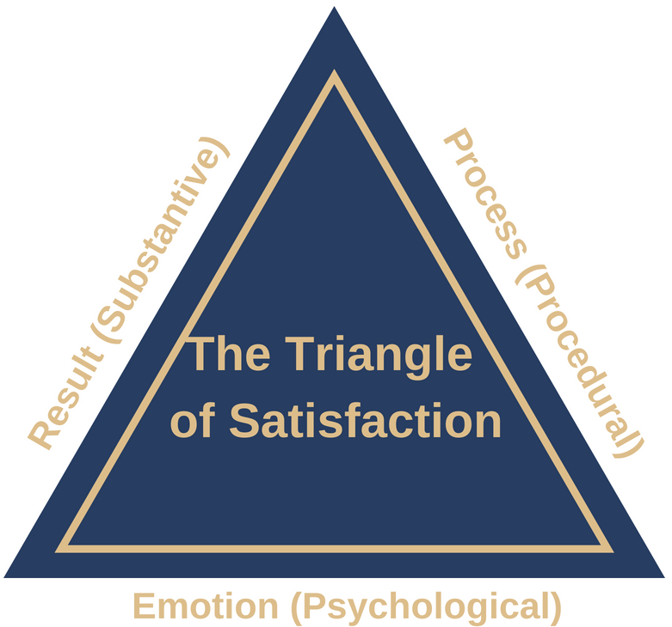
TRIANGLE OF SATISFACTION
The Mediation Process: Practical Strategies for Resolving Conflict
Christopher W. Moore (2014)

Slide 14
@ACC Australia
@Association of Corporate Counsel Australia
@The Accord Group Australia
#morethanalawyer
#byinhouse
#NatCon18
#mediation
#understanding
www.accordgroup.com.au
cecilyzhu@accordgroup.com.au
www.linkedin.com/in/cecilyzhu

