Slide 1
Governance, culture and accountability beyond 2018
#morethanalawyer
#byinhouse
#NatCon18
#goodgovernance
Jennifer Darbyshire
General Counsel, Governance (NAB)
LinkedIn: @jenniferdarbyshire

Slide 2
Heightened scrutiny
“Ultimately, trust can only be restored if these companies work root and branch to change their ways… to rebuild their culture from deep within.”
James Shipton, ASIC Chairman
“Often, process failures or poor decision-making have been the result of a lack of clear accountability for ensuring a product works as it should, a risk is fully understood, or that a system delivers what was intended.”
Wayne Byres, APRA Chairman
“It is clear that the culture, conduct and compliance of the sector are well below the standard Australians expect and deserve”
Hon Josh Frydenberg MP
"Compliance appeared to have been relegated to a cost of doing business.”
Hon Kenneth Hayne AC QC

Slide 3
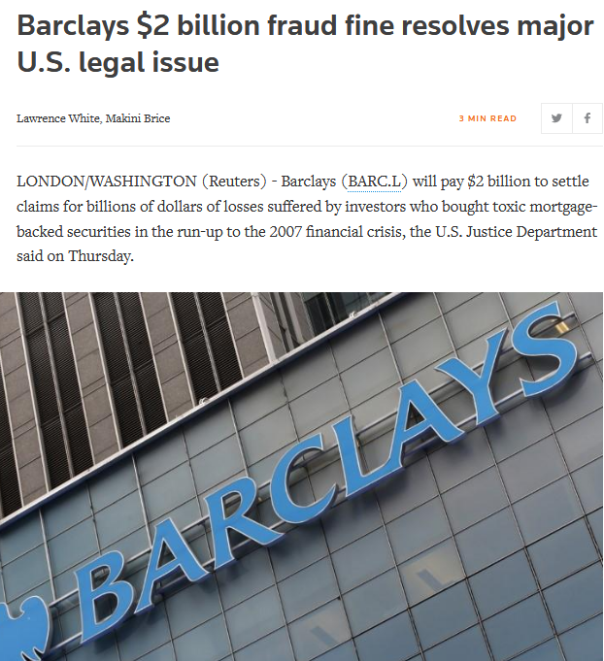
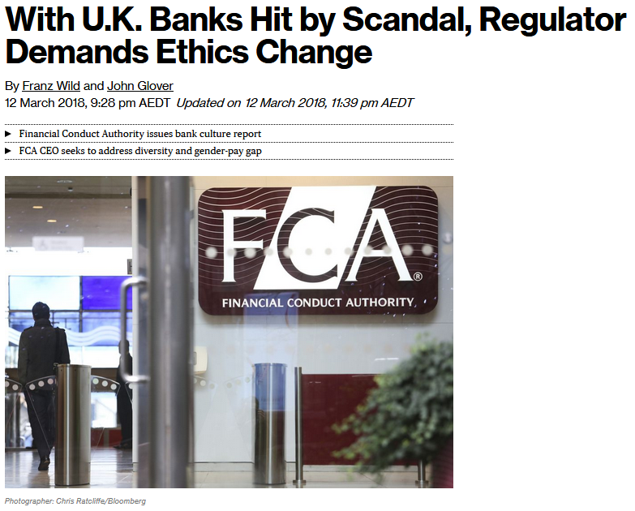
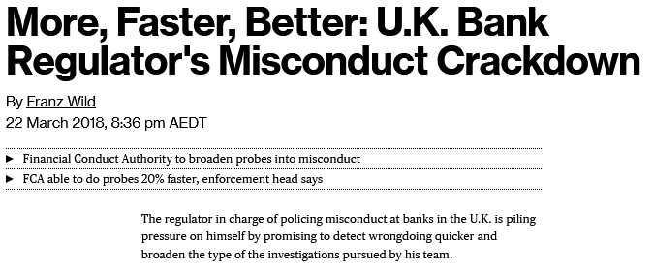
The UK experience

Slide 4
Warnings from 2015
“We are closely examining the experience of the United Kingdom, the United States and other jurisdictions so that we learn the lessons to help ensure that we don’t end up with mis-selling of this scale in Australia.”
Peter Kell, Deputy Chair, ASIC
“The root causes seem to include distorted incentives coupled with an erosion of a culture that placed great store on acting in a trustworthy way”
Glenn Stevens, Former Governor RBA
“There is a need for a cultural shift in the financial industry – and it needs to happen now”
Greg Tanzer, Former ASIC Commissioner

Slide 5
Banking Executive Accountability Regime – Key concepts
BEAR imposes a heightened accountability regime on Authorised Deposit-taking Institutions (ADIs) and its ‘Accountable Persons’ (APs)
‘Accountable Persons’ are:
Directors
Senior executives responsible for managing particular functions designated under legislation
Senior executives responsible for managing a significant part or aspect of the ADI’s operations
Must have coverage across all operations
BEAR came into operation on 1 July 2018 for the four major ADIs – other ADIs have until
1 July 2019

Slide 6
BEAR – Key concepts (cont)
The regime is focused on prudential matters
The ADI and its APs are subject to obligations:
“Accountability obligations” – conduct standards
Obligation on ADI to identify an AP accountable for all parts / aspects of its business, and register them with APRA before they can act in their role
Obligation on ADI to provide APRA with accountability statements for each AP and an “accountability map”, showing each AP’s role and responsibilities across the ADI
Obligation on ADI to defer a proportion of APs' variable remuneration for a prescribed period and to take “proportionate" action if an AP does not comply with his or her accountability obligations
Obligation on ADI to report a breach by it or an AP of their accountability obligations – no materiality limitation

Slide 7
BEAR – Key concepts (cont)
What happens if an AP gets it wrong?
APRA cannot impose fines on individual APs, but conduct could expose the ADI to material financial penalties if it is also found to have breached its own accountability obligations
APs may face financial implications through a reduction in variable remuneration
An AP could be deregistered by APRA which means they cannot continue to act in their role while deregistered. Deregistration is a public process
APRA can also direct the ADI to reallocate responsibilities if it considers there is prudential risk
APRA will also look to the ADI to ensure it takes appropriate action if accountability obligations are breached, including consequence management / performance management

Slide 8
APRA / CBA Report
On 1 May 2018, APRA released the Final Report of the Prudential Inquiry into the Commonwealth Bank of Australia.
Governance: the way in which decisions are made, including how financial objectives, values and strategic priorities impact decision-making and risk-management, and how decisions are implemented
Accountability: the way in which staff, both individually and collectively, fulfil their responsibilities and the consequences of not doing so
Culture: the norms of behaviour for individuals and groups that determine collective ability to identify, understand, openly discuss, escalate and act on current and future challenges and risks

Slide 9
Proposed changes to ASX Corporate Governance Principles
On 2 May 2018, the ASX Corporate Governance Council announced the proposed fourth edition of its Corporate Governance Principles and Recommendations:
Announced at a time of various challenges to corporate governance practices, including Royal Commission, APRA’s report into CBA and BEAR
Presented as “anticipating and responding to” some of these governance issues
Retains the same eight core principles from the third edition
Includes a redraft of Principle 3 to address emerging issues around corporate values and culture, and the “social licence to operate”

Slide 10
Royal Commission
Round 7 Hearings
19 – 23 November Sydney
26 – 30 November Melbourne
Focus on causes of misconduct and conduct falling below community standards and expectations of financial services entities (including culture, governance, remuneration and risk management practices). Will also include the role of ASIC and APRA.

Slide 11
Three key takeaways
Learn from what’s happening in the financial services industry
Initiatives underway in the financial services industry are relevant and can be easily translated
Governance, accountability and the right culture are what’s needed to (re)gain and maintain trust

Slide 12
Questions?
#morethanalawyer
#byinhouse
#NatCon18
#goodgovernance
Jennifer Darbyshire
General Counsel, Governance (NAB)
LinkedIn: @jenniferdarbyshire

