Slide 1
Locked up: Your termination rights aren’t what they used to be
Ian Innes, Special Counsel
16 November 2018

Slide 2
The standard corporate appointments
When hard times strike …
A television station
Outsourced HR function and software
Café and retail confectionary chain

Slide 3
For example, this:
Customer may terminate this agreement if the Service Provider has had a Controller appointed or is in liquidation, in provisional liquidation, under administration or wound up or has had a Receiver appointed to any part of its property.

Slide 4
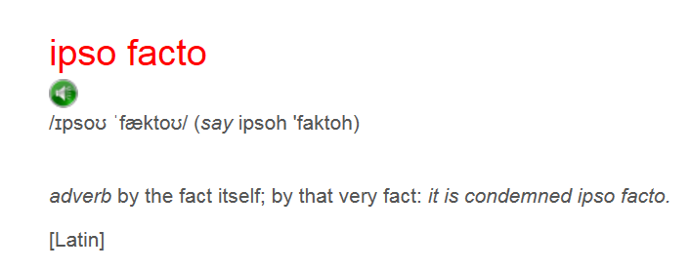
Ipso facto reforms – What is this?
Treasury Laws Amendment (2017 Enterprise Incentives No. 2) Act 2017
See ss 415D – 415G, 434J – 434M, 451E – 451H Corporations Act

Slide 5
Insolvency Basics

Slide 6
The standard corporate appointments
The standard corporate appointments
Liquidation, Provisional Liquidation
Controller, Receiver, Charge Holder/Security Interest Holder/ Mortgage in Possession
Administration: Voluntary Administration, Deed of Company Arrangement
Scheme of Arrangement
Appointments outside Australia
cf personal:
Bankruptcy (and associated statutory compromises)

Slide 7
Liquidation
Liquidation
What is it: liquidator gets in assets, sells them, adjudicates on claims by creditors, pays them, then deregisters the company
Unsecured creditors – subject to some priority claims, rank equally and behind secured creditors
Moratoria – on commencing litigation without Court’s leave
Commercial drivers: best return for all creditors

Slide 8
Controller/Receiver
Controller/Receiver
What is it: secured creditor enforcing a charge
Unsecured creditors – are not paid by a Controller
No moratoria
Commercial drivers: best return for secured creditor (must take reasonable steps to achieve market value)

Slide 9
Voluntary administration
Voluntary administration
What is it: a process to attempt to restructure the business of a company
Acts in interests of all creditors
Process:
appointed by directors/substantial secured creditor
first meeting held within 8 business days
second meeting held in approx. a month, or longer if Court orders
creditors decide:
hand back to directors
enter Deed of Company Arrangement (DOCA)
liquidation

Slide 10
Voluntary administration
Voluntary administration
Moratoria:
on commencing litigation without Court’s leave
on enforcement of security interests (except substantial charges in a decision period)
on the taking back of property owned by third parties or leased
Commercial drivers:
maximises the chances of the company, or as much as possible of its business, continuing in existence; or
if not, a better return to creditors than in a winding up

Slide 11
Terminating a contract (and other enforcement options)
Understanding the reforms

Slide 12
Ipso facto reforms – In more detail
Ipso facto reforms – In more detail
Any right (not just termination) triggered (automatically or by election) by:
the appointment or existence of a Managing Controller of the whole or substantially the whole of the corporation’s property; or
corporation being under administration; or
the corporation’s financial position during those appointments; or
“a reason that is, in substance, contrary to this subsection”.
Similar operation for scheme of arrangement (to avoid liquidation)
These are outside the stay regime:
receiver of limited assets
some liquidations
deed of company arrangement

Slide 13
Ipso facto reforms – In more detail
1. Terminating a contract (and other enforcement options)
Ipso facto reforms – In more detail
Subject to a stay
Stay lasts:
for the duration of the appointment
for any winding up following an administrator or scheme
Rights unenforceable after the appointment in respect of the appointment, etc (ie you can’t just enforce after it ends)
Appt Administrator
Creditors resolve to wind up
Winding up

Slide 14
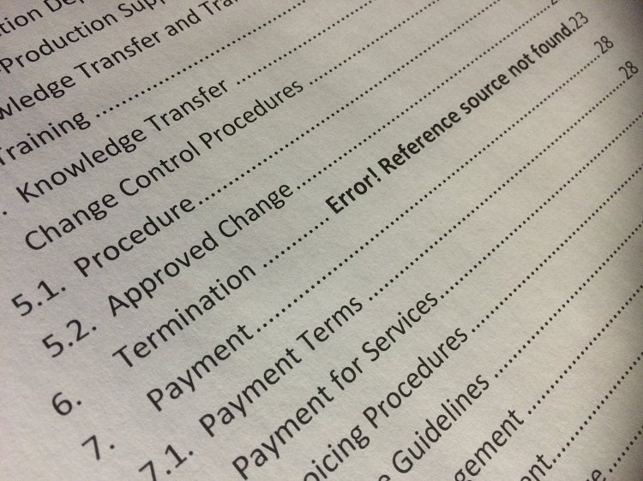
Ipso facto reforms – In more detail
1. Terminating a contract (and other enforcement options)
Ipso facto reforms – In more detail
Ability of Court to lift that stay, expand it, or extend it
Ability of Administrator, Liquidator or Managing Controller to consent during the stay period
** Does not stop reliance on other events of default (eg failure to pay or perform)

Slide 15
Ipso facto reforms – Exceptions (summary)
1. Terminating a contract (and other enforcement options)
Ipso facto reforms – Exceptions (summary)
Cannot be compelled to advance further money or credit during stay
Substantial charge holder can still enforce during “decision period”
AND ALSO
Corporations Amendment (Stay on Enforcing Certain Rights) Regulations 2018 – see reg 5.3A.50 Corporations Regulations
Corporations (Stay on Enforcing Certain Rights) Declaration 2018

Slide 16
Ipso facto reforms – Exceptions (summary)
1. Terminating a contract (and other enforcement options)
Ipso facto reforms – Exceptions (summary)
Government contracts, national security, border protection, defence, public hospital, public health
Specific types of financing arrangements and financial instruments [not listed here]
Contract for the sale of a business
Special purpose vehicles for securitisation or PPP
Special purpose vehicles for project finance arrangement
Escrow arrangements for codes, passwords, computer software
Commercial ship charter
Operating rules of financial market, clearing and settlement facilities
Contract, agreement or arrangement after 1 July 2018 but before 1 July 2023 for work, good or services for a particular project that relates to building work (defined) for in excess of $1bn

Slide 17
Ipso facto reforms – Exceptions (summary)
1. Terminating a contract (and other enforcement options)
Ipso facto reforms – Exceptions (summary)
The following rights triggered by relevant insolvency event:
Interest rate changes
Indemnities
Terminating standstill or forbearance
Right to change priority
Set off, combining accounts, netting balances
Assigning or novating rights
Fixing a floating charge
Step in rights
Enforcing a possessory security interest
Appointing a controller over all or substantially all the assets of the company

Slide 18
Ipso facto reforms – Which contracts?
1. Terminating a contract (and other enforcement options)
Ipso facto reforms – Which contracts?
Contracts, agreements or arrangements entered into at or after 1 July 2018
BUT EXCEPTION:
Contract, agreement or arrangement entered into on or after 1 July 2018 but before 1 July 2023, as a result of either of the following:
the novation of, or the assignment of, one or more rights under a contract, agreement or arrangement entered into before 1 July 2018;
a variation of a contract, agreement or arrangement entered into before 1 July 2018

Slide 19
Ipso facto reforms - Before
1. Terminating a contract (and other enforcement options)
Ipso facto reforms – Before
Insolvent means, in relation to a person, if:
it is (or states that it is) an insolvent under administration or insolvent (each as defined in the Corporations Act); or
it has had a Controller appointed or is in liquidation, in provisional liquidation, under administration or wound up or has had a Receiver appointed to any part of its property; or
it is subject to any arrangement, assignment, moratorium or composition, protected from creditors under any statute or dissolved (in each case, other than to carry out a reconstruction or amalgamation while solvent on terms approved by the other parties to this agreement); or
an application or order has been made (and in the case of an application, it is not stayed, withdrawn or dismissed within 30 days), resolution passed, proposal put forward, or any other action taken, in each case in connection with that person, which is preparatory to or could result in any of (a), (b) or (c) above; or
it is taken (under section 459F(1) of the Corporations Act) to have failed to comply with a statutory demand; or
it is the subject of an event described in section 459C(2)(b) or section 585 of the Corporations Act (or it makes a statement from which another party to this agreement reasonably deduces it is so subject); or
it is otherwise unable to pay its debts when they fall due; or
something having a substantially similar effect to (a) to (g) happens in connection with that person under the law of any jurisdiction.

Slide 20
Ipso facto reforms - After
1. Terminating a contract (and other enforcement options)
Ipso facto reforms – After
Insolvent means, in relation to a person, if:
it is (or states that it is) an insolvent under administration or insolvent (each as defined in the Corporations Act); or
it has had a Controller appointed or is in liquidation, in provisional liquidation, under administration or wound up or has had a Receiver appointed to any part of its property; or
it is subject to any arrangement, assignment, moratorium or composition, protected from creditors under any statute or dissolved (in each case, other than to carry out a reconstruction or amalgamation while solvent on terms approved by the other parties to this agreement); or
an application or order has been made (and in the case of an application, it is not stayed, withdrawn or dismissed within 30 days), resolution passed, proposal put forward, or any other action taken, in each case in connection with that person, which is preparatory to or could result in any of (a), (b) or (c) above; or
it is taken (under section 459F(1) of the Corporations Act) to have failed to comply with a statutory demand; or
it is the subject of an event described in section 459C(2)(b) or section 585 of the Corporations Act (or it makes a statement from which another party to this agreement reasonably deduces it is so subject); or
it is otherwise unable to pay its debts when they fall due; or
something having a substantially similar effect to (a) to (g) happens in connection with that person under the law of any jurisdiction.

Slide 21
Terminating a contract (and other enforcement options)
Now what?

Slide 22
Ipso facto reforms – Core Points
1. Terminating a contract (and other enforcement options)
Ipso facto reforms – Core points
Don’t panic
Stay = draft a comprehensive definition of “insolvency event” anyway
Consider other pre-emptive (non) performance based rights
Timeframes and triggers
Can you draft your way into an exemption?
Change of control rights
Be aware of the risks of exercising a right which not available (eg repudiation)
Being clear and give the reason for termination

Slide 23
Ipso facto reforms – Core Points
1. Terminating a contract (and other enforcement options)
Ipso facto reforms – Contract management
Risk assessment for critical suppliers
Will my contractual obligations be a burden in an insolvency appointment (eg exclusivity)?
Active management of financial performance
Being alert to signs of insolvency
Reporting obligations and information rights
Rights against solvent parties
But still being commercial

Slide 24
Trends (the first four months)
Not much changes in approach
Bolstering rights to termination for cause (eg “material default”)
Is my termination right clear and enforceable?
BUT too early to tell?

