Slide 1
Corporate counsel
What responsibility do in-house counsel have to advise on human rights and ethics?

Slide 2
Investors and human rights: offshore detention
Divestment from Broadspectrum, following mounting evidence of failures to protect human rights
Living arrangements in Nauru (2012). Source: Department of Immigration and Border Protection

Slide 3
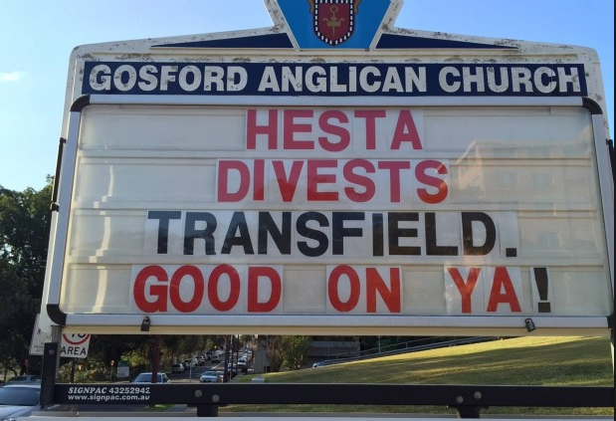
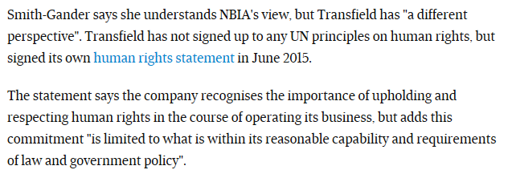
Broadspectrum – services to asylum seekers on Nauru

Slide 4
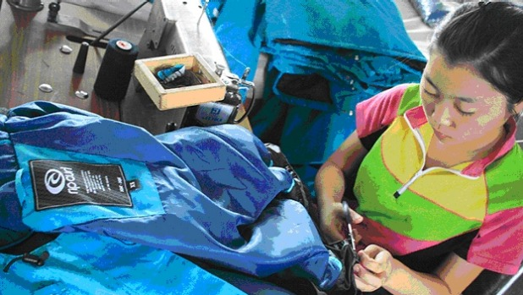
Investors and human rights: Rip Curl
Revelations that garments are manufactured in factories where workers are routinely exploited
Photo: Anjaly Thomas/Sydney Morning Herald

Slide 5
The business case for human rights
GDP will increase significantly in economies that achieve diversity in employment, equality of opportunity and recognition of merit
An increase of 5% in paid employment of over 55s would have a $48 billion impact on the economy
13% boost to Australia’s GDP if we can close the gender pay gap
Closing the gap between participation rates for people with and without disability would increase GDP by $43 billion over a decade

Slide 6
