Slide 1

ACC Chicago
Mission Statement
Workshop
Board Retreat January 2022
Notes:
Amy

Slide 2

What word best captures our mission?
We asked you to tell us, in a few words or less, what word or statement best captures the mission of the Chapter. Here’s what you said…
Notes:
Amy

Slide 3

Notes:
Amy

Slide 4


Guidelines
Guidelines to ensure we create a safe space that is inclusive and inviting for everyone to participate
Be positive
Be prepared to participate
Be open minded
Be creative
Don’t keep your thoughts to yourself
Have fun!
Notes:
Amy

Slide 5
What’s in a mission statement?
Let’s look at a few…
Can you guess the
company?
Mission Statement
A mission statement is a declaration of intent, or a mantra toward professional success.
Popularized in the 1980’s as a way for companies to articulate who they are.
Notes:
Christine

Slide 6
To organize the world’s information and make it universally accessible
and useful.
Hint
This company has become synonymous with searching.
Notes:
Christine

Slide 7

Notes:
Christine

Slide 8
Spread ideas.
Hint
This company is popular for its “talks.”
Notes:
Christine

Slide 9

Notes:
Christine

Slide 10
Connect the world’s professionals to make them more productive and successful.
Hint
The Facebook for professionals.
Notes:
Christine

Slide 11

Notes:
Christine

Slide 12
To inspire and nurture the human spirit - one person, one cup and one neighborhood at a
time.
Hint
Originally from Seattle, this company now has more than 32,000 locations in 76 countries.
Notes:
Christine

Slide 13


Notes:
Christine

Slide 14
To bring inspiration and innovation to every athlete
in the world.
Hint
Founded in 1964, this company’s name comes from the Greek goddess of victory.
Notes:
Christine

Slide 15

Notes:
Christine

Slide 16

What makes a good MISSION STATEMENT?
Discussion
What works? What doesn’t work?
Is it too vague?
Does it use subjective language?
Is it too serious? Too funny?
Notes:
Char

Slide 17
Our Mission
We want our mission statement to:
Be authentic
Convey a sense of purpose
Be specific
Align with our core values
Notes:
Char

Slide 18

Attribute/Values Card Sort
Select
Sort
  ✔ - things we are
  X - things we are not
  ? - torn
  N/A - does not apply
Narrow
Prioritize
Tip
The Brand Deck is a tool to help us figure out who we are.
Notes:
Char

Slide 19

Write Insights
Activity:
Write an insight statement (or two) using one or more of the words we selected from the card sort exercise.
Tip
Select the attributes that describe how you want to contribute to the Chapter.
Notes:
Amy

Slide 20
Examples:
Be an ambassador for professional development best practices in order to provide a [welcoming] and [inclusive] environment for our members.
Provide a [clear] and [consistent] experience to our members through quality programming and networking activities.
Notes:
Amy

Slide 21
What people are saying
Notes:
Amy/Christine/Char

Slide 22
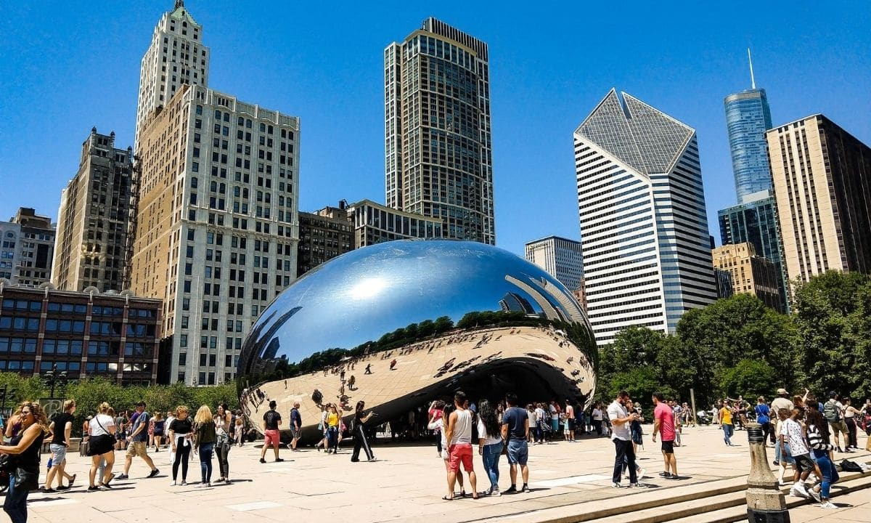
Our Mission Statement
Notes:
Amy/Christine/Char

Slide 23
4. Closing
Design a fun poster
Print and hang where you can see it to stay motivated
Share it
Make sure our members know our mission
What’s next?
Look back on the mission statement to help make decisions and guide our strategic plan
Notes:
Christine

