Slide 1
Running Meetings:
Best Practices for Meetings
Board Retreat January 2022

Slide 2
Functions of a meeting
Defining the team
To revise, update and add to the group
Help members understand the collective aim of the group
Create a commitment to the group’s decisions and objectives
Where the group exists and works as a group
Status arena

Slide 3
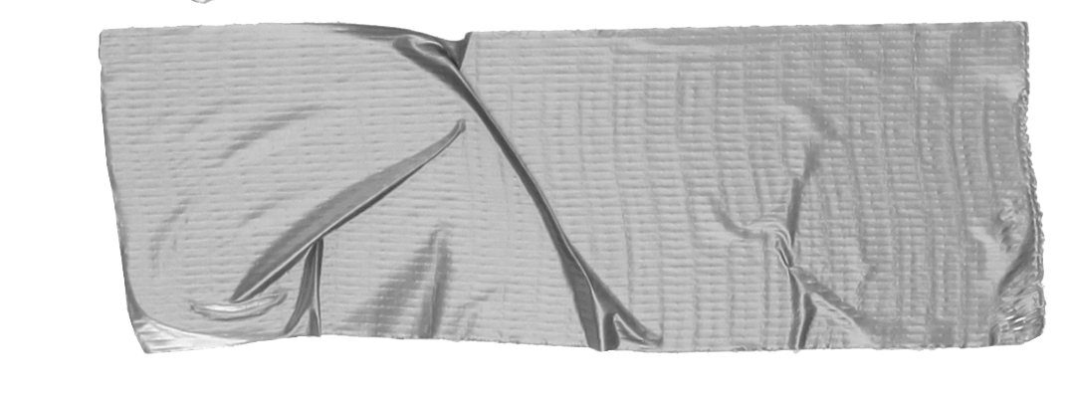
1. Before the Meeting
Define Objectives What is the purpose of the meeting?
People Determine who will attend
Papers Create agenda and other documents

Slide 4
Agenda Items should be divided into one of the following categories:
Informative-digestive
Keeps the group up to date on status of projects
Constructive-originative
“What shall we do?”
Executive Responsibilities
“How shall we do it?”
Legislative Framework
System of rules, routines and procedures
Tip
A clear agenda keeps team members on track during meetings and helps them complete their follow-ups when meetings are over.

Slide 5
2. Agenda Considerations
Some things to consider when creating the agenda:
Early part of the meeting is more lively, put items requiring mental energy first
Start with items that unite the team and leave divisive discussions for later
Don’t dwell on trivial but urgent items
Keep meetings to 1.5 hours or less
Include a start and end time and stick to it
Keep pre-read documents brief
Leave general unstructured discussions for the close of the meeting

Slide 6
Structure of Discussion
Consider structuring the discussion like a visit to the doctor’s office:
“What seems to be the trouble?”
What is the problem and how do we solve it?
“How long has this been going on?”
Case history
“Why don’t you lie down?”
Physical exam, how do things currently stand
“You seemed to have slipped a disc.”
With facts established, move towards a diagnosis
“Take this prescription to the pharmacy.”
Treatment options
Tip
Think about a meeting like a visit to the doctor’s office.
“What seems to be the problem?”

Slide 7
3. Conduct the Meeting
Follow agenda and structure of discussion
Ensure meeting starts on time
List late arrivals and early departures in the minutes
Control the discussion
Break the silence
Reinforce good behaviors
Encourage clash of ideas not personalities
Don’t squash suggestions
Come to the most senior people last
Close on a positive note

Slide 8
4. Following the Meeting
Distribute minutes. Minutes should include:
Time and date of meeting, where it was held and who chaired it
Name of all present and apologies for absence
All agenda items (and other items) discussed and all decisions reached
If action was agreed on, record (and underline) the name of the person responsible for the assignment
The time at which the meeting ended
The date and time of the next meeting

