Slide 1
Top 5 Employment Law Tips for a Successful 2023
February 10, 2023

Slide 2
Presented by
Bill foster
Ben hepner
Jasmine little
Grant burns
Shareholder
Greenville
bfoster@littler.com
Associate
Greenville
bhepner@littler.com
Associate
Charlotte
jlittle@littler.com
General Counsel
AFL

Slide 3
Agenda
Top Compliance and Litigation Plays to Protect Your Company
The Remote Worker
Quiet Quitting
AI Tools in Human Resource Decisions
IE&D Hot Topics
Top Compliance and Litigation Plays to Protect Your Company

Slide 4
Managing the Legal Implications for Remote Employees

Slide 5
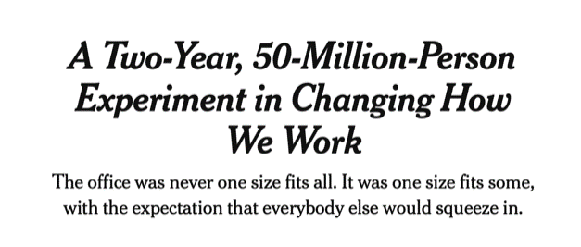
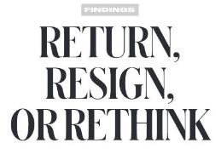

Slide 6
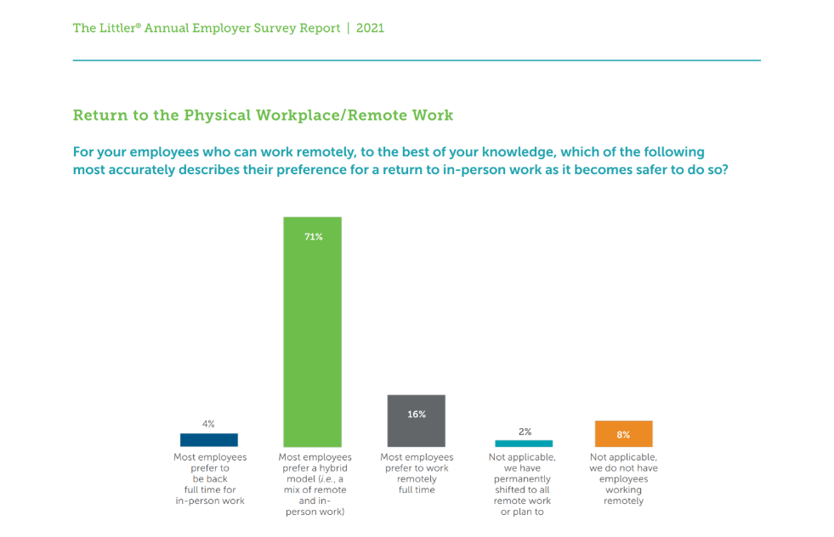
6

Slide 7
Employee Expectations in the Post-Pandemic Workplace

Slide 8
An astonishing 14 million to 23 million Americans intend to relocate to a different city or region as a result of telework.”
Adeyo Akala, NPR

Slide 9
Embracing the “Wandering Worker”
“Ocean views and unreliable Wi-Fi: What it’s like to work from a transatlantic cruise?”
“Royal Caribbean's new partnership with SpaceX's Starlink opens possibility to work remotely on cruise ships”
“Princess Cruises wants remote workers to live on its tech-enabled ships”

Slide 10
Survey
Time!

Slide 11
Survey Question #1 Is your organization continuing to allow employees to work remotely?

Slide 12
Survey Question #2 Have any of your remote workers relocated to new jurisdictions where you did not previously have business operations?

Slide 13
Survey Question #3 Have any of your remote workers relocated to new locations outside of the United States, or do you anticipate any of them doing so?

Slide 14
Embracing Remote Work and Wandering Workers
Employees can, and do, work anywhere
Employers can, and do, recruit everywhere to meet their business needs
Does flexibility mean increased legal risk?
YES, unless properly managed

Slide 15
Dealing With Remote Work: (Some Of) The Issues
Tax Withholding & Payroll Mandates
Unemployment Insurance
Workers’ Compensation
Wage and Hour Laws
Training
Leave and Benefits
Information/Data Privacy & Security

Slide 16
Where Are Your Employees?
Each state has different laws applicable to all aspects of employment, such as wage and hour, paid sick leave, vacation accrual, harassment & discrimination
Many states, and municipalities, have enacted their own minimum wage laws
Employees may be entitled to the benefits of certain laws even if the employer does not operate in that state
Relocations can even occur overseas or (aghast!) to California

Slide 17
Have an Issues Checklist
Build and maintain your own checklist:
State/local/international business licensing & registration
Required notices to employees in the state or municipality, including “workplace” posters
Payroll tax withholding
Unemployment insurance
Workers’ compensation
Equal employment laws
Accommodations, leaves of absence, and paid sick leave
Wage and hour (Including exemption status, min. wage, meal/rest breaks, pay frequency, pay deductions/changes, expense reimbursements)
Equal pay requirements
Training requirements
WARN Act
Enforceability of restrictive covenants
Privacy/data security requirements

Slide 18
What Do We Do?
Reissue requests to employees to update their working location
If you have employees who have wandered, determine if there are any issues (e.g., tax issues, license issues, differences in state or municipality employment laws)
Roll out new teleworking agreement/policy
This policy should include clause that requires the employee to disclose any change in work location
It should also state that the current work location is the only approved location

Slide 19
Handling Accommodation Requests for Remote Work
Key questions to consider:
Is in-person work essential—really?
What operational hardships are created by employees working from home?
Be prepared to explain why remote work during the pandemic was not optimal
Technological issues?
Decreased productivity, performance issues?
Effects on teamwork, creativity?
Can you prove it?

Slide 20
Engage in the Interactive Process
Learn the facts
What are the job functions; what are we allowing others to do?
Get medical documentation
Learn what employee can/can't do by engaging in the interactive process
Is there a hardship?
Document

Slide 21
Remote Work Toolkit for Employers
Guide, Model Policy and Model Agreement for companies to use when implementing remote work in the pandemic and post pandemic era
To learn more or purchase Remote Work Toolkit, email innovation@Littler.com
Purchase online for instant access: littler.com/buy-rw-toolkit

Slide 22
Quiet Quitting: How to Prevent Employees From Quiet Quitting

Slide 23
What Is “Quiet Quitting” and Why Did It Develop?
Most traditional scenario:
Employees self-limit their obligations at work to only their core job duties and avoid work beyond or outside of their job descriptions
This may not be the only scenario!
The Great Resignation
Significant resignations in 2021 drove the demand for employees
Employees/applicants had a lot of leverage in 2021 and 2022
This cultivated an environment where employees could quietly quit their existing positions for better opportunities

Slide 24
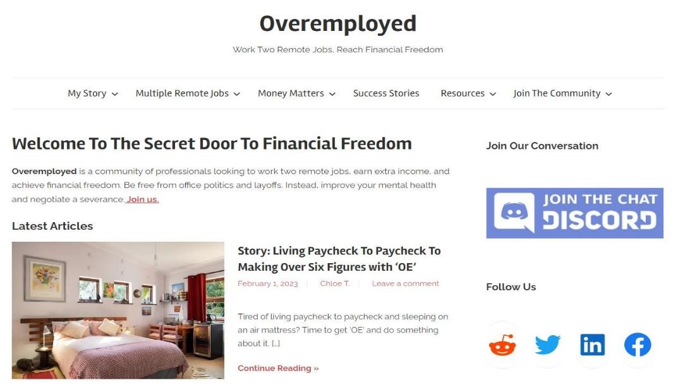

Slide 25
Other Examples of “Quiet Quitting”
“Career polygamy” and “overemployment” are on the rise
Remote workers often use technology to assist in juggling responsibilities for multiple jobs
Mouse jigglers
Multiple computers/devices
Meeting DJ’s

Slide 26
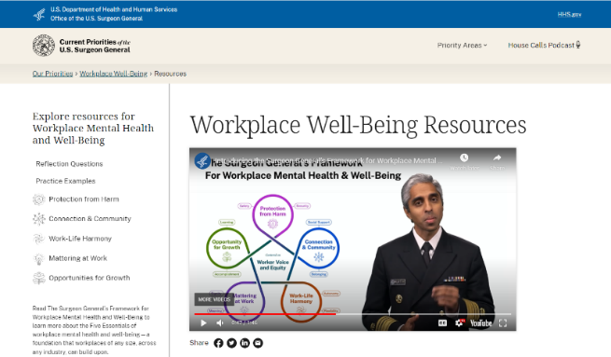
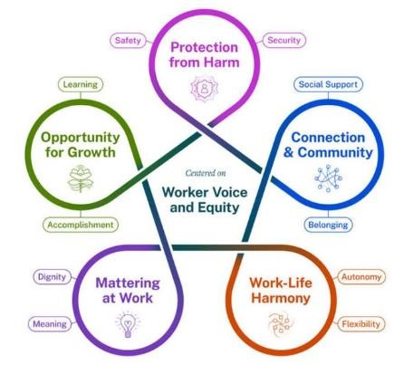
U.S. Surgeon General - Dr. Vivek Murthy Releases Framework For Workplace Mental Health and Well-Being
Workplace Mental Health & Well-Being — Current Priorities of the U.S. Surgeon General (hhs.gov)

Slide 27
Five Essentials for Workplace Mental Health and Well-Being
Protecting employees from harm
Create conditions for physical and psychological safety
Connection and community
Foster positive social interactions and relationships in the workplace
Work-life harmony
Promote practices that better assure work-life harmony
Establishing value at work
Provide and encourage a culture where employees matter at work
Providing opportunities for growth
Create opportunities for employees to accomplish goals and promote opportunities for growth

Slide 28
“How can we prevent quiet quitting?”

Slide 29
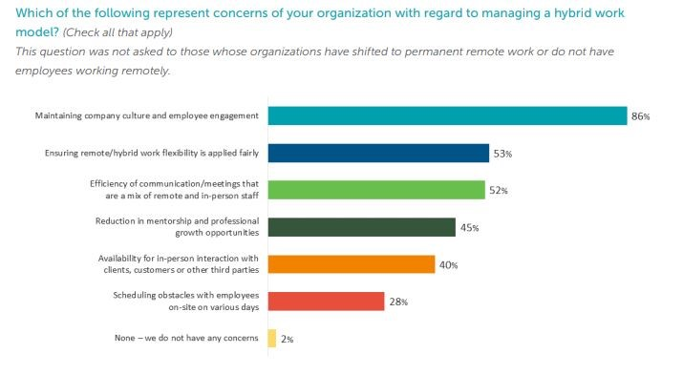

Slide 30
Connect, Invest, Trust
Open door policies, regular meetings to discuss concerns
Commit to learning about your employees’ experiences, expectations, and goals
Invest in mentoring, motivating, and quality supervision of employees
Recognize value

Slide 31
Transparency
Reassess expectations for employees
Review and revise job descriptions, performance review criteria
Communicate these changes and expectations
Be mindful of potential disparate impact

Slide 32
Reward
Consider incentives:
Adjusting bonuses
Incentives
Other benefits
Career opportunities
Structure incentives to reward commitment and enthusiasm for the company

Slide 33
Monitor
Productivity tracking
Performance metrics
Regular reviews
Routine check-in calls
Consider the privacy implications of these measures

Slide 34
Document and Enforce
Consider updated moonlighting policies
Expressly prohibit vs. consent required
Other policies to consider
Conflict of interest
Non-compete
Confidentiality agreements and privacy policies

Slide 35
AI Tools in Human Resources

Slide 36
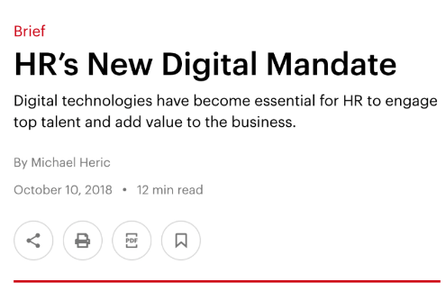
AI and HR’s New Digital Mandate
No facet of HR remains untouched, and the potential is just emerging:
Online recruiting
AI-assisted interviewing
Machine learning predicting who will resign
Chatbots handling out-sick notices
Smart redesign algorithms evaluating performance and identifying employees for layoff
The Promise: Cost savings, speed, quality and accuracy – all essential to remain competitive

Slide 37
What Are These HR AI Systems...?
Video interviewing and assessments
Blind resumes
Ensure all applicants are getting a “thank you for applying” email
Utilizing chat bots to give candidates access to information they need at anytime
Quickly getting open job information out on social media
Having algorithms screen resumes for you

Slide 38
Risk: The Emergence of Algorithmic Bias and Biometric Class Actions
AI-powered talent acquisition includes both recruiting and assessment
Such systems are often described and viewed as more objective because of the technology. This can be true or misleading, and sometimes even false.
AI uses algorithms which are created by humans and can reflect human biases - both intentionally and unintentionally created
Using AI-powered HR systems requires awareness of the potential of algorithmic bias, which can include biases that are unlawful such as discriminating against talent on basis of protected categories such as age, sex, race, color, disabilities, religion, national origin, and several others, depending on applicable laws
Intentional discrimination is possible, such as alleged age restriction on social media advertising

Slide 39
Benchmarking Legal Compliance for AI-Powered HR Systems
Benchmarking legal compliance for AI-Powered HR systems
Vital role of in-house legal compliance attorney as part of the overall multi-disciplinary and diverse compliance team
Catalogue and understand existing laws and regulations regarding algorithmic intelligence, data, and privacy rights, including regulatory environment
Incorporate legal compliance review and documentation into all phases of development of ai-powered HR systems: design, building, implementation, and monitoring
Determine whether HR system includes automated AI decision making; if so, include human oversight and ability to change decisions

Slide 40
Inclusion, Equity and Diversity

Slide 41
Inclusion, Equity & Diversity Playbook

Slide 42
How Employers are Addressing DEI – Recruiting:
Over the past 12 months, which steps have you taken to achieve diversity in recruiting?

Slide 43
How Employers are Addressing DEI – Equity Measures
What equity measures have you introduced over the past 12 months?

Slide 44
How Employers are Addressing DEI – Inclusion Efforts
What inclusion measures have you introduced over the past 12 months?

Slide 45
Communication Efforts Around DEI
How are you currently communicating your efforts around DEI to employees?

Slide 46
Job Descriptions
Review the job description and try to see if there are any biases reflected in the description
Get feedback from persons that have different backgrounds
Emphasize the importance of DE&I for the company and the position

Slide 47
Outreach
Signal to particular types of individuals that the company is interested in them:
Job fairs, recruiting at educational institutions where a demographic is well represented, or working with organizations that serve women, minorities, veterans, or the disabled
Advertising media that are likely to reach minority communities
Identifying job boards with high rates of minority participation
Partnering with professional associations and other organizations that serve minority communities

Slide 48
Conducting Interviews
Consider the diversity of the decision-makers
Mansfield Rule: Have we given sufficient consideration to diverse candidates?
Use assessments or rubrics for the interviews
Be consistent in the questions asked during the interviews
Ask candidates questions about DE&I
Group decisions for the candidate selection

Slide 49
Top Compliance and Litigation Plays to Protect Your Company

Slide 50
EEOC Charges Filed

Slide 51
EEOC Litigation Trends – ADA Claims

Slide 52
How to be Proactive – Thinking of Discovery in New Ways

Slide 53
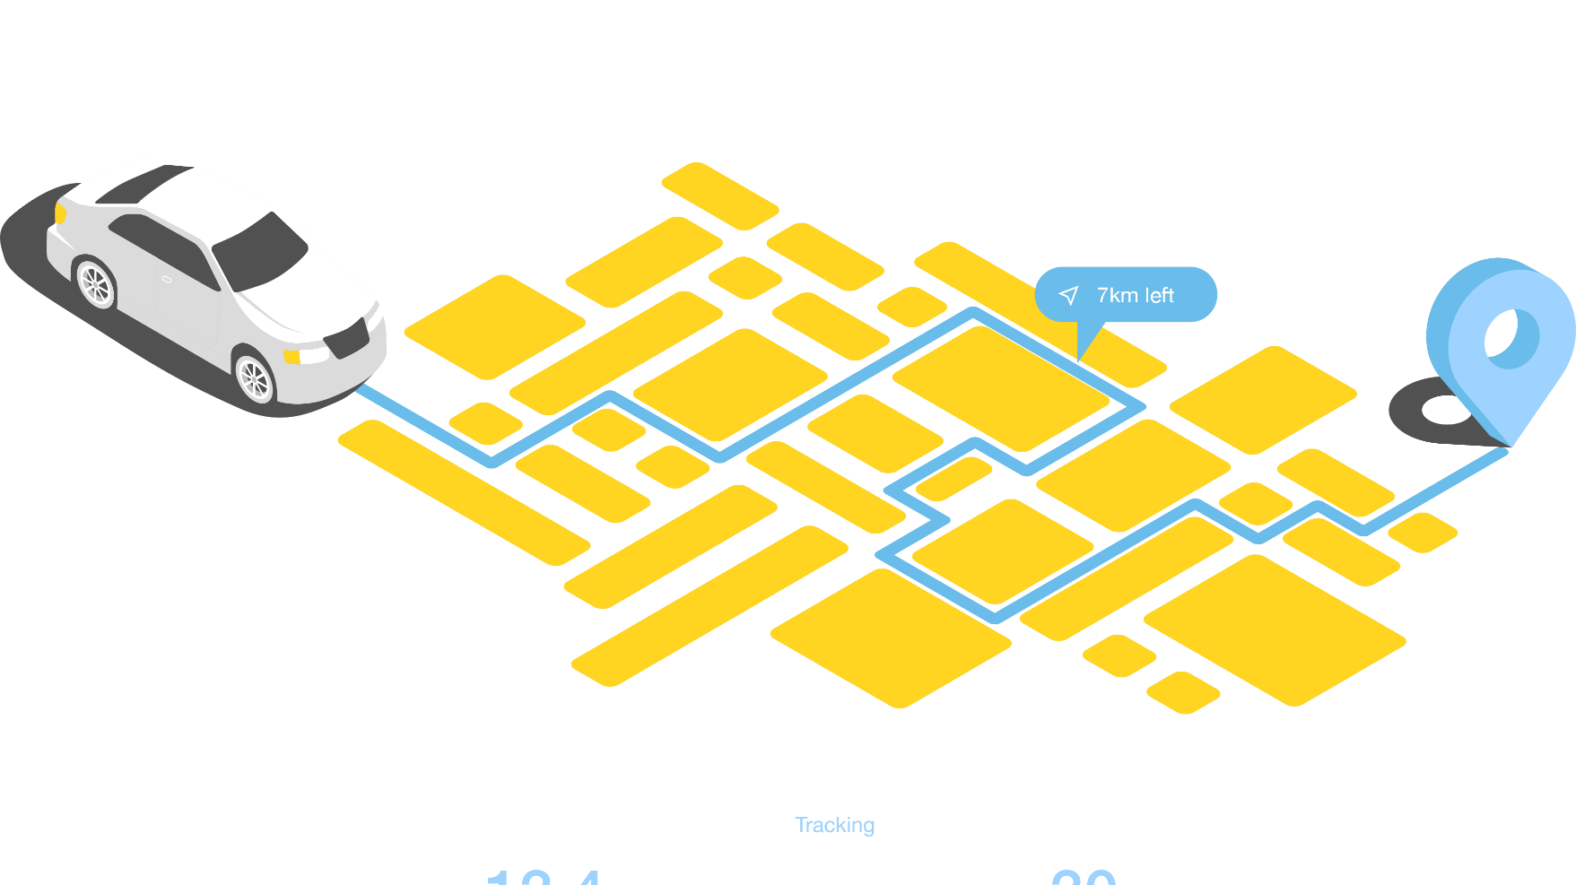
New Sources of Data

Slide 54
Sources of Electronic Evidence
Home or personal email accounts
Social media accounts (e.g., Facebook, Twitter, LinkedIn, Tumblr, Flickr, Instagram, MySpace, Vine, Google+, MySpace, Meetup.com, Orkut, Gather.com, Tumblr, Windows Live Spaces, MSN Spaces or similar accounts)
Home or personal computers, or other machines capable of sending or receiving emails or other messages or storing ESI (e.g., PDA, cell phones, smart phones, iPod Touches or similar devices, iPads, tablets, etc.)
Cloud storage accounts (e.g., Google Documents, iCloud, Zoho, Dropbox, iCloud, BackBlaze, Crashplan, Mozy, or similar internet- or “cloud”- based services that store or back-up documents, data and devices)
Linkedln, Monster.com, CareerBuilder.com accounts or similar professional networking services
iWatch, Pebble, FitBit, Microsoft Band, Samsung Gear 2, Cookoo, Sony Smartwatch 3, Qualcomm Toq

Slide 55
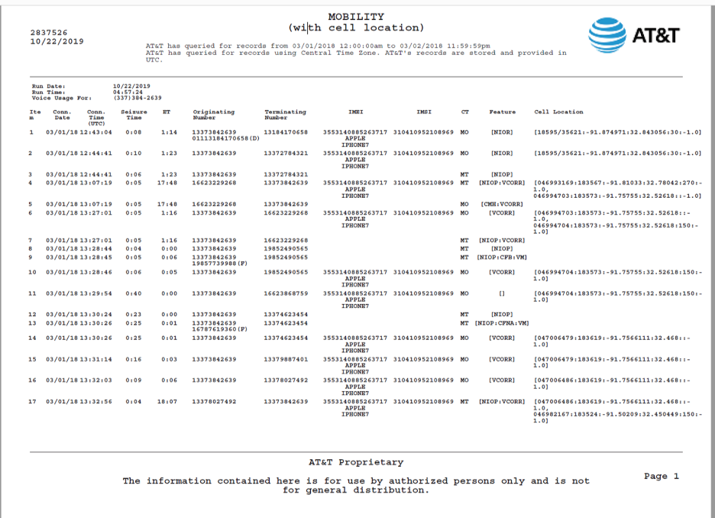
Consider All Sources of Potential Relevant Information!
Cell phone records can tell a compelling story
Records can establish who/when/where
Text messages are also becoming increasingly relevant for credibility
Increasing disputes over privacy and attorney-client privilege
Timing of these requests is critical!!

Slide 56
Corporate Representative Depositions
Commonly used and often abused
What does Rule 30(b)(6) require?
“must designate one or more officers, directors, or managing agents, or designate other persons who consent to testify on its behalf; . . . about information known or reasonably available to the [corporation].”
Keep in mind the obligation to “adequately prepare” to testify
Pay close attention to topics and subject matter covered in topics
Investigate issues referenced in topics if necessary

Slide 57
Proactive Compliance Measures

Slide 58
Compliance Basics
Know Your Compliance Status
Audit for legal compliance and establish a plan for improvement and messaging change.
Document your compliance measures (good faith).
Get Familiar with State Laws
Some states and localities have complex additional requirements.
Focused Compliance Efforts: Create Evidence to Combat the Most Common Claims
Build evidence around specific claims if necessary.
Implement critical policies and procedures.
Document!!
Arbitration Agreements
Strongly consider a mandatory arbitration agreement with a class action waiver.

Slide 59
Documentation Helpful to Establish Compliance
Up-to-date job descriptions
Job postings or recruiting materials
The employee’s resume that lists his/her job duties
Employee performance reviews
Employee self-assessment
Time sheets reviewed & approved by supervisors
Training materials
Onboarding documents & orientation materials

Slide 60
Investigating in the Workplace
1 | Interview Complainant
2 | Plan the Investigation
3 | Interview Witnesses
4 | Reaching and Documenting Findings
5 | Follow Up with Complainant

Slide 61
Your Role As An Investigator
No biases
Good listener
Appropriate investigation
Attention to detail
Reach reasonable conclusions
Properly document investigation
If appropriate, recommend remedy

Slide 62
Being Proactive – Re-Examining Your Policies

Slide 63
Policies
Does The Company Have A Handbook with Policies to Point To?
Non-Discrimination /Non-Retaliation
Defining Sexual Harassment
Reporting Procedures
Job Descriptions
Is The Company Following These Polices?
Do All The Managers Follow Progressive Discipline And Document Correctly?
Is Every Investigation Conducted The Same Way?
Are All Reports Escalated the Same Way?
Are There Certain Forms HR Is Expected To Use For Different Situations

Slide 64
Will Your Policies Help Or Hurt You
Clear and Accurate Language In A Job Description
Using Words Correctly in All Policies
Document Retention Policies
Creating Clear Expectations For Employees
Training That Accompanies Policies
Progressive Discipline That is Too Detailed
Investigation Procedures That Require Particular Order or Disclosure
Having Great Policies But Failing To Follow Them
Polices That Are So Detailed They Are Burdensome
Helpful
Hurtful

