Slide 2
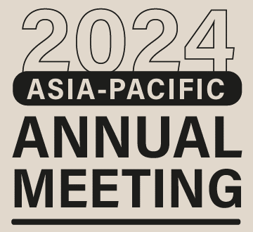

Slide 3
AGENDA
IP protection in Singapore, China, Japan, US
What to look out for when expanding overseas
Cultural considerations

Slide 4
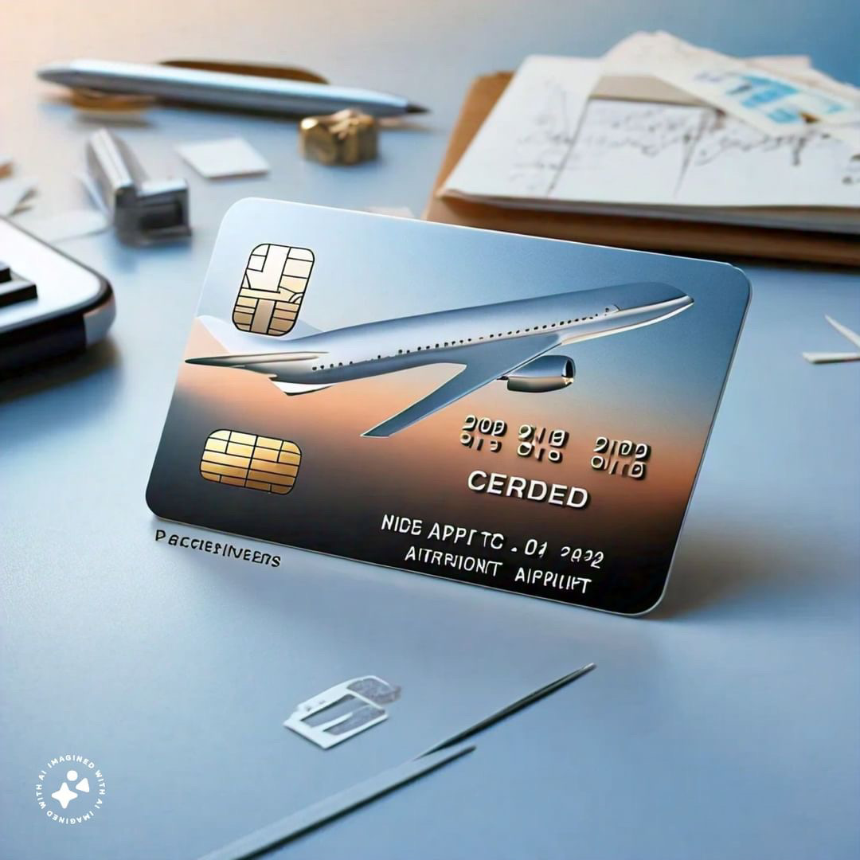
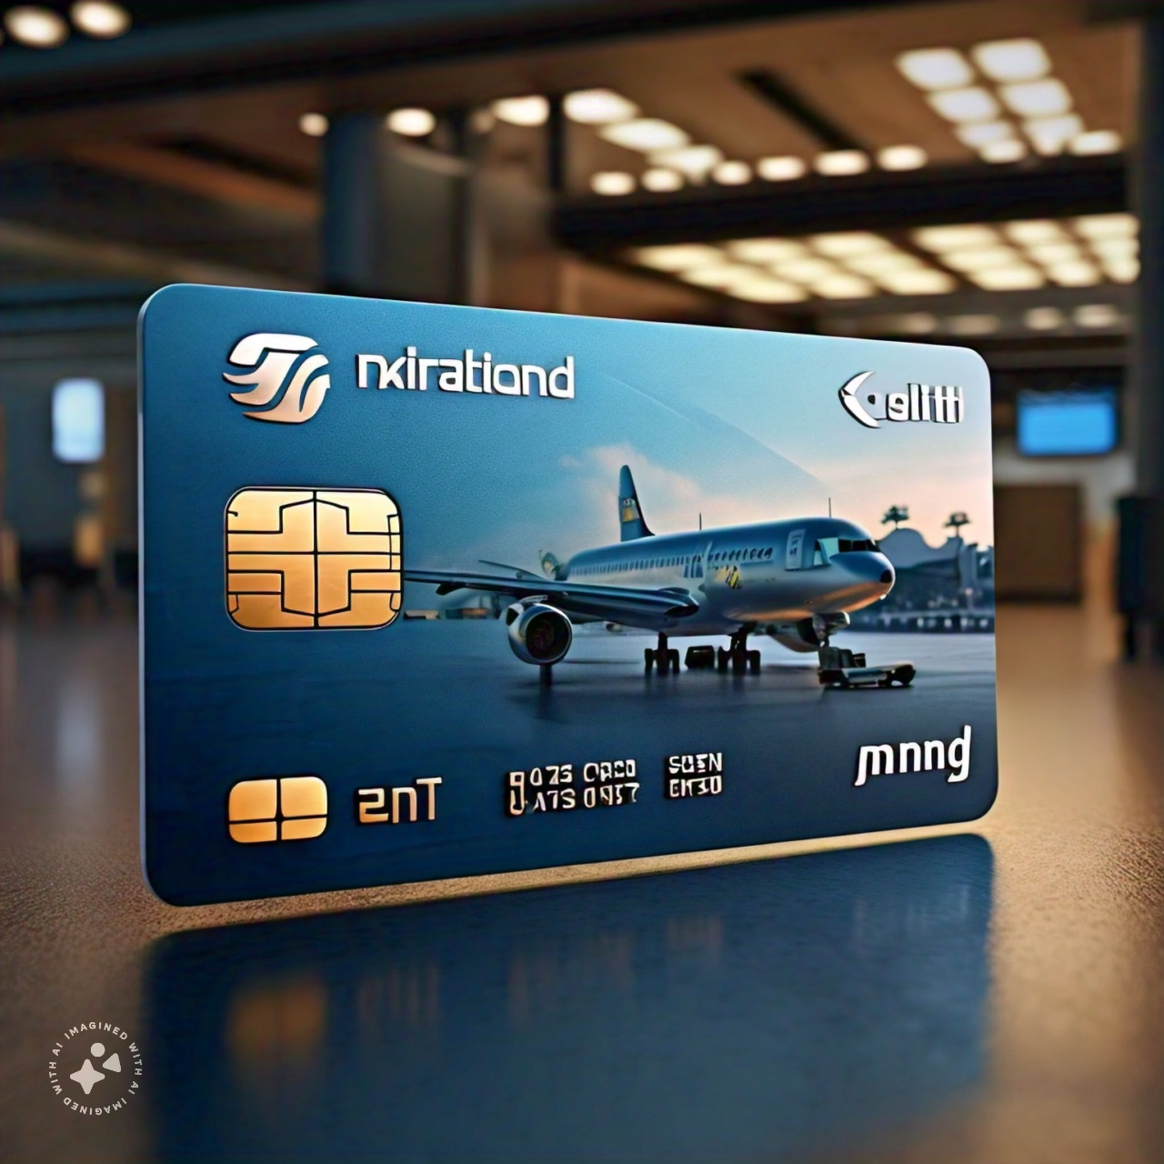
IP Protection | What’s in your portfolio?
Intellectual Property Rights
Patents
Trade Marks
Trade secrets & Know-how
Registered Designs
Copyright
Copyright
Trade Marks
Notes:
James will talk through the various IPs in a credit card.

Slide 5
IP Protection | What’s in your portfolio?
Copyright
Automatic protection, no SG registry
Affixed on tangible medium
Human authorship
Life of author + 70 years
[US] Registration for enforcement
[Japan/SG] Use of copyrighted data for AI training
[China] recognizing Gen-AI works?
Trade Marks
Registration required with IPOS
Passing-off protection for unregistered marks
First to file system
10 years – renewable
[US/Japan/China] Similar
[Japan/China] Care should be taken in the translations - pronunciation and in some cases the meaning → affecting distinctiveness
Notes:
James will talk through the sg position.
Akiba san – Under current copyright law, using data to train AI generally doesn’t constitute infringement (Art. 47-7).
Akiba san – Care should be taken in the case of English and Chinese trademarks. The Japanese reading changes the pronunciation and in some cases the meaning. [Example if possible?]
Nikon vs Nike
Toilet paper in mandarin vs Japanese
Pregnacy example.

Slide 6
Example
Chinese – Japanese
湯
手紙
English – Japanese
NIKON, NIKE
ASICS
Mandarin

Slide 7
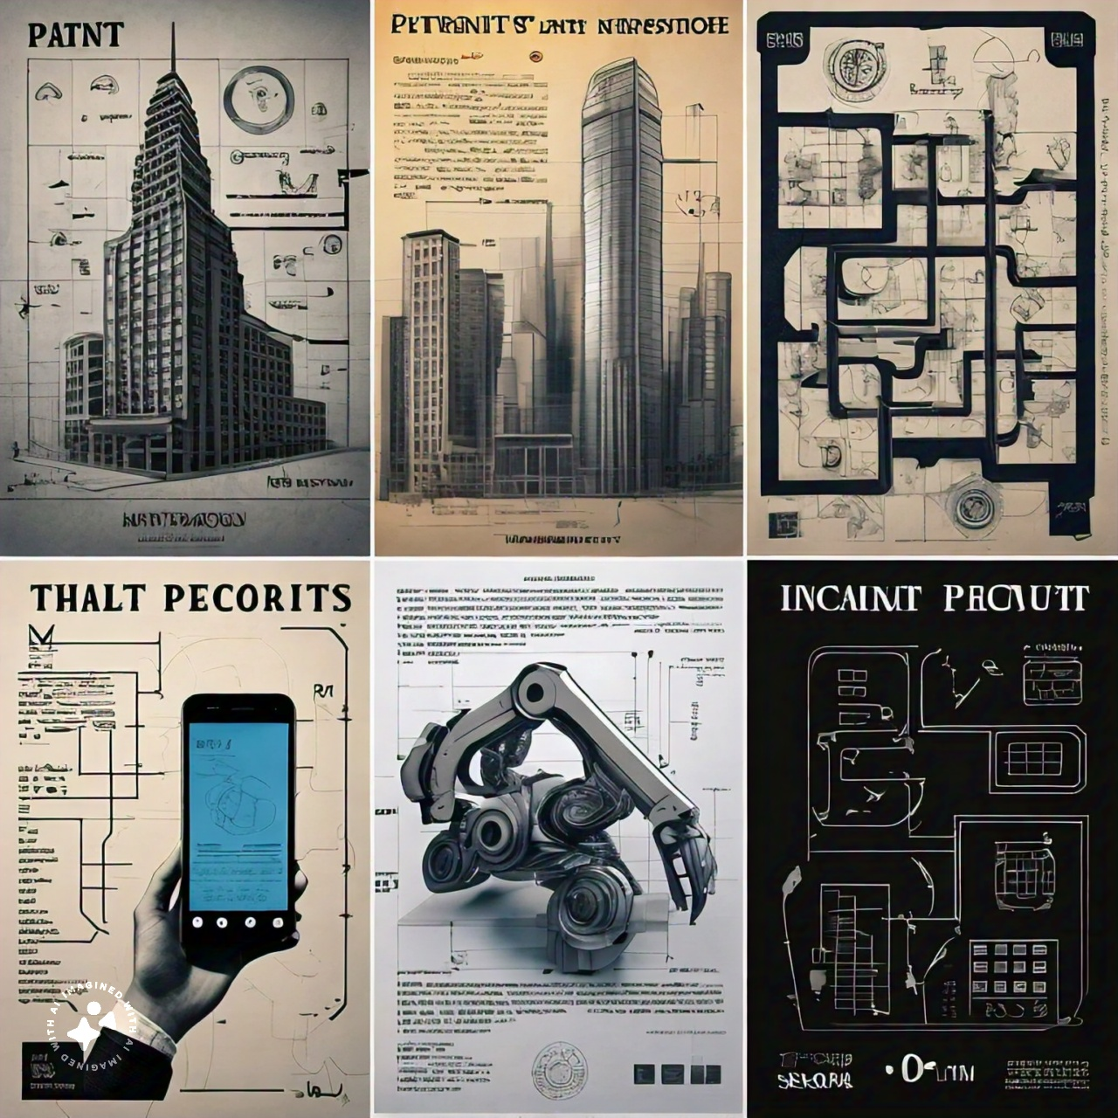
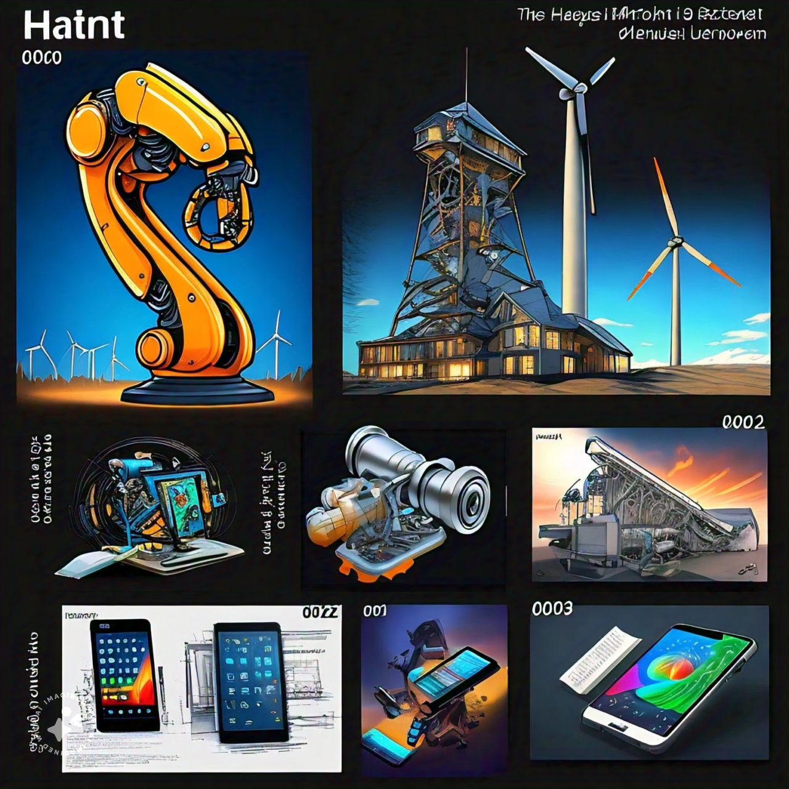
IP Protection | What’s in your portfolio?
Patents
New + inventive + industrial application
First-filing required (aka national security clearance) for SG resident, at least 2 months prior to overseas filing. Possible to obtain permission from registry (s.34 Patents Act)
First to file system
20 years – non-renewable; escalating fees
Infringement is somewhat strict liability – mens rea generally relevant for damages
[Japan] First filing requirement changes since 1 May 2024
[US/China] First filing requirements for inventors located in US/China
Notes:
Akiba – Japanese position. First filing position has changed.
Charles - Inventors who are located in the US and China. Criminal element for some types of invention – e.g. India.

Slide 8
Inventors who are located in both the US and China
IP Protection | What’s in your portfolio?
File Security Examination Request with the Chinese Patent Office
File patent application in the US
Obtain Foreign Filing License from the USPTO
File Patent Application in China
Or
Note: Patent will be invalid in China if without Security approval
Notes:
Charles to elaborate.

Slide 9
Protection
Infringement
Enforcement
Expansion overseas | What to look out for?
Branding partnerships
Licensing marks and copyright
Quality control issues
Labour standards
Newer developments
UPC
Beijing IP courts
Filing applications overseas
Translation issues
Cost and enforcement in less developed jurisdictions
Discovering infringements
Importance of internal education on IP (esp. Asia)
Dilution/blurring marks
Litigation
Risk mitigation for trademarks and patent infringement
China – unique considerations
Discovery issues
Notes:
James: Working with a client that had an idea that they wanted to protect in various countries. (Example - Translation in Thailand, similar issues arose with Korea and China). When we began to file important applications in these countries, we back-translated claims. To consider issues of cost and enforcement in less developed jurisdictions.
Preventing people from diluting mark – opposition work.
Importance of educating employees on IP related issues – at Mastercard, employees often are the first source of flagging infringements.
Akiba-san: if everything falls apart and you have to litigate - what countries to pay attention to for risk mitigation/patent perspective – US, Germany / EU, China – different countries have different levels and risks of patent and trademark infringement (where’s your competition? Where do you want to enforce? Where are you at risk of infringing? What’s your market?)
As for litigation, the risk in the U.S. is generally very high, due to expensive legal fees, extensive discovery system, jury trial and relatively high damage awards. Many continental law countries do not allow extensive discovery or jury trials.
Charles-san will tell us about the unique litigation risks in China.
In the area of patent law, attention is focused on the newly launched Unified Patent Court (UPC) system in Europe.
In Japan, since the number of lawsuits is very small, the amount of damages awarded is relatively low, and the rate at which patents are declared invalid is relatively high, so, the overall risk is not considered significant. However, Japanese judges are very fair and hardworking. With the right strategy, you may be able to obtain a judgment in a very short period of time. That may make sense in the context of a global litigation strategy.
It is important to have a reliable partner/counsel in each country where rights are exercised. They are not only familiar with local laws, but also with the cultural background of the country they are advising. In some cases, efforts should be made to secure personnel who can serve as an interface between the two parties.
For this reason, it is also important to gather information on a regular basis, and conventions like the ACC are one way to do this. In Japan, JETRO (Japan External Trade Organization) widely disseminates information on IP systems and enforcement of rights, and also sponsors various seminars about business risks in various foreign countries. For example, there are several study groups, with JETRO as a starting point, that work together on counterfeit measures for each industry.
Charles: How to factor in China regardless of whether of not your business wants to operate in China.
Competitors (or Manufacturers) Filing Patents on Your Company's Inventions
A relatively common practice for companies in China is to monitor international application publications for ones that are not pursued further in China
The manufacturer or competitor will then copy the international application possibly changing the application slightly, and then file the application in China
In order to cancel the patent your company must challenge the patent at the China patent office in an invalidity proceeding
This is not a simple task and requires time and resources
It might be worthwhile to file your own patent in China to avoid this situation
IP Courts in Beijing?
Success rates in China for patent infringement cases:
Pro-Plaintiff
Plaintiffs prevailed in roughly 80% of all patent infringement cases
In contrast, Germany win rate is approximately 66% and the United States win rate is approximately 60%.
In China, permanent injunctions were automatically granted in nearly all cases (approximately 94%) where infringement was found
Marcus: Growing brand awareness/mind share through collaborations can be a useful way of helping both brands’ grow. For e.g. CAG curates its brand partnerships to cater to various segments of the market – from family friendly brands, to more upscale luxury offerings. Intended to influence its own branding strategy to achieve perhaps different aims from partner – e.g. driving footfall (not necessarily spending).
- E.g. Asian Games x Changi Pay / Jewel x Disney / Changi x Chuppa Chups/ sponsorship deals with Shiseido/HSBC.

Slide 10
Culture affecting IP| Observations
Notes:
Charles
GUANXI – relationship in China
Manufacturers/agents registering patents/trademarks in their own names to “protect” foreign clients.
Social score – Judgment against individual, impact on individual is significant.
Most important person sits furthest from the door - where you sit, how you drink alcohol, how to receive a business card. E.g. government involved, formalities.
Akiba-san – cultural differences in negotiating with US, Korean, Taiwanese, and Japanese companies
Maybe, it would be better to describe cultural consideration in Japan than to talk about other countries (negotiation methods vary by person, or age, or background, rather than by country).
In Japan, there are various kinds of business manners. How to exchange business cards, the order in which to sit, where to stand in an elevator, where to sit in a cab, and so on. However, this is rapidly changing. Most of the younger generation does not care much. There may be generational conflict. On the contrary, if foreigners know these manners, Japanese people will be surprised and the foreigners will get somehow respected, although it is just fine.
Marcus – Singapore cultural considerations due to wide variety of cultures, differences, religions, etc.
Eastern and western mix. Both seeping into, both easier and harder to navigate. Being able to code switch useful skill.
Sensitivity over all aspects of branding and advertising. Alcohol marketing – to take into consideration religion, conservative culture – non sexualized, generally brands avoid poking fun of/parodying politicians (neutral stance).
Non-confrontational / deference to seniority, hierarchical (some).

Slide 11
Thank You

Slide 12
Security and First Filing Issues
Time and Type of Description needed for an FFL varies among countries
China
6-8 weeks, no expedited process, complete application
Singapore
2-3 business days, short summary and id of the technology area
U.S.
Usually within 3 business days if no national security concern
Scope of license is limited to subject matter provided to PTO at time license is requested.
India
Usually 2-3 weeks, no way to expedite

Slide 13
Foreign Filing Licenses
Foreign filing licenses are required by some countries (including the US) in order to file a patent application in a foreign country. For example, a patent application made in the US must be first filed in the US, unless a foreign filing license is obtained beforehand.
The laws regarding foreign filing licenses vary from country to country. This can result in dealing with competing “first to file rules” for patent applications that include inventors/applicants from two or more countries. Accordingly, it is important to review the laws of each country in question regarding inventorship/ownership and first filing requirements. (See ABA Model Rule 1.6(b)(6))
In academia, collaboration occurs between professors in different countries. There can be a joint invention arising out of such collaboration. If non-US institution is filing the application, they may need to file first in the US.

Slide 14
Foreign Filing Licenses
United States:
A patent application can be filed in another country if any of the following occurs:
(1) at least six months have passed after filing the patent application with the USPTO and the subject matter sought to be patented is not subject to a secrecy order under 37 C.F.R. § 5.2;
(2) a foreign filing license is granted in the filing receipt received after filing the patent application; or
(3) a separate petition for an expedited foreign filing license is granted.
An expedited foreign filing license can be used when: the filing receipt has not yet been issued or did not include a foreign filing license; there is no corresponding U.S. patent application filing; there is additional subject matter to that which has already been licensed; or expedited handling is requested.
A PCT Application filed in a non-US Receiving Office is not a proxy for a foreign filing license. (See ABA Model Rule 3.3).

Slide 15
Foreign Filing Licenses
China:
Where any individual or entity intends to file an application for patent abroad for any invention or utility model developed in China, it shall request from the China National Intellectual Property Administration (CNIPA) a confidential examination in advance (a process similar to the foreign filing license provisions in the US).
If the subject matter of the patent application is determined to relate to security, national defense, or other state interests, then a foreign filing license may not be granted.
Failure to obtain foreign filing license may give rise to criminal penalties for the applicant.
Note: nationality of the inventor(s) is not relevant, only the geographical location of the inventor at the time of invention. (See ABA Model Rule 3.3).

Slide 16
Foreign Filing Licenses
India:
Patents Act of India requires a first filing in India for all residents of India, regardless of where the invention occurred. Patent applications with listed inventors who are residents of India wanting to file for patent protection outside of India, there are two options:
(1) file in India first, wait for six weeks, and if no objections, file outside India; or
(2) before filing elsewhere, request a separate foreign filing license in India.
Since “resident of India” is not defined under the Patents Act, for practical purposes it is presumed that a resident of India is one who qualifies as a “tax resident” of India.
India does have potential criminal penalties for failing to obtain a foreign filing license.
Note: geographical location of the inventor(s) is not relevant, only residency. (See ABA Model Rule 3.3).

