Slide 2
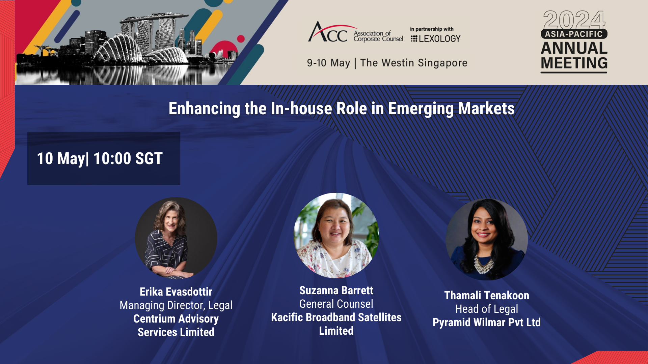
Enhance the In-house role in Emerging Markets
Erika Evasdottir
Managing Director, Legal
Centrium Advisory Services Limited
Suzanna Barrett
General Counsel
Kacific Broadband Satellites Limited
Thamali Tennakoon
Head of Legal
Pyramid Wilmar Pvt Ltd

Slide 3
Enhancing the In-house role in Emerging Markets
Today’s Discussion
What is an In-house Counsel?
Challenges to become a Strategic Partner
Achieving a ‘Seat at the Table’
Q & A
Evolved Role of an In-house Counsel

Slide 4
What is an In-house Counsel?
General Counsel / Chief Legal Officer/ Head of Legal
Organization / Corporation
A full-time employee who works as an Attorney for the Corporation

Slide 5
Challenges to achieve a ‘Seat at a Table’
Limited resources and budgets provided
Lack of support from the management team
Lack of updated systems implemented in the organization
Constantly evolving business models and complex international structures
General Counsel / Chief Legal Officer/ Head of Legal

Slide 6
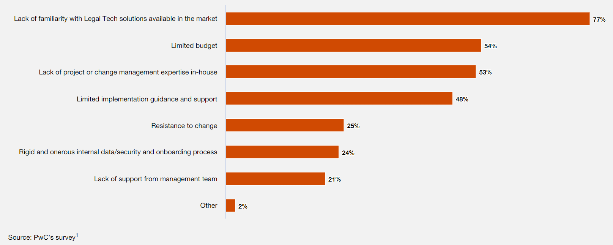
Survey conducted on Major Challenges for In-house legal
https://www.pwc.com/gx/en/about/pwc-asia-pacific/the-new-equation-for-legal-departments-of-the-future-in-asia-pacific.html

Slide 7
Evolved Role (Highly Procedural Markets v Emerging Markets)
Legal Adviser
Senior Corporate Manager
Empowering teams
Empowering team
Strategic Business Partner
General Counsel / Chief Legal Officer/ Head of Legal

Slide 8
Highly Procedural Markets
Emerging Markets
Roles played in different Markets
General Counsel / Chief Legal Officer/ Head of Legal

Slide 9
Leadership in Ambiguity
Integrity / Company Protection
Clear Communication
Integrity
Pragmatism / "Perfect"
Enable safe risk taking
Continuous learning
Build cross disciplinary thinking

Slide 10
Achieving a ‘Seat at the Table’: Highlighting Our Value
Implementation of Internal Procedures
New Legal/Regulatory Requirements
Updates to Risk Management Strategies
Empowerment of Company Functions
General Counsel / Chief Legal Officer/ Head of Legal

Slide 11
Achieving a ‘Seat at the Table’: Highlighting Our Value
Integration with the Executive Team
Cost Management
Talent Development in the Legal Team
Technological Solutions Implemented
General Counsel / Chief Legal Officer/ Head of Legal

Slide 12
Q & A
Discussions

Slide 13
Coffee Break
11:10-11:40

