Slide 2
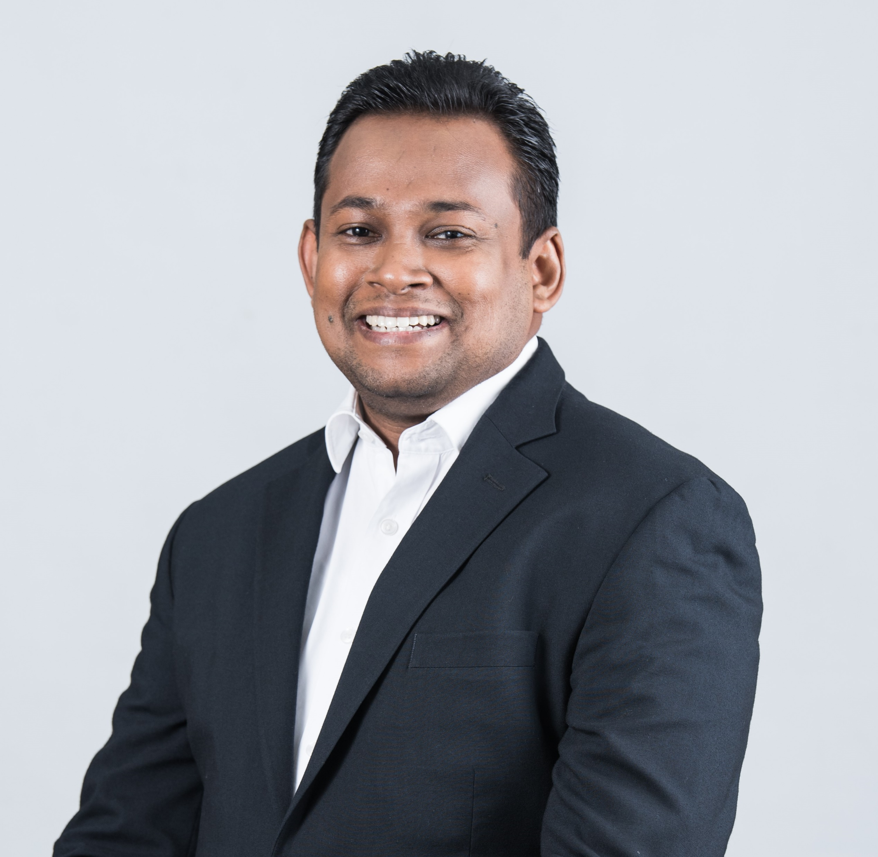
Future Disputes in APAC Region
Matthew Kasdin
Director & Senior Counsel
Maxeon Solar Pte Ltd
Singapore
Keerthi Pathiraja
Asst. Director – Legal & Regulatory Affairs / Company Secretary
Nestlé Sri Lanka

Slide 3
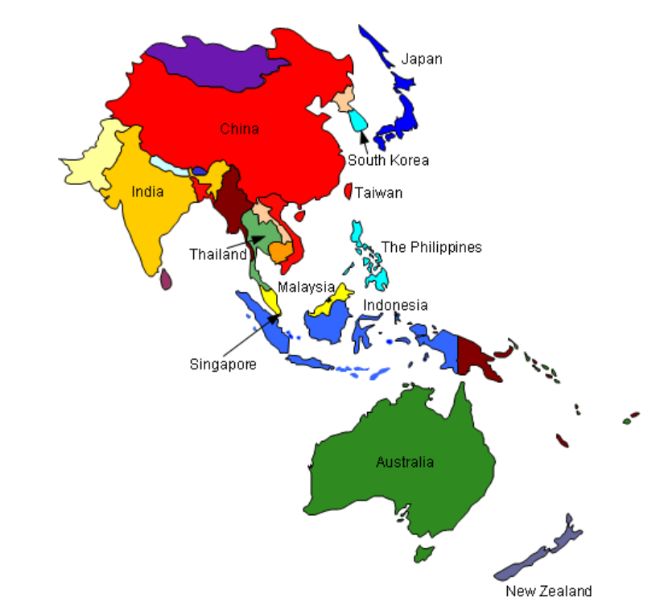
Introduction

Slide 4
61% of Global Population
GDP US$ 39 trillion -56% of world economic output
Trade Hub - 56% of total US Trade
Supply Chain Hub
Agriculture
Growing Middle Class
Rise of Contribution to Global GDP

Slide 5
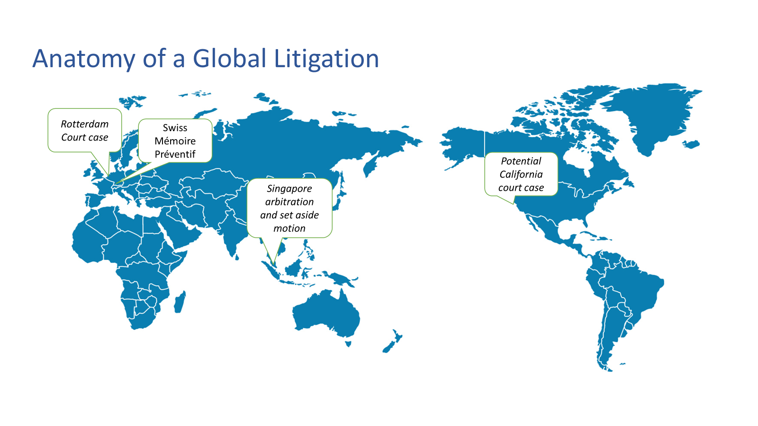

Slide 6
Multijurisdictional Disputes
Digital Assets and Cyber Disputes
Environmental, Social, and Governance (ESG) Litigation
Supply Chain Disruptions
Cultural Diversity
Rise in Class Actions
Challenges

Slide 7
What could be done?

Slide 8
Harmonization of Laws
(or a Business-Friendly Choice Law)

Slide 9
Arbitration
A Preferred Choice

Slide 10
Growing Importance of
Mediation

Slide 11
Influence of Technology

Slide 12
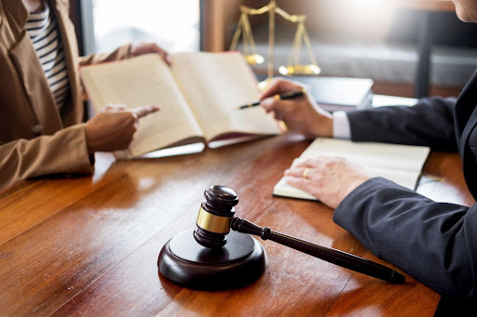
Specialized Courts and Tribunals

Slide 13
Cross-Border
Collaboration

Slide 14
Conclusion

