Slide 1
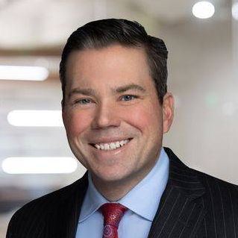
The Overlap of the National Labor Relations Act, Title VII, and other Employment Laws:
What Every Legal Professional Should Know.
Raeann Burgo Partner, Pittsburgh rburgo@fisherphillips.com 412.822.6630
Brian Balonick Regional Managing Partner, Pittsburgh bbalonick@fisherphillips.com 412.822.6633

Slide 2
Disclaimer
The information in this presentation is provided for informational purposes only.
It does not necessarily represent the position or opinions of the firm or its partners or attorneys collectively, and does not constitute legal advice or the establishment of an attorney-client relationship.

Slide 3
Dischargeable Conduct or Protected Activity?
In a discussion in the breakroom about safety issues, a Black employee compares employees using their voices to collectively improve working conditions to the Black Lives Matter protests that resulted from the killing of black men over the last few years.
Another white employees responds to the black employee by saying:
“Nothing will be gained from mentioning Black Lives Matter in discussing safety issues. Black Lives Matter just represents a crusade to address what happened
to a bunch of [racial expletive] criminals who got what they deserved. All lives matter.”

Slide 4
Dischargeable Conduct or Protected Activity?
Member of picket line yelled to a black replacement workers who crossed the picket line:
“Hey, did you bring enough KFC for everyone?”

Slide 5
Dischargeable Conduct or Protected Activity?
Employee, upset with how his supervisor talked to him during an organizing campaign, posted on social media during a break:
“Bob is such a NASTY MOTHER F***** don’t know how to talk to people!!!!!! F*** his mother and his entire f***ing family!!!!! What a LOSER!!!! Vote YES for the UNION!!!!!”

Slide 6
What’s On Tap
NLRA Basics
Title VII, ADEA and ADA Overview
Overlap and/or Tension between NLRA and Other Employment Laws
Unfair Labor Practice Charges
Employer Takeaways
Notes:
Alba

Slide 7
Why Do You Care About the NLRA
Applies to Non-Union Workforces
Employees Do Not Need Attorneys
Damages Are Much More Expansive
Notes:
Raeann

Slide 8
The National Labor Relations Act (NLRA)

Slide 9
National Labor Relations Act
Passed in 1935 (Oldest federal workplace statute)
Congress declared it to be “the policy of the United States to eliminate the causes of certain substantial obstructions to the free flow of commerce and to mitigate and eliminate these obstructions when they have occurred by encouraging the practice and procedure of collective bargaining and by protecting the exercise of workers of full freedom of association, self-organization, and designation of representatives of their own choosing, for the purpose of negotiating the terms and conditions of their employment or other mutual aid or protection.”
Notes:
Brian

Slide 10
Who is Covered by the NLRA?
The NLRA applies to most private sector employers, including manufacturers, retailers, private universities, and health care facilities.
The NLRA does not cover public-sector employees, agricultural and domestic workers, independent contractors, employees working for their parents or spouses, workers for air and rail carriers covered by the Railway Labor Act, and supervisors.
https://www.nlrb.gov/about-nlrb/rights-we-protect/the-law/jurisdictional-standards
Notes:
Brian
Activities considered protected under the NLRA include discussions about working conditions and wages between co-workers, wearing of union insignia and filing of grievances about work issues.

Slide 11
Who’s Who At The NLRB And Why It Matters
Notes:
Raeann

Slide 12
The NLRB And Its General Counsel
Five-Member Board
Adjudicates cases
Appointed by the Party in office
Two Democrats
Two Republicans
One member from the political party of the President
Office of the General Counsel
Investigates and Prosecutes Unfair Labor Practice Charges
Notes:
Raeann
26 Regional Board offices through out the country.
Five-Member Board – Appointed for 5 year term, with one Board member term expiring each year. So no more that three members can be from the same political party.
Exercises rule and decision-making authority – they decide cases which establish labor laws.
Establishes doctrine governing representation and ULP cases

Slide 13
Biden and his Board
Biden pushes to be the “most pro-union president you’ve ever seen”
Significant swing back in favor of employees and organized labor
Notes:
Raeann

Slide 14
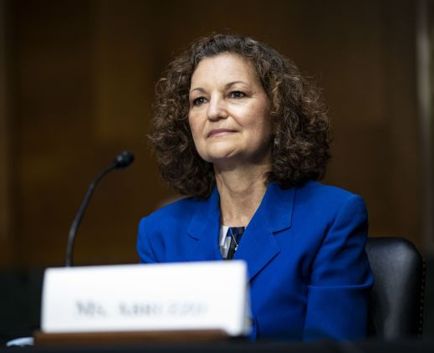
NLRB General Counsel
Jennifer Abruzzo
Nominated by Biden and confirmed on July 28, 2021 to be NLRB’s General Counsel
Agency’s “top sheriff”
Issues GC Memos to the Board’s Regions
Campaign to Overturn Pro-Employer Rulings
Notes:
Raeann
General Counsel - Jennifer Abruzzo
Confirmed July 28, 2021 to be NLRB’s General Counsel
Special Counsel of the CWA
Prior experience with NLRB under Lafe Solomon & Dick Griffin
Agency’s “top sheriff”
4-year term - independent from the Board and is responsible for the investigation and prosecution of unfair labor practice cases and for the general supervision of the NLRB field offices in the processing of cases.
Discuss some of the HR topics impacted by her memos. General Counsel Abruzzo released GC 21-04, Mandatory Submissions to Advice, as her first memo, which identified Board decisions that she believed were contrary to the Agency’s Congressional mandate, as they improperly compromised the statutory rights of workers that the NLRB is required to protect. Updated it again.
Wants the Regions to take up these issues to change the law relating to the NLRA.

Slide 15
Employment Areas Impacted by GC Memos
Workplace Investigations
Handbooks
Confidentiality
Non-disparagement
Non-solicitation
Conflicts
Notes:
These are the areas of Employment that the GC Memo

Slide 16
Section 7 Of The NLRA
Notes:
Raeann

Slide 17
National Labor Relations Act Section 7
Employees Shall Have The Right To:
Self-organize, form, join, or assist labor organizations
Bargain collectively through their chosen representatives
Engage in other concerted activities for the purpose of collective bargaining or other mutual aid or protection; or
Refrain from any or all such activities….
Notes:
Raeann
Workers can act together to try to improve their workplace. This includes talking to each other about their pay and working conditions and how to fix what they perceive as problems. The NLRA makes it an unfair labor practice for an employer “to interfere with, restrain, or coerce employees in the exercise of the rights guaranteed in Section 7” of the NLRA. Employers with non-unionized workforces often unknowingly engage in activities that unlawfully interfere with, restrain, or coerce employees in the exercise of their Section 7 rights. We will discuss in more detail later on.

Slide 18
Section 7 Rights
Traditional examples of the rights protected by Section 7:
Forming or attempting to form a union among the employees of a company
Joining a union whether the union is recognized by the employer or not
Assisting a union to organize the employees of an employer
Going out on strike to secure better working conditions
Refraining from activity on behalf of a union
Notes:
Raeann
If in a non-unionized work force you think how is this relevant to me. As Alba mentioned, nonunion workforces still face liability under the NLRA.

Slide 19
Section 7 Rights
Modern examples of rights protected by Section 7:
Complaints via email and social media
Repeated disruptive complaints regarding pay and benefits
Discussions of confidential internal investigations
The right to not being discriminated or retaliated against for engaging in protected concerted activities
Social Justice
Other activities commonly regulated by handbook policies
Notes:
Raeann
Beware the new water cooler
Employees have the right to engage in something called concerted activity, when "two or more employees take action for their mutual aid or protection regarding terms and conditions of employment
These days, this can happen online. Facebook has become the water cooler.
And when these conversations happen online, it's still considered concerted activity; Section 7 protections extend to online conduct. Online conversation was the means used by our employee John in the story we shared earlier in the presentation.
During the “Obama Board” years, the NLRB dramatically expanded application of Section 7
Lawfulness of handbook policies and work rules governing non-union employees
During the “Trump Board” period, the NLRB aggressively rolled back many of the prior Board’s changes
Under Biden, we see a return to Obama Board doctrine (and potentially an even further pendulum swing toward labor)
the current NLRB is actively expanding the scope of Section 7 protections. Section 7 rights are very broad and employers should assume that when presented with a question of whether an employee is engaging in Section 7 rights, the answer with this particular Board will lean towards yes.
Recent rulings emphasize that even well-intentioned workplace rules can violate Section 7 if employees might reasonably perceive them as restrictive of their rights.

Slide 20
Protected Concerted Activity?
John and his coworkers collectively met with management regarding their safety concerns related to the facility.
Notes:
Brian

Slide 21
Protected Concerted Activity?
Desiree and a group of co-workers discussed their salaries. A small group of employees were upset that their salaries were lower than other coworkers. Desiree decided to post what she learned about her coworkers’ and her salary on Change.org. In the post, she requested that the Company audit its pay practices, increase everyone’s pay, and signed the post “on behalf of employees at Company.”
Notes:
Alba
Is it protected concerted activity? Yes
Can you take down the post? Taking down the post is risky because it is protected, and the action could be deemed as interfering with an employee’s Section 7 rights.

Slide 22
Social Media, Chats, and Protected Concerted Activity
Employee conduct on social media (e.g., Facebook, Instagram, LinkedIn) can constitute protected concerted activity
Individual “griping” v. group action
Commenting on and/or “liking” others’ posts
Memes and emojis
Notes:
Brian
Be mindful of instant messaging systems
Reminder regarding case where employee commented to manager and others liked it.

Slide 23
Things to Consider Before Discipline
Did co-workers join in the conversation?
Is it a continuation of earlier group action?
Did comment relate to employment terms and conditions?
Is the comment purely personal and did the employee seek to initiate or to induce or to prepare for group action?
Is information “maliciously false” or protected by other laws (i.e., HIPAA)?
Notes:
Brian – what considerations should you add to your employee conduct analysis before you discipline.
PCA usually don’t happen on its own. The PCA happen with other conduct. Yelling at customer.

Slide 24
Title VII, ADEA and ADA Overview
Notes:
Raeann

Slide 25
Title VII, ADEA and ADA
Protects employees and job applicants from employment discrimination based on race, color, religion, sex, sexual orientation, gender, gender identity, national origin, age, disability
Protects employees from being subject to a hostile work environment
Prohibits employees from being retaliated against for engaging in protected activity
Notes:
Raeann

Slide 26
Enforcement Guidance on Harassment
Released April 30, 2024 – First guidance from the EEOC on harassment since the 1990s
Broad protections for LGBTQ+ workers,
Sexual harassment includes pregnancy, childbirth and “related conditions”
Clarifies Protection on Religious Expression
Harassment can occur virtually
Guidance for you to update your policies
Provides useful key points on complaint/investigation process and training
Notes:
Raeann
Broad protections for LGBTQ+ workers, providing the following examples:
Denial of bathroom usage consistent with gender identity
Intentional and repeated misgendering – including use of pronouns
Sexual harassment includes pregnancy, childbirth and “related conditions”:
Includes lactation, contraception and abortion decisions
Clarifies Protection on Religious Expression:
Duty to protect workers against religiously motivated harassment
Not required to accommodate religious expression that creates or “reasonably threatens to create” a hostile work environment – attempts to persuade if objected to
Harassment can occur virtually:
Harassment can include communication by email, instant message, videoconference, etc.
Guidance for you to update your policies:
Includes resources to assist employers in reviewing and updating harassment policies
Provides useful key points on complaint/investigation process and training
Highlight Complaint/Investigation Process--The guidance provides several factors to be considered in determining whether an employer failed to act reasonably to prevent the unlawful harassment from occurring, including the adequacy of the employer’s anti-harassment policy, complaint procedures, and training; the nature and degree of authority the alleged harasser exercised over the complainant; the adequacy of the employer’s efforts to monitor the workplace; and the adequacy of the employer’s steps to minimize known or obvious risks of harassment. The guidance goes on to state that even if the employer acted reasonably to prevent unlawful harassment, it may still be liable for the harassment if it did not act reasonably to correct harassment about which it knew or should have known.

Slide 27
Enforcement Guidance on Harassment
Guidance provides several factors to be considered in determining whether an employer failed to act reasonably to prevent the unlawful harassment from occurring
the adequacy of the employer’s efforts to monitor the workplace
the adequacy of the employer’s steps to minimize known or obvious risks of harassment
Notes:
Raeann
Broad protections for LGBTQ+ workers, providing the following examples:
Denial of bathroom usage consistent with gender identity
Intentional and repeated misgendering – including use of pronouns
Sexual harassment includes pregnancy, childbirth and “related conditions”:
Includes lactation, contraception and abortion decisions
Clarifies Protection on Religious Expression:
Duty to protect workers against religiously motivated harassment
Not required to accommodate religious expression that creates or “reasonably threatens to create” a hostile work environment – attempts to persuade if objected to
Harassment can occur virtually:
Harassment can include communication by email, instant message, videoconference, etc.
Guidance for you to update your policies:
Includes resources to assist employers in reviewing and updating harassment policies
Provides useful key points on complaint/investigation process and training
The Board’s rulings on workplace policies will/may limit an employer’s ability to monitor the workplace and minimize risk.
Highlight Complaint/Investigation Process--The guidance provides several factors to be considered in determining whether an employer failed to act reasonably to prevent the unlawful harassment from occurring, including the adequacy of the employer’s anti-harassment policy, complaint procedures, and training; the nature and degree of authority the alleged harasser exercised over the complainant; the adequacy of the employer’s efforts to monitor the workplace; and the adequacy of the employer’s steps to minimize known or obvious risks of harassment. The guidance goes on to state that even if the employer acted reasonably to prevent unlawful harassment, it may still be liable for the harassment if it did not act reasonably to correct harassment about which it knew or should have known.

Slide 28
Overlap and/or Tension between NLRA,
Title VII and Other Laws

Slide 29
Title VII, Employment Laws, Etc.
NLRA

Slide 30
Workplace Rules, Confidentiality, and the NLRA
Handbooks
Investigations
Notes:
Raeann- Focus is on what is protected activity and whether the workplace rules chill employees Section 7 rights.
On August 2, 2023, the NLRB changed the legal standard on workplace misconduct rules. Under the new standard, the Board analyzes whether an employee “would reasonably construe” the applicable rule or policy as chilling protected conduct under Section 7 of the National Labor Relations Act. To avoid a violation, employers must now show that workplace conduct rules are narrowly tailored to special circumstances justifying any infringement on employee rights.
The new standard subjectively examines whether a workplace rule or policy has a reasonable tendency to interfere with employees’ exercise of Section 7 rights. In other words, if an employee could reasonably interpret the rule to be coercive (even if a noncoercive interpretation is also reasonable), then the burden shifts to the employer to justify it.
Investigations
-Review your policies related to confidentiality related to complaints about harassment and discrimination. Broad confidential policies may be construed by an employee as interfering with their Section 7 rights. Some companies have employees sign confidentiality agreements, but they could be deemed likely unlawful under the current standard.

Slide 31
Workplace Civility
Policies that likely violate the NLRA:
No profanity or abusive language toward co-workers
Employees must behave in a “positive and professional manner
Notes:
Raeann
-Example – Employee yells at the manager and HR because he/she is upset about the salary for all women in the same title and role.
Title VII –
Requiring civility and courtesy or prohibiting offensive behavior
Discipline of workers for racist, sexist, and other profane speech or conduct
Current Political Climate
Restricting political activities that may have a nexus to employee interests
While picketing outside the employer’s place of business, a locked-out employee makes racially offensive comments to or
about replacement workers. The company fired him for violating its workplace anti-harassment policies by making racist remarks on a picket line, but Board has ordered to give him his job back with back pay plus interest. They were not violent in character, and they did not contain any overt or implied threats to replacement workers or their property and there waw no threatening behavior or physical acts of intimidation towards the replacement workers.
Yet, Board ruled an employee’s Black Lives Matter uniform marking was protected by labor law—the employer maintained a company-wide dress code policy that said, “the apron is not an appropriate place to promote or display religious beliefs, causes or political messages unrelated to workplace matters.”
Starting in August 2020, a customer facing employee donned an apron prominently displaying a Black Lives Matter slogan. Six months later, the employee and a small group of coworkers made complaints that they were subjected to racial harassment at work. The employee emailed company officials requesting further action to protect employees of color. The company subsequently advised the employee that his apron was in violation of the dress code policy and directed him to either remove it or resign
The NLRB held that a customer-facing employee who wrote “BLM,” an initialism for “Black Lives Matter,” on his work uniform apron was engaged in protected concerted activity under the National Labor Relations Act (NLRA). As a result, the company directive for him to comply with the dress code policy and remove the marking violated labor law, and the employee’s resulting decision to resign over the directive amounted to a “constructive discharge” entitling him to backpay and reinstatement.
The Region initially concluded that the employee’s actions were a “logical outgrowth” of ongoing concerted activities culminating in a group request for protection from alleged racial harassment. Employee discussions in the workplace regarding racism should be deemed inherently concerted because systemic racism, including an employer’s racial discrimination or racial harassment, and/or tolerance of such discrimination or harassment, necessarily implicates significant terms and condition of employment and is of vital importance to employees.”
Yet -
Boards umbrella covers all behavior by employees -- Those in which they complain about harassment and when they engage in harassment.

Slide 32
Money Matters
Pay Equity, Pay Transparency, Discussing Salary and Wages
Employees have the right to communicate with their coworkers about their wages, as well as with labor organizations, worker centers, the media, and the public.
Notes:
Raeann
Requiring employees to keep "customer and employee information secure," and only use it "fairly, lawfully and … for the purpose for which it was obtained," finding that a reasonable employee would construe rule to prohibit discussion of wages and terms and conditions of employment and would not read it to be confined to data privacy issues. Fresh & Easy Neighborhood Mkt. & United Food & Com. Workers Int'l Union, 361 NLRB 72, 73 (2014).
“Disclosure of confidential information, including Company, customer information and employee information maintained in confidential personnel files" was deemed to prohibit employees from discussing wages and working conditions.
Example of Colorado Pay Transparency

Slide 33
Employee Conduct During Section 7 Activity
1. the place of the discussion
2. the subject matter of the discussion
3. the nature of the employee’s outburst
4. whether the outburst was, in any way, provoked by an employer’s unfair labor practice
Notes:
Brian
Setting-specific standards aimed at deciding whether an employee has lost the protection of the Act.

Slide 34
Employee Conduct During Section 7 Activity
Key Premise
“disputes over wages, hours, and working conditions are among the disputes most likely to engender ill feelings and strong responses.”
This is Why
“misconduct in the course of Section 7 activity is treated differently that misconduct in the ordinary workplace setting that is unrelated to Section 7 activity.”
Notes:
Brian

Slide 35
I Received An Unfair Labor Practice Charge. Now What?
Notes:
Brian

Slide 36
Common ULP Allegations Under Section 8
Protected concerted activity (with or without a union) - § 8(a)(1)
Overbroad rules (with or without a union) - § 8(a)(1)
Interference with employee free choice - § 8(a)(1)
Employer domination or interference - § 8(a)(2)
Discriminatory discharge - § 8(a)(3)
Employer retaliation - § 8(a)(4)
Refusal to bargain in good faith - § 8(a)(5)
Violating the “TIPS” rules - All of the above
Notes:
Brian

Slide 37
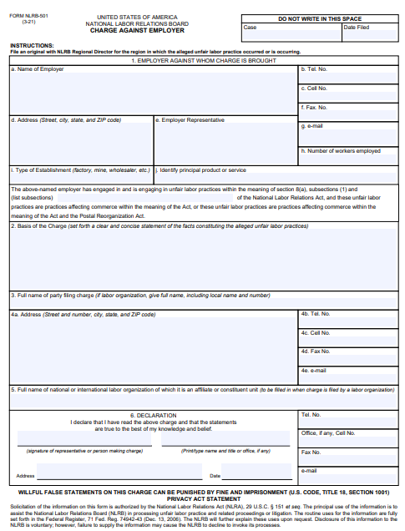
The Unfair Labor Practice Charge
Simple form
Usually doesn’t contain much information about the factual allegations
Short turnaround time to respond
Notes:
Brian
https://www.nlrb.gov/sites/default/files/attachments/pages/node-195/501_3-21.pdf
Charges initiated by Unions, Employers or individuals
Overseen by General Counsel, delegated to Counsel for General Counsel
Investigated at Regional level
Board Agent/Field Examiner reporting up to Regional Director
Prima facie case
Detailed allegations letter w/information/ESI request
Position Statement
Supplemental requests/investigative subpoenas
Settlement options
Injunctive relief
Tell your story in your position statement

Slide 38
ULP Response Strategies
Similar to a Position Statement to the EEOC
Consider Submitting Affidavits from Key Fact Witnesses
Litigation Hold
NLRB Request to Interview Witnesses
Notes:
Raeann

Slide 39
Unfair Labor Practice Investigation
If meritorious, a ULP Complaint Issues
Trial before an Administrative Law Judge
Formal evidentiary process
Subpoena authority
Burden generally falls upon General Counsel
Routes of appeal
Exceptions filed with NLRB (Board members)
Petition for Review of Final Decision & Order to Circuit Court of Appeals
Notes:
Brian

Slide 40
Settlement with NLRB
Notice Posting
Backpay
Reinstatement
Injunctive Relief
Notes:
Brian
Also, highlight GC-Memo on Settlements and other terms in the agreement.

Slide 41
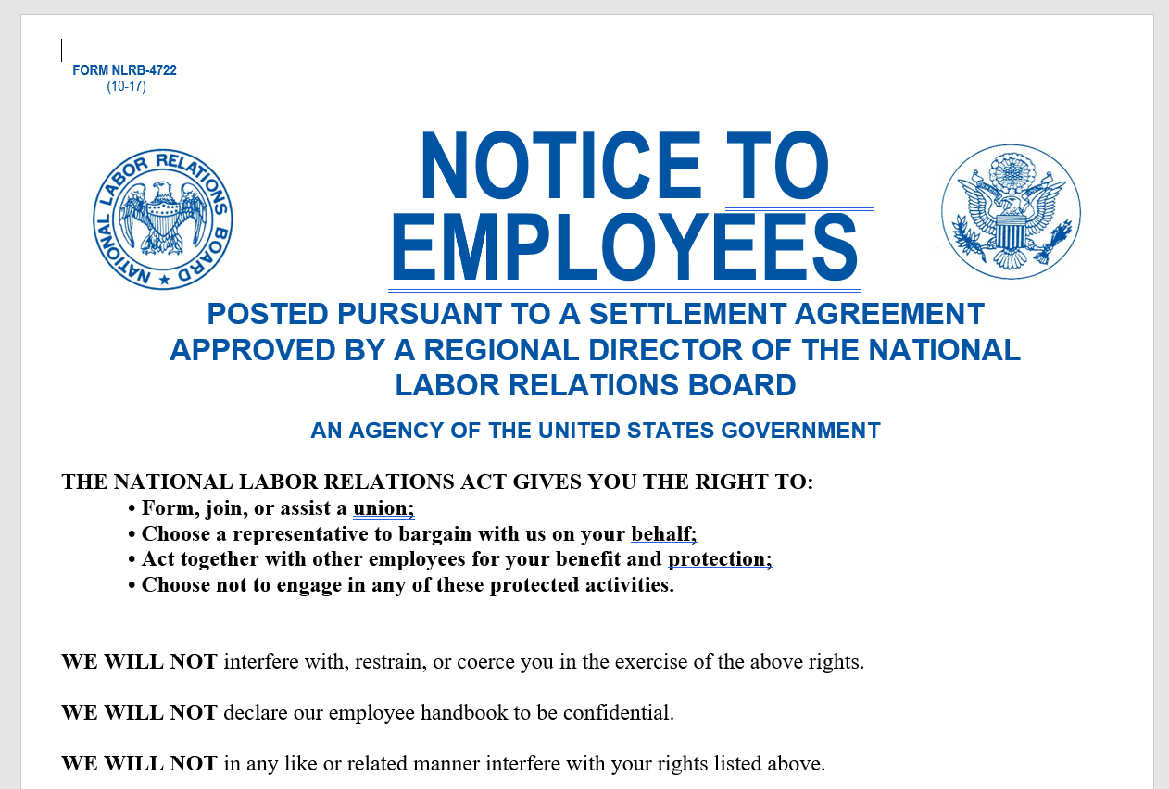
Notice Posting
Notes:
Brian

Slide 42
Recent Settlements in NLRB Cases
Apology letter
Backpay for missed car payments and credit card payments
Class Relief for Unlawful Policy
Positive Letter of Reference
Job Search Costs (including reimbursement of mileage and gas costs)
Costs associated with loans and credit card advances
Legal representation costs in evictions proceedings
Notes:
Brian

Slide 43
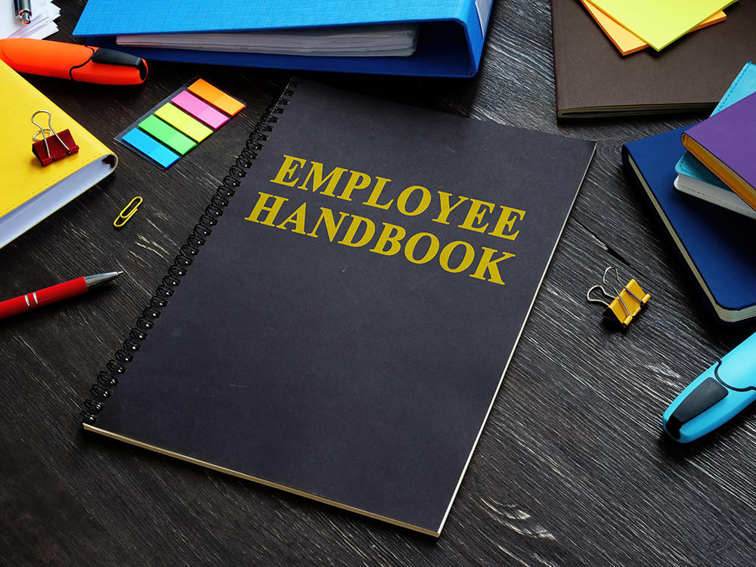
Avoiding Common Pitfalls
Failing to take ULPs seriously
Inadequate documentation
Retaliating
Out of Date Handbook
Notes:
Raeann

Slide 44
Employer Takeaways
Notes:
Raeann

Slide 45
Takeaways
Be mindful that an employee’s conduct may constitute protected concerted activity
Don’t retaliate against an employee
Review your handbooks, agreements, and stay up-to-date
Consider the context in which the inappropriate conduct occurs
Reach out to outside counsel for guidance
Stay tuned for (more) potential changes in the law

Slide 46
QUESTIONS?

Slide 47
THANKS
Raeann Burgo Partner, Pittsburgh rburgo@fisherphillips.com 412.822.6630
Brian Balonick Regional Managing Partner, Pittsburgh bbalonick@fisherphillips.com 412.822.6633

