Slide 1
Protecting Trade Secrets in a Remote World
Presented by:
Rick L. Etter (Pittsburgh)
rick.etter@ogletree.com

Slide 2
Disclaimer
These materials have been prepared by the lawyers of Ogletree Deakins to inform our clients of important information in these areas of law. They are not, of course, intended as specific legal advice, but rather are offered to alert our clients to important developments and potential problems that may affect their business operations. When clients are faced with actual or potential business problems relating to these areas, they are encouraged to seek specific legal counsel by contacting the lawyers in our firm with whom they normally work.
Any reproduction in any form or incorporation into any information retrieval system or any use without the express written consent of Ogletree Deakins is prohibited.

Slide 3
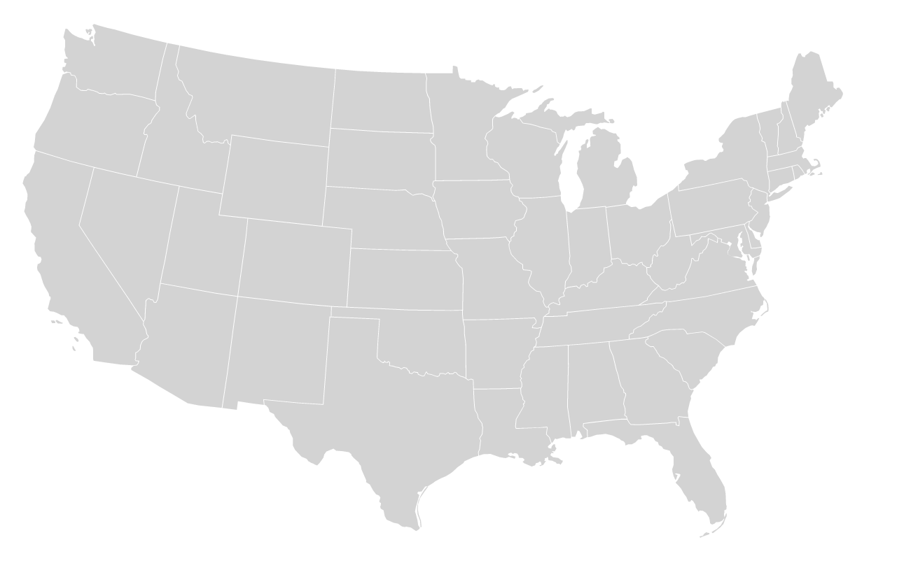
Berlin, Germany
Paris, France
Mexico City, Mexico
1,000+ Lawyers
56 Offices Worldwide
30+ Practice Areas
Our broad geographic reach allows our lawyers to work together as “one team,” making national representation possible and effective.
Toronto, Canada
London, United Kingdom
Montreal, Canada
St. Thomas
Ogletree Office Locations

Slide 4
Recent Firm Accolades
Best Law Firms® 2024
Chambers USA 2024
“Law Firm of the Year” Employment Law – Management We have been named a “Law Firm of the Year” 13 years in a row!
Tier 1 national rankings in additional practice areas: Litigation – Labor & Employment
Labor Law – Management
Immigration Law
Employee Benefits (ERISA) Law
Litigation – ERISA
A “formidable labor and employment practice with numerous offices across the USA, providing advice on the whole range of relevant matters such as internal workplace investigations, litigation and regulatory compliance.”
BTI Consulting Group ranked Ogletree ta top-10 law firm for client service in the BTI Client Service A-Team 2024 report.

Slide 5
Agenda
What is a trade secret?
What are the risks?
Practical Tips!!
Onboarding Process
Policies & Procedures
Data Security Protocols
Departing Employee Process

Slide 6
Trade Secret Protections
Trade secrets are protected by state and federal law
Defend Trade Secrets Act
Pennsylvania Uniform Trade Secrets Act

Slide 7
What is a trade secret?
Under DTSA, trade secret is defined as “all forms and types of financial, business, scientific, technical, economic, or engineering information . . . if (A) the owner thereof has taken reasonable measures to keep such information secret; and (B) the information derives independent economic value, actual or potential, from not being generally known to, and not being readily ascertainable through proper means by, another person who can obtain economic value from the disclosure or use of the information.”

Slide 8
What is a trade secret?
Known outside of company?
Known by employees inside the company?
Secrecy measures?
Value of information to company and to competitors?
Investment in developing?
Ease or difficulty in acquiring or duplicating?

Slide 9
What is a trade secret?
Examples of trade secrets may include:
Customer and supplier information (even if unwritten)
Production and operational methods
Formulas
Financial information

Slide 10
What are the risks?
Maintaining the secrecy of information
Getting information to remote workers
Security of personal networks and systems
Need to use storage devises
Development of trade secrets by remote workers
“Work made for hire” issues
Use of artificial intelligence
Ensuring departing workers do not retain information

Slide 11
What are the risks?
How does trade secret misappropriation occur?
Smart phones & tablets
Storage devices
Cloud computing
File transfer accounts
Email
Social media

Slide 12
Practical Tips for Employers

Slide 13
Onboarding Process
Develop checklist for onboarding employees with access to trade secrets and confidential information
Review applicable policies and procedures with employee
Include requirement to segregate personal and business information
Require employee acknowledgment

Slide 14
Onboarding Process
Require Confidentiality Agreements
Be specific about what is being protected – define trade secrets
Use plain English
Establish that trade secrets may be stored electronically, on paper, or in employee’s memory
Include discussion of inevitable disclosure

Slide 15
Policies & Procedures
Confidential Information Policy
Use of Electronic Resources Policy
BYOD Policy
Use of Artificial Intelligence Policy
IT Policies

Slide 16
Policies & Procedures
Confidential Information Policy
Define what information is confidential
Identify who has access
Employee’s responsibility to return
Ensure appropriate whistleblower carve outs
Acknowledgment

Slide 17
Policies & Procedures

Slide 18
Policies & Procedures
IT Policies
Include personal devices and accounts used for work
Require password protection
Require immediate reporting of lost/stolen devices

Slide 19
Policies & Procedures
IT Policies
Track confidential information and trade secrets
Who may access, modify, copy or delete
Stamp “CONFIDENTIAL,” “TRADE SECRET,” or serialize
Conduct forensic reviews and periodic audits

Slide 20
Data Security Protocols
User Facing
Password changes and minimum construction standards
Screen locking and login protocols
Multi-factor authentication for devices and access to restricted databases
Automated access and use policy pop-ups

Slide 21
Data Security Protocols
Internal Flags
Flag system for downloads and print jobs outside of certain parameters
After hours
Particularly large files or a certain number of files
Flag system for access to certain websites, web portals, or off-hours/internet/VPN access

Slide 22
Data Security Protocols
Internal Restrictions
Restrict use of and access to cloud storage
Restrict use of and access to external storage devices
Consider locking USB ports
Gateway filtering and monitoring of email
Consider flags for key words or file type exports

Slide 23
Data Security Protocols
Internal Restrictions
Drive encryption
Email/Skype/Messaging encryption
Firewall protocols
VPN use protocols
Data wiping protocols

Slide 24
Departing Employee Process
Exit interview
Off-boarding checklist
Forensic scrub
Continuing obligations letter

Slide 25
Departing Employee Process
Exit Interview
Develop consistent procedure
Remind of continuing obligations
Provide copies of any restrictive covenant agreements
Review off-boarding checklist
Include IT on exit interview team

Slide 26
Departing Employee Process
Off-boarding checklist
Confirm identity of personal devices and accounts used
Confirm all company information removed/deleted from such accounts and devices
Confirm all company property and devices returned
Confirm understanding of continuing obligations
Employee acknowledgment

Slide 27
Departing Employee Process
Forensic scrub
Analyze employee’s devices and accounts
Image devices and accounts
Delete data
Consider privacy concerns

Slide 28
Departing Employee Process
Continuing obligations letter
Standardize language
Tone?
Include preservation demand?
Consider whether to send to new employer
When should cease & desist letter be sent instead?

Slide 29
Thank you!
Rick L. Etter
One PPG Place, Suite 1900 | Pittsburgh, PA 15222
rick.etter@ogletree.com | 412-230-8963

