Slide 1
Robo-lawyer: When AI Serves as First Chair
Danielle Bruno McDermott (JD, CIPP/US)
Sunu Pillai (JD, CIPP/US)
John Marty (JD, CIPM)

Slide 2
Agenda
AI Basics and Background
Technology and terminology overview
Framework
U.S. Law and Regulations
AI Governance: The In-house Perspective
Data Governance
Use Cases
AI Tool Procurement
Employee Use of AI
AI in Practice
Effective Use of AI
Discussion of Risks
AI in the Courtroom
ABA Opinion 51
Standing Orders
AAA’s use of AI Tools

Slide 3
AI Basics and Background

Slide 4
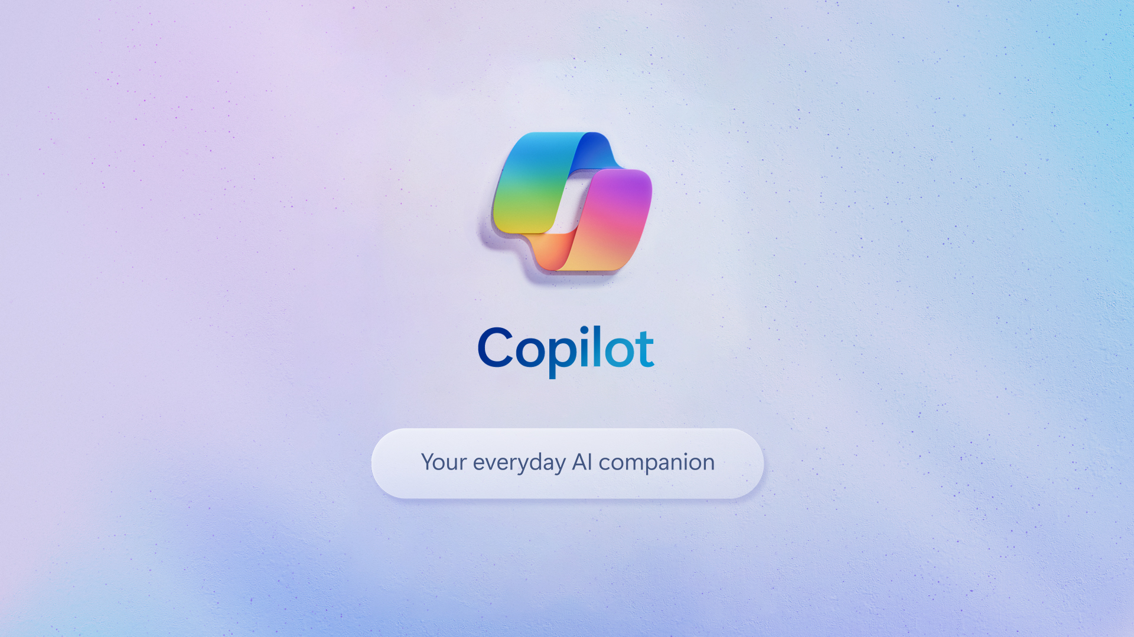
How did we get here?

Slide 5
Drivers of modern “AI”
Increased Computing Power
Big Data and Data Availability
The Growth of the Cloud
Notes:
Regarding number 1 and 3 – an estimated $40 billion of capital investment in data servers by the largest tech companies. Perfect storm of technology and capital

Slide 6
AI and GenAI Terminology
AI – “Intelligence” of machines or technology (as opposed to human intelligence)
Machine Learning (ML) – AI involving algorithms that enable computer systems to iteratively learn from data and make decisions, inferences, and predictions
Generative AI (GenAI) – Subset of AI that can produce “new” content in a manner that mimics human output
LLM - Large Language Model – Based on a “neural network” with millions or billions of parameters
NLP/NLU – Natural Language Processing/ Understanding
Hallucination – Generating fictitious data

Slide 7
What is an LLM?
A probabilistic model of language
Content creation – text, images, audio files, code (and “deepfakes”)
Produces output based on probabilities and parameters – looking for the next likely word using predictive analytics
Can be optimized for fluency, not accuracy
An LLM does not “know” the answers to a prompt
Best for repetitive language (not computational) tasks and phraseology
Notes:
The parameters of the LLM are the different features of the language model, such as the ability to generate different types of text, the ability to translate languages, and the ability to summarize text. The more parameters an LLM has, the more complex it can be and the more tasks it can perform.

Slide 8
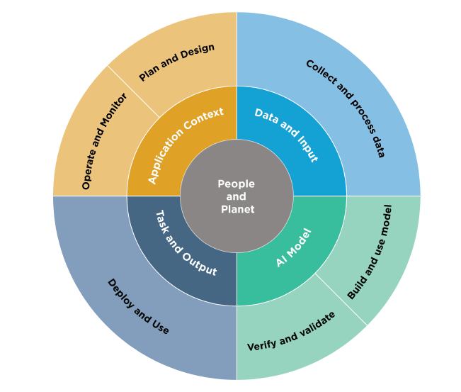
NIST Risk Management Framework
Minimize anticipated negative impacts
Identify opportunities for positive impacts
Flexible framework
Lifecycle and key dimensions of an AI System (NIST RMF Fig 2)

Slide 9
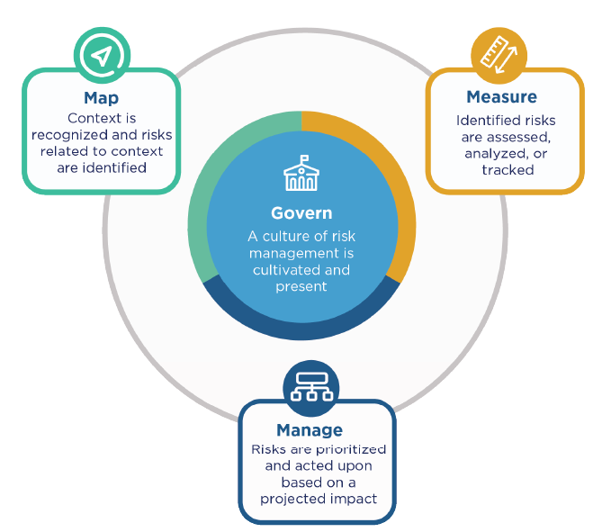
NIST Risk Management Framework
Govern
Policies & Procedures
Accountability Structures
Map
Context
Categorization
Capabilities / usage
Risks & benefits
Impacts
Measure
Methods & Metrics
Evaluation
Tracking
Documentation
Manage
AI Risks
AI benefits
Risks & benefits from third parties
Documentation and monitoring
AI Risk Management Activities (NIST RMF Fig 5)

Slide 10
EU AI Act
Classifies AI according to its risk:
Unacceptable risk is prohibited (e.g. social scoring systems and manipulative AI).
High-risk AI systems are regulated.
Limited risk AI systems, subject to lighter transparency obligations
Minimal risk is unregulated
Majority of obligations fall on providers (developers) of high-risk AI systems
Users (persons who deploy an AI system in a professional capacity, not affected end-users) have some obligations.
Requirements on General Purpose AI Model providers
https://artificialintelligenceact.eu/high-level-summary/

Slide 11
U.S. Law and Regulations
• Currently, there is no overarching AI law in the United States, although some states have endeavored to begin regulating AI within their jurisdiction.
• On the federal level, there have been various executive orders directing federal agency action, for example, the Executive Order on the Safe, Secure, and Trustworthy Development and Use of Artificial Intelligence. This EO focuses on actions administrative agencies must take to investigate AI solutions, create regulations to govern AI, and deploy AI, but does not regulate private actors.
!!
Big concepts here: safety, privacy, auditability, prohibitions on use of AI to create dangerous materials, protection of Americans from AI-enabled fraud, and directing further agency action on AI, like the requirement of a National Security Memorandum.

Slide 12
U.S. Law and Regulations
While also not technically binding on private actors, the Blueprint for an AI Bill of Rights is a very helpful authority to consider and follow for responsible deployment of AI.
The Blueprint provides guidance and five overarching principles for responsible use of AI.
The Five Principles include:
AI Systems should be safe and effective
Prohibition on Algorithmic Discrimination
Data Privacy Requirements
Notice and Explanation
Human Alternatives and Opt-outs

Slide 13
U.S. Law and Regulations
States are starting to promulgate their own laws and regulations to govern AI
CCPA and proposed Automated Decision-making Technology (ADMT) regulations
If you are in scope for CCPA, you will likely be in scope for the ADMT regulations once passed if you use AI.
The Draft ADMT Regulations propose establishing three requirements for businesses that use ADMT for covered uses: (1) pre-use notice, (2) opt-out rights, and (3) access rights.
Colorado Artificial Intelligence Act (SB 205)
This was signed into law with a compliance date of February 1, 2026.
Primarily focused on high-risk artificial intelligence systems, which is defined as any system that, when deployed, makes or is a substantial factor in making a “consequential decision” about a CO consumer. Consequential decisions relate to those involving education, employment, financial services, housing, health care, or legal services.
Includes protections against algorithmic discrimination.
Imposes various obligations relating to documentation, disclosures, risk analysis and mitigation, governance, and impact assessments for developers and deployers of high-risk AI systems.
For any and all AI systems that are deployed on consumers in CO, deployers must ensure that customers are given notice of the AI.

Slide 14
AI Enforcement (& Litigation) Already Underway
The FTC has been the most active agency in terms of enforcement actions against companies for use of AI (so far).
FTC Enforcement action against Rite Aid
On December 12, 2023, The FTC filed a civil action against Rite Aid in federal court (Eastern District of Pennsylvania), alleging that Rite Aid used biometric facial recognition technology in its retail stores without taking reasonable steps to address the risks that such technology was likely to result in harm to consumers because of false-positive facial recognition match alerts. After investigating Rite Aid’s use of the technology, the FTC filed the action, including various allegations about Rite Aid’s use and failure to conduct appropriate diligence as to the technology’s deployment, including that Rite Aid:
Failed to consider the risks that false positives had on consumers, including risks of misidentification based on race or gender;
Did not test the system for accuracy;
Did not enforce image quality controls;
Failed to train its staff on appropriate use and processes for use of the technology;
Did not monitor, test, or track the accuracy of results; and,
Did not keep accurate records of the outcomes of alerts or track false positives.

Slide 15
AI Governance: The In-house Perspective

Slide 16
Good AI Governance Starts with Data Governance
Why data governance?
Data governance enables organizations to better harness the power of their data, ensure data integrity/accuracy, and promote compliance by keeping records of data flowing in and out of their systems.
o First, create a data policy, procedures/charter, and committee of cross- functional experts to evaluate the data flowing out of your organization (privacy, compliance, security, legal, etc.).
o Second, employ the data governance committee to meet periodically to review data export (and maybe import) requests.
o Finally, keep exceptional records, review the process periodically, and ensure that data feeds are turned off when vendors are no longer used.

Slide 17
AI governance builds on data governance, since AI is powered by data and requires data for an output.
A cross functional group of experts and leaders in your organization must be designated to review use cases to use AI.
Your AI Review Committee should include various stakeholders including but not limited to legal, privacy, technical teams, security, ideally data science experts, and the appropriate level of leadership to review requests for use of AI.
What is the intended use of the tool? What due diligence has been conducted? Do we have data flow diagrams, architecture information, or model diagrams? Are we comfortable that the tool is safe and secure? Where is the data stored? Does this use fit within our mandate or policies for safe and responsible use of AI?
Legal teams (including privacy experts) must be engaged in the contracting any time data related to individuals is used in an AI tool; ideally, the AI governance committee will also review and vet that the appropriate contracting is in place prior to deployment.

Slide 18
Additional AI Governance Considerations
Other Considerations may include:
What data is used by the model in question? Do we need or have consent to use data in this way?
What security or other AI risks are presented by this use case—data leakage? Model drift? Hallucinations? Cybersecurity risk by reverse engineering prompts? Safety concerns?
Consent/Notice?
Training?
Auditing?
Special Considerations?

Slide 19
AI Tool Procurement
Most organizations that seek to use AI are going to contract with outside vendors to use their tools.
AI tool procurement is a very new and evolving space; similar considerations to procurement of a SaaS offering, but with some nuances.
AI Due Diligence
You need to ask questions about the tool—how does it work? Does it utilize external LLMs? Is it algorithmic? Is it a black box? Is it audited?
Get data flow and architecture diagrams
Ask questions about how the tool (especially generative AI) was trained
Data segregation
Hallucinations
”AI Incidents”
How is any risk of bias mitigated?
Does the vendor offer training, procedure documents, or white papers?
Where is the human in the loop?

Slide 20
AI Contracting – Not One Size Fits All
The terms of a contract for a complex AI tool will depend greatly on the type of tool, how it is being used, and the model’s technical architecture.
If no data is leaving your systems, the risks are much lower (albeit not zero).
Try to get representations/terms around hallucinations, model drift, data leakage, legality of the training material, the developer’s mitigation of algorithmic bias, developer’s auditing of their tool, requirements around data deletion and purging, and subcontractors.
You want to restrict the tool developer’s use of your data (ideally, you don’t want the developer using your data to outright train new models, but it may not always be possible to prevent that from happening with the model you are using actively).
If the developer has to use your data to train in order for you to use the tool, make sure it is de-identified or anonymized pursuant to industry standards. Vet their process, and also require representations about it in the contract.
Indemnification
SLAs?
This is a rapidly evolving space, and there is no one size fits all to AI contracting.
Notes:
AI Contracting

Slide 21
Employee Use of AI
To start, your organization should create an AI use policy. (Ideally, you already have an information use and disclosure policy!!!)
An AI policy should identify what uses of AI are permissible, and those that are prohibited.
Technical safeguards may be required to block AI tools from use on organizational systems if you do not want employees to use, for example, ChatGPT or other public facing AI.
You may want to prevent employees from using ChatGPT that is not on a private tenant procured by your organization because of the risk of consumer data being used, trade secrets being divulged, or other sensitive or proprietary information losing its protection due to it being submitted to these public facing generative AI models. Once you input data into ChatGPT, you lose control of it, unless you’ve paid for a private instance of the tool.
Also, copyright concerns of using AI generated work.
Privilege?
Arguably, if you put content into an AI tool that is not private, you’ve disclosed that information to a third party and no privilege may attach.

Slide 22
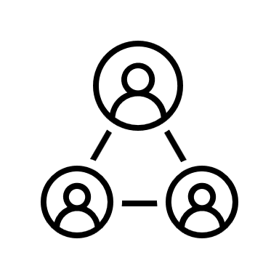
HR Use of AI
If you are using AI for HR functions, there are likely many additional considerations. This is a “high-risk” use case.
Employee privacy
Sometimes use of AI on employee data may require notice to employees.
Caution: Are you putting sensitive information about employees into an AI tool (and if so, what protections are in place?).
Ensure that technical teams vetted the architecture to ensure no sensitive personal data is used by the tool other than to create the output (i.e., no training of tools on sensitive employee data).
Considerations around legal compliance—are you taking adverse action based on an AI output? There are concerns around if that is advisable—and if you are doing it, a human in the loop is always best practice. Also, localities and states are implementing laws restricting use of AI in hiring, firing, and other HR functions, while existing laws continue to apply:
Title VII/ADA/ADEA
NYC Local Law 144
Colorado AI Act
Class action risk

Slide 23
AI in Practice

Slide 24
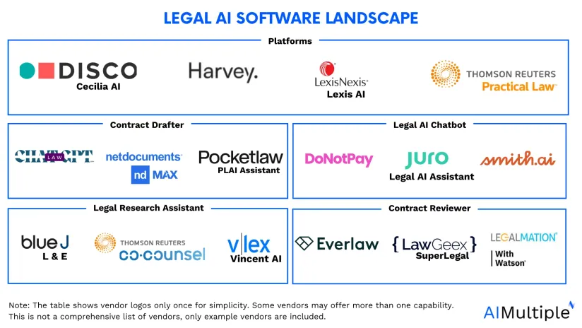

Slide 25
Use Cases
Legal Research
Policy and Contract Analysis
Document Review and E-Discovery
Factual Analysis and Summaries
Drafting

Slide 26
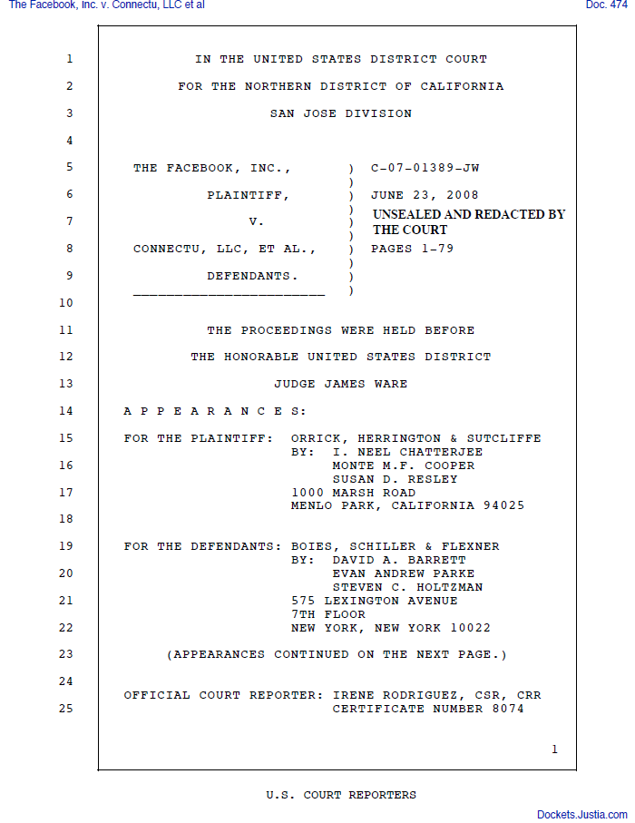
The Importance of Effective Prompting
Notes:
Motion to Enforce Settlement Hearing
79 page

Slide 27
AI Prompts
Prompts are the instructions given to AI to perform specific tasks
The quality of the output is highly dependent on the clarity and specificity of the prompt

Slide 28
The Prompt

Slide 29
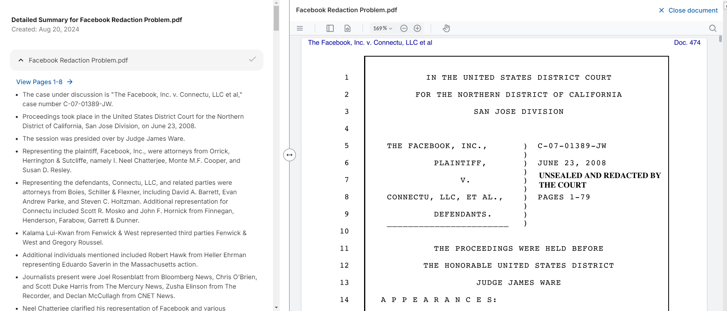

Slide 30
“I am analyzing the effectiveness of arguments presented by Facebook in the document. Provide a summary of each argument made by Facebook and provide any counter arguments made by the defendants.”

Slide 31
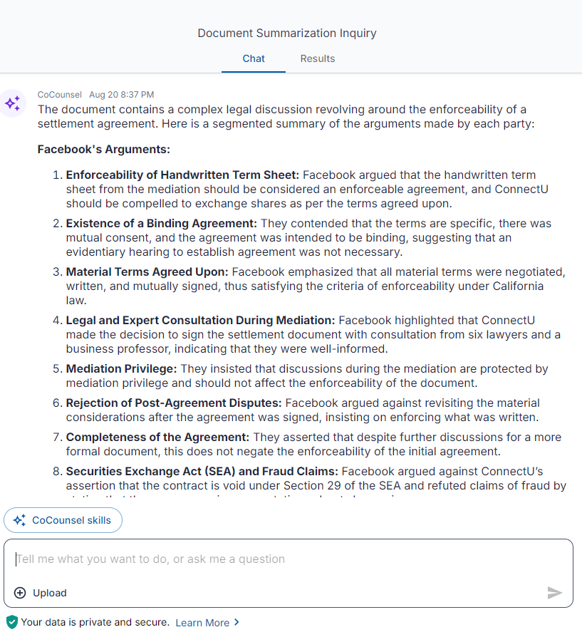

Slide 32
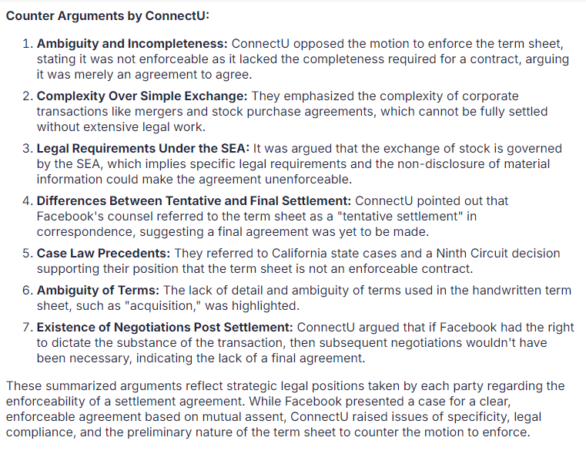

Slide 33
Effective AI Prompts
Clarity: Be clear and unambiguous
Specificity: Define the task precisely
Context: Provide sufficient background or context
Outcome-Oriented: State the desired result explicitly

Slide 34
Effective AI Prompts
State how you want your output presented
Consider providing a “perspective” (“Act as if…”)
Model feedback and refinement is critical
Ideal Formula: Intent + Context + Instruction+ Format
“You are an attorney defending a business in a negligence dispute. Plaintiff has filed a motion for summary judgment. Analyze the document provided and provide a summary of Plaintiff’s arguments in the form of a bulleted list. Within this list, include the legal citations relied on by Plaintiff in their motion.”
Notes:
Be aware of the model’s limitations. For example, does it have the ability to conduct legal research?

Slide 35
Examples
"Summarize the key points of the attached 20-page lease agreement, focusing on the tenant's obligations and any penalties for early termination.“
Directs the AI to focus on specific sections and provides a clear objective.
"Analyze the enforceability of a waiver clause in a contract where the client waives the right to sue for negligence, considering recent case law in California.“
Specifies the type of analysis, the legal concept, and the jurisdiction.

Slide 36
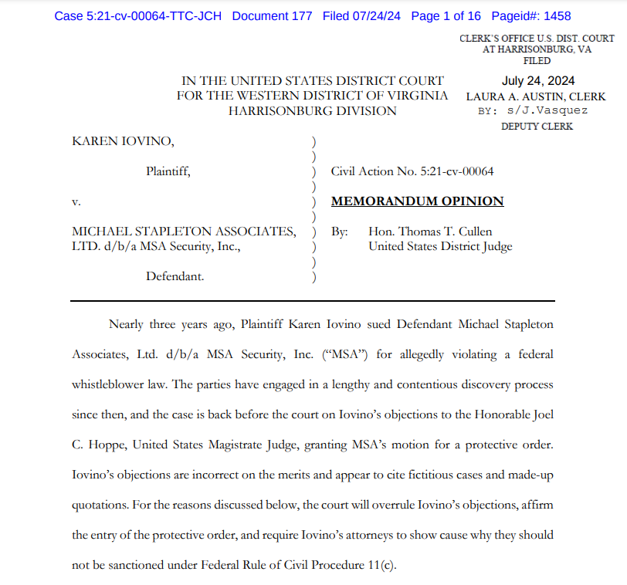
Pitfalls
Risks and Pitfalls
Confidentiality
Hallucinations
Bias
Notes:
Iovino v. Michael Stapleton Associates, Ltd., 5:21-cv-64 - Iovino’s objections are incorrect on the merits and appear to cite fictitious cases and made-up quotations. For the reasons discussed below, the court will overrule Iovino’s objections, affirm the entry of the protective order, and require Iovino’s attorneys to show cause why they should not be sanctioned under Federal Rule of Civil Procedure 11(c).
Michae Cohen - Michael Cohen, Donald Trump's former fixer and lawyer, said in court papers unsealed on Friday that he mistakenly gave his attorney fake case citations generated by an artificial intelligence program that made their way into an official court filing.
Ease of access/universality?

Slide 37
AI in the Courtroom

Slide 38
ABA Opinion 512 – Generative AI Tools
Competence (Model Rule 1.1)
Reasonable understanding of the capabilities and limitations
Independent verification of output
Full responsibility for the work
Consider the client’s interests and objectives
Confidentiality (Model Rule 1.6)
Assess the likelihood of disclosure, sensitivity of information
Client’s informed consent is required if inputting information related to the representation
Understand the Terms and Privacy Policy of the GAI Tool
Communication (Model Rule 1.4)
Disclosure required when prompted
May require unprompted disclosure
Communicate if relevant to the reasonableness of fee
Communicate when the output influences a significant decision

Slide 39
ABA Opinion 512 – Generative AI Tools
Meritorious claims (Rule 3.1 & 3.3) & Candor to Tribunal (Rule 8.4(c))
Review output from GAI tools to ensure output is not false
Supervisory Responsibilities (Rule 5.1 & 5.3)
Establish policies regarding use of GAI
Ensure that lawyers and non-lawyers are trained in the use and risks
Ensure that lawyers and non-lawyers comply with the professional obligations
Reasonable efforts to ensure third party conduct is compliant
Fees (Rule 1.5)
Charge for time expended
May be unreasonable to charge the same flat fee when using GAI
Absent an agreement, firm may charge client the direct cost associated with the tool
Mostly considered overhead and not billable
Time spent learning about the tool not chargeable

Slide 40
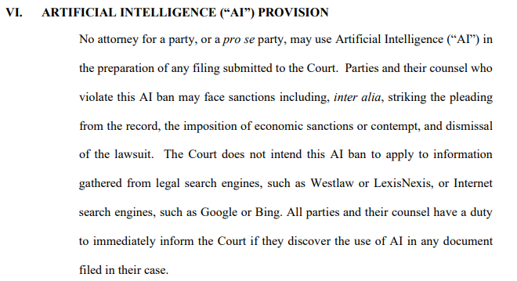
Standing Orders on AI

Slide 41
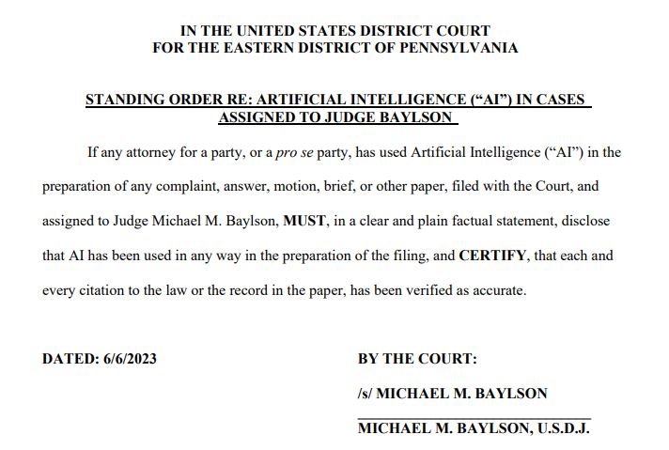
Standing Orders on AI

Slide 42
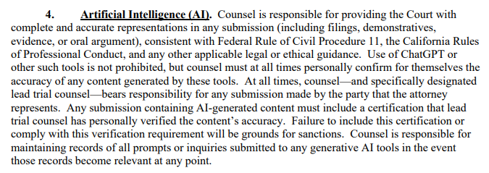
Standing Orders on AI

Slide 43
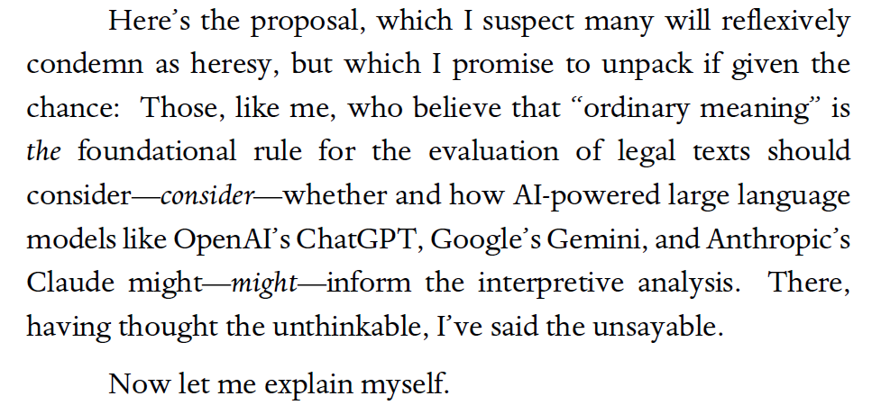
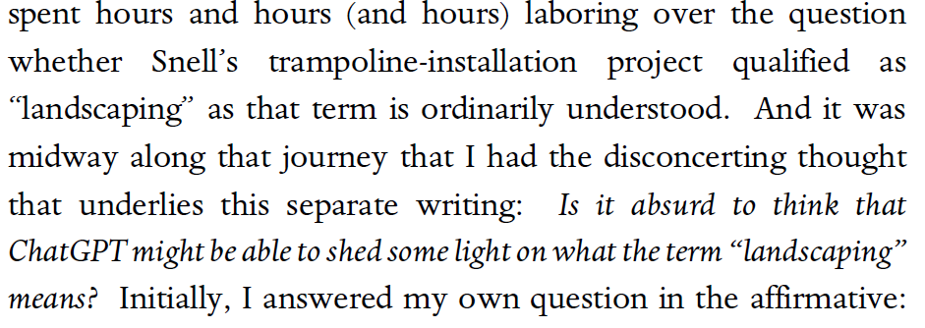
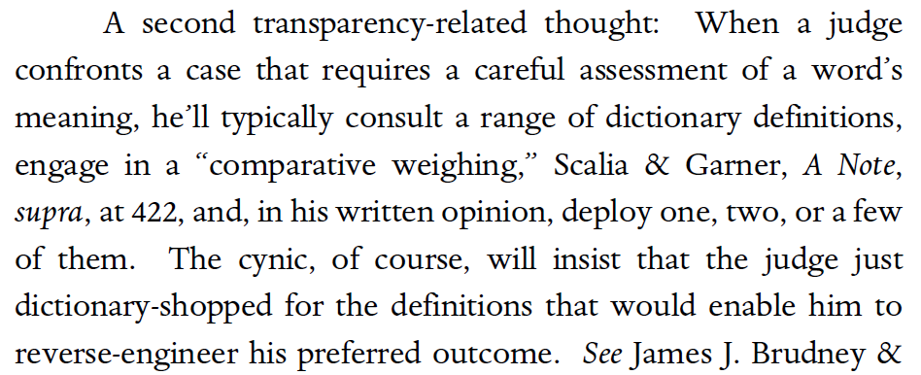
Judge Newsom (11th Circuit) Opinion

Slide 44
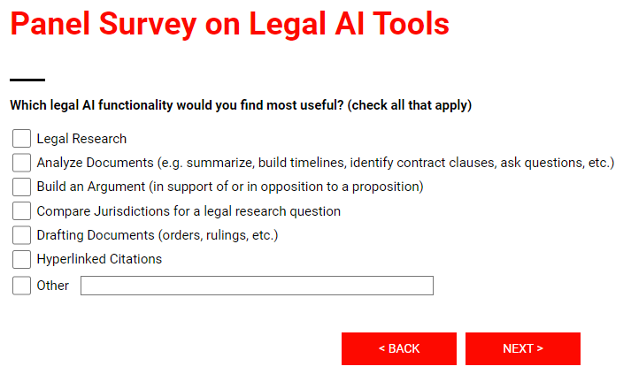
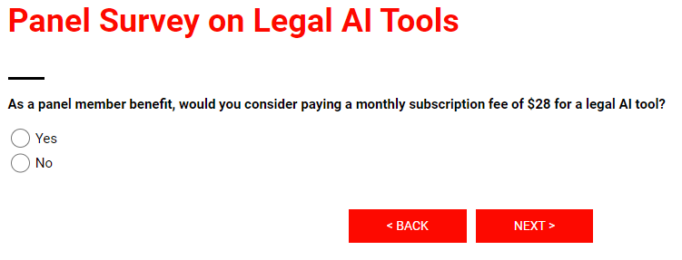
AAA investigating use of AI Tools

Slide 45
Questions?

