Slide 2
Real Property Concerns in Corporate Transactions
August 28, 2024

Slide 3
Be Proactive in Your Purchase Agreement
Representations and Warranties
Covenants
Conditions to Closing
Inspection Period/ Due Diligence
Objection Process

Slide 4
Representations and Warranties
An assertion of fact given by one party to induce another party to enter into an agreement or take some other action
Purposes:
Mechanism for obtaining disclosures
Aid in due diligence by helping to “smoke-out” problems
Mechanism for allocating risk between parties
Remedy:
Action for damages and/or other remedies (termination)

Slide 5
Representations and Warranties
Title Example:
Good and [marketable/valid] title to the Property
No outstanding options, ROFRs, ROFOs or other preemptive rights to purchase the Property
Zoning Example:
Property is zoned “X”
Property is in compliance with all applicable Laws [Where “Laws” is defined to include zoning ordinances and building codes.]

Slide 6
Covenants
An agreement to do or not to do something
Title Example:
Delivery of estoppels with respect to multi-party easements or maintenance agreements
Zoning Example:
Seller will provide copies of all certificates of occupancy
Remedy:
Action for damages and/or other remedies (termination)

Slide 7
Conditions
A future, uncertain event, the occurrence or non-occurrence of which will determine whether contractual obligations (i.e. to buy or sell) must be performed
Title Example:
Title Company shall have issued to Buyer, or shall be irrevocably committed to issue to Buyer, the Title Policy
Zoning Example:
All certificates of occupancy are in place and there are no open violations
Remedy:
Excused performance

Slide 8
Title Objection Process
Process by which buyer has the opportunity to send an objection notice with respect to exceptions noted in the title commitment or matters shown on the survey
Zoning matters are typically not included, but can be if agreement permits
Seller responds stating what objections they are willing to remedy
An agreement to remedy becomes a covenant
Declining to remedy typically gives buyer a period to elect to terminate the agreement or waive the objection

Slide 9
Inspection Period
Agreements contemplate an inspection period
30-45 days
Use inspection period to complete title and zoning review
Buyer has the right to terminate for any reason
Can be used as leverage with seller

Slide 10
Diligence Process
Evaluate the totality of the information
Identify material risks
Arrive at a strategy

Slide 11
Due Diligence
Who performs due diligence?
Buyers
Sellers
Lenders
Insurers

Slide 12
Diligence Process – Title
Title Search and Commitment
Identify documents of record
Analyze existing restrictions or conditions on the property
Title Endorsements
Access
Conditions, Covenants and Restrictions

Slide 13
Diligence Process - Surveys
Survey Review
Existing encroachments
Setbacks or other zoning concerns
Identify site conditions

Slide 14
Due Diligence - Environmental
Phase I Environmental Site Assessment
Scope
Purposes
Phase II Environmental Site Assessment
Scope
Concerns

Slide 15
Contractual Considerations Relating to Diligence
Site Access
Stand-alone Document or PSA
Key provisions

Slide 16
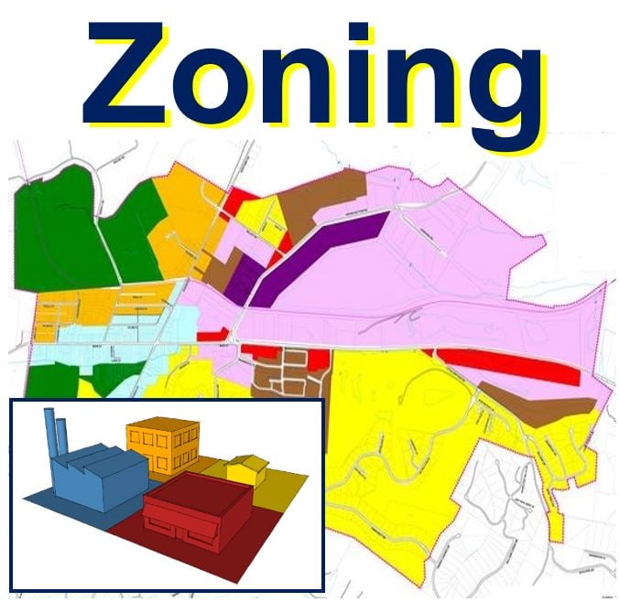
What is Zoning?
Established framework for use and development of land, typically regulated by the states, but dictated and enacted by local governments, based on the idea of separating incompatible uses by including them in different zoning districts.
Notes:
In Pennsylvania, the governing law is the Pennsylvania Municipalities Planning Code (53 P.S. 10101 et seq.)

Slide 17
Why Does Zoning Matter?
Costly “fixes” to abate violations or obtain missing permits and approvals.
Revocation of an occupancy permit, which results in a shut down of operations and use.
Costly litigation that has the potential of shutting down operations and use until resolution.
Notes:
The potential impacts and threats to a property’s use and operations are significant when zoning is ignored or isn’t properly evaluated and addressed.
Your lender likely cares – A LOT.
If you know the universe of issues, you can proactively address and develop a plan with Seller for addressing them.

Slide 18
What You Need to Ask
Zoning Harmony
Zoning District?
Use Permitted?
Bulk / Area Regulations?
Permits / approvals?
Legal Nonconformity?
Rebuild Rights?
Notes:
What zoning district is the property located?
Is the use currently permitted in the zoning district?
If so, what are the applicable bulk and area regulations and does the property or proposed development fit within the confines of the same?
If not, was it permitted and properly approved at its inception?
What is my threshold for rebuild?

Slide 19
Notes:
5 ways to protect yourself:
Don’t sign or commit to anything without first confirming ZONING!
Be proactive with your Purchase Agreement
Due Diligence – give zoning the attention it deserves
Understand the Universe of Inspections
Know your right to rebuild in the event of a casualty
Have a game plan for missing CofOs

Slide 20
Confirm Zoning FIRST!
DON’T
Sign an LOI
Spend time and money negotiating a PSA
Execute a lease
Expend money on an architect /engineer
Buy inventory or equipment
Take on the expense of moving
UNTIL
You confirm your use and development is permitted on the subject property.
Notes:
Most municipal ordinances are available online.

Slide 21
Make the Most of Due Diligence
Include zoning records as part of seller’s required DD disclosures:
Previous zoning reports & verifications
Surveys
Permits
Approvals
Certificates of occupancy
Notices of violation & warning letters
Hire a third-party zoning consultant or land use attorney to prepare an independent zoning report
Utilize the state’s record disclosure law
Review online information
County or municipal assessment information
GIS
Zoning regulations
Analyze the records
Call the municipality
Notes:
PSA provision specifically articulating due diligence items requested related to zoning (e.g., previous zoning reports, surveys, permits and approvals)
Add a third-party zoning consultant or land use attorney to your DD team
Utilize the state’s RTKL
It is an easy, inexpensive process that can yield significant results.
Submit your requests immediately after executing your PSA because municipalities have a generous range of time for response. In PA, it’s 5 BD plus 30 calendar days.
Analyze the Records
Understand what permits and approvals exist for the property and use; analyze any conditions applicable, as approvals and permits will oftentimes contain ongoing conditions or obligations separate and apart from the Zoning Ordinance that as the property owner you must satisfy. Failure to comply can give rise to a violation and puts your certificate of occupancy (operation of the property) at risk.
Records to request and review:
conditional use approvals
special exception approvals
variances
special permits
land development/site plan approval
certificates of occupancy / compliance
business licenses
Call the municipality
Only after PSA executed and in Inspection Period.

Slide 22
Understand What Inspections Are Required / Triggered
Obtaining a Business License
Obtaining a missing Certificate of Occupancy
Transferring a Certificate of Occupancy
Conditions to previous zoning approvals
Mere changes in ownership
Notes:
In addition to your DD inspection, be cognizant of your municipality’s required inspections.
Some municipalities tie inspection requirements to business license registrations or renewals, some tie it to the transfer of a certificate of occupancy, some impose it as a condition to approval, and other stricter municipalities require it upon a mere change in ownership.
PSA provisions (including options for amendment)
Seller handles inspection and pays for all fixes
Seller handles inspection and pays for all fixes up to a certain amount, with buyer having the option to terminate if fix exceeds agreed upon amount and Seller elects not to fix
Escrow by Seller with Buyer fix post-closing

Slide 23
Understand Your Casualty Rebuild Rights
Notes:
Understand going in what, if any, legal nonconformities exist at the property.
Understand the applicable casualty provision
What is the threshold of destruction permitted before losing nonconforming status?
If the use is no longer permitted in the zoning district, or a legal nonconformity exists, continued use of the same post casualty is usually not guaranteed after 50% destruction.
Down Zoning

Slide 24
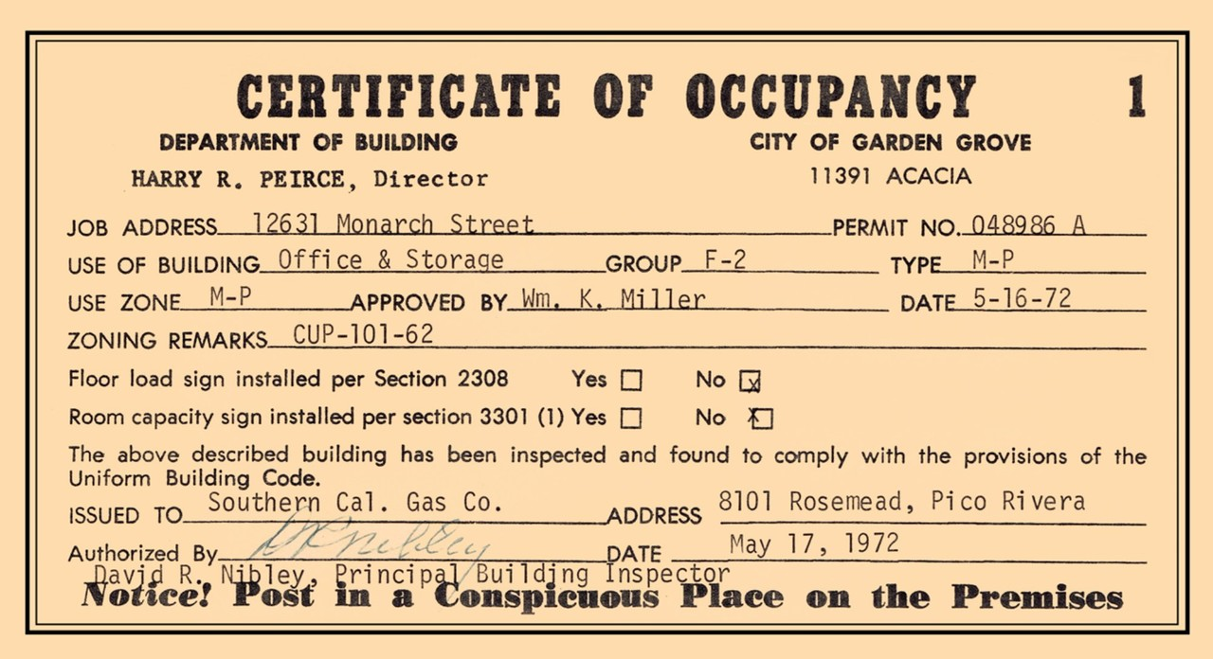
Plan for Missing Certificates of Occupancy
Notes:
There are several reasons a CofO could be unavailable:
Seller or its predecessor never obtained one
Seller and municipality are terrible records keepers
Municipality purges records after so many years
PSA provisions
Be prepared with a “no violation” statement – many lenders will require it.
Ask for retroactive compliance (future sale of property).

Slide 25
Questions?
Mary H. Binker, Esq.
mbinker@babstcalland.com
Kevin T. Wills, Esq.
kwills@babstcalland.com
Jessica M. Barnes, Esq.
jbarnes@babstcalland.com

