Slide 1


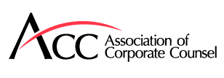
Navigating The Boardroom
Trends And Best Practices For Directors And Board Advisors
25 July 2024 | 12:00PM – 2:00 PM

Slide 2
Navigating the Boardroom – Agenda
Board Room Dynamics
Managing Complex Regulatory Frameworks
  Cybersecurity
  ESG
  AI
Best Practices for Strong Corporate Governance Policies
  Overview of Fiduciary Duties
  Strategies for Board Advisors to Implement Effective Governance Policies
  Tools and Resources for Maintaining Strong Governance
Tips for Aspiring Directors and Board Advisors

Slide 3
Boardroom Dynamics
Perspective from CEO Seat
Perspective from Independent Director Seat
Public vs Private – Differences
    In private company context, private Equity vs Venture Backed company
What Makes a Good Director

Slide 4
Managing Complex Regulatory Frameworks – Cybersecurity
Considerations for allocating responsibility for Cybersecurity oversight
  Audit Committee vs Risk Management Committee
  Inclusion of Cybersecurity expertise in Board skills matrix
  Understanding of key players in investigation/response team
Disclosure requirements Cybersecurity Incidents
  8-K Item 1.05
  Requirement to file form 8-K within 4 business days
  Materiality determination will inform scope of “decision makers” – including potentially prompt briefing of Board
Texas Data Privacy & Security Act
  Effective as of July 1, 2024
  Enforcement posture
  Scope – applies to any person that:
    Conducts business in Texas, or produces a product or service consumed by Texas residents;
    Processes or engages in the sale of personal data; and
    Is not a “small business” as defined by the US Small Business Administration

Slide 5
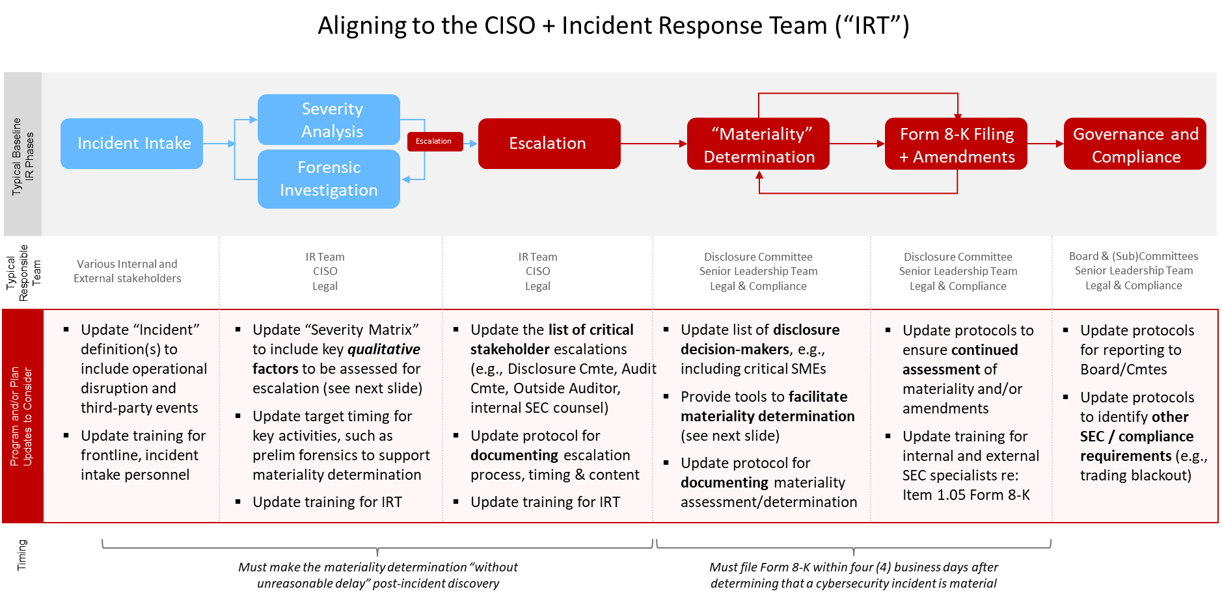
Managing Complex Regulatory Frameworks – Cybersecurity (cont.)

Slide 6
Managing Complex Regulatory Frameworks – ESG
SEC Climate Rules
  April 4, 2024 SEC issued stay in relation to proposed climate disclosure rules. The Rules would have required, among other items, disclosure of board oversight of climate-related risks and any role played by management in addressing and managing a registrant’s material climate-related risks and disclosures related to climate-related targets and goals.
  Despite stay, many companies (including private companies) continuing efforts around climate-specific tracking/goals.
Other considerations for Boards
  International reporting requirements (CSRD, CSDDD etc.)
  Value chain
  Scrutiny around greenwashing
  Anti-ESG Trends
  Stock Exchange requirements and Institutional Investor guidelines

Slide 7
Managing Complex Regulatory Frameworks – AI/Disclosure
Increased opportunity has led to increased scrutiny – expect questions at board level
  EU has published the AI Act (in force from August 1, 2024) and proposed the AI Liability Directive (awaiting committee decision)
  In the United States an Executive Order was issued on October 30, 2023 – leading to proposed rule making by Department of Commerce. Comment period ended on April 29, 2024.
  SEC comments around disclosures focused on:
      Comments around “true” machine learning relative to simple algorithm
      Risks associated with data sets used in machine learning
      Extent to which AI tools are proprietary/developed in-house
      AI “supply chain” participants
AI Washing
SEC Disclosure Considerations

Slide 8
Best Practices for Strong Corporate Governance
Duty of Care
  Requires that, prior to making a business decision, directors act on an informed basis, after due consideration of all material information reasonably available to them and with appropriate deliberation, including the input of legal and financial advisors selected with reasonable care
  When analyzing whether directors have satisfied their duty of care, courts focus on the process used in making the decision. Strategies for satisfying duty of care:
      Avoid haste, as well as the appearance of haste, in making decisions
      Ensure the distribution of pertinent information as far in advance of any meeting as possible
      Carefully review all relevant documents before approving them or authorizing their execution
      Ask questions, probe and test the information presented
      Seek and consider the advice of advisors (lawyers, bankers, etc.) that have relevant expertise on the subject matter of the proposed decision
      Document deliberations carefully, accurately and completely

Slide 9
Best Practices for Strong Corporate Governance
Duty of Loyalty
  Requires that the directors’ actions be motivated solely by the best interest of the corporation and its stockholders, not by the directors’ own interests or for reasons unrelated to the best interests of stockholders generally
  Includes a director’s obligation to act in good faith
  A common area of concern involves “interested” transactions and / or situations in which a director’s personal interests diverge from those of the corporation or its stockholders generally
  Examples of potential conflicts of interest that may implicate the duty of loyalty may include:
      A director buys or sells products, or otherwise engages in commercial relations, with the corporation
      A director is an investor in a competing enterprise
      A director fails to present a business opportunity that might be of interest to the corporation or takes the opportunity for himself / herself (or directs it to another party)
      A director seeks to invest in or acquire the corporation
      A director misuses corporate assets for personal use

Slide 10
Best Practices for Strong Corporate Governance
Duty of Good Faith
    The duty of loyalty includes the duty to act in good faith, which is generally defined by reference to conduct involving “bad faith,” which includes knowing violations of positive law or a conscious disregard of duty
Duty of Disclosure
    Directors are required to disclose all material information to their fellow directors and, when stockholder action is sought, to the corporation’s stockholders
    The duty of disclosure includes a duty not to mislead stockholders and fellow directors
Duty of Oversight
    Directors have a duty to exercise care in overseeing the business and affairs of the corporation, including monitoring key risks
    Liability may be imposed upon directors in connection with their duty of oversight where:
          The directors fail to implement any reporting or information systems or controls, or
          Having implemented such a system or controls, the directors consciously failed to monitor or oversee the operations thereof, thus disabling themselves from being informed of risks or problems requiring their attention

Slide 11
Best Practices for Strong Corporate Governance
Several recent cases in Delaware (a jurisdiction that often sets market expectations) have focused on the importance of the board’s duty of oversight and underscored the importance of ensuring that:
  The corporation has sufficient regulatory and compliance systems enabling the board to monitor key risks
  Regulatory and compliance issues are effectively reported to the board
      Highlights the importance of timely reporting by management to the board to allow board to monitor and respond to potential issues.
  When issues are reported to the board, the board takes initiative to remedy such issues
  Board minutes accurately reflect the reports made to the board and the board’s response
      Directors should ensure that their risk-monitoring efforts are appropriately and specifically documented, including in the meeting minutes
  Liability may be imposed upon directors in connection with their duty of oversight where:
      The directors fail to implement any reporting or information systems or controls or
      Having implemented such a system or controls, the directors consciously failed to monitor or oversee the operations thereof, thus disabling themselves from being informed of risks or problems requiring their attention

Slide 12
Tips for Aspiring Directors
Leveraging a Targeted Network
    Raise interest with directors/advisors in your network
Delivering Required Expertise
    Companies maintain and update a list of key attributes that they seek when evaluating candidates
Understanding the Search Process
    Typically, placements are handled through search firms, stock exchanges also maintain directories/tools to help listed companies identify director candidates
Q&A

Slide 13
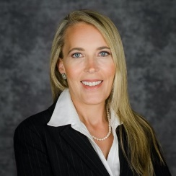
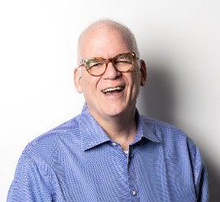
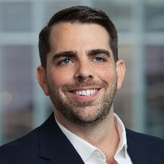
Speakers
Brandie Clevenger
General Counsel
ProTrans
Cotter Cunningham
Chief Executive Officer
ExpertVoice
Sam Rettew
Partner
Austin
Capital Markets
E | samuel.rettew@lw.com
T | +1.737.910.7342

Slide 14
Asia
Beijing
Hong Kong
Seoul
Singapore
Tokyo
Europe
Brussels
Düsseldorf
Frankfurt
Hamburg
London
Madrid
Milan
Munich
Paris
Middle East
Dubai
Riyadh
Tel Aviv
United States
Austin
Boston
Century City
Chicago
Houston
Los Angeles
New York
Orange County
San Diego
San Francisco
Silicon Valley
Washington, D.C.
LW.com
Latham & Watkins operates worldwide as a limited liability partnership organized under the laws of the State of Delaware (USA) with affiliated limited liability partnerships conducting the practice in France, Hong Kong, Italy, Singapore, and the United Kingdom and as an affiliated partnership conducting the practice in Japan. Latham & Watkins operates in Israel through a limited liability company, in South Korea as a Foreign Legal Consultant Office, and in Saudi Arabia through a limited liability company. © Copyright 2023 Latham & Watkins. All Rights Reserved. In connection with this document, you agree not to share with Latham & Watkins any confidential information regarding this potential engagement unless and until an attorney/client relationship is established and agreed-upon in writing. The information, documents (electronic, printed or otherwise) and other materials provided to support this presentation are for general information and training purposes only. The aforementioned, or any other information provided in support of this presentation are not intended to constitute legal advice and should not be relied on or treated as a substitute for legal advice from an appropriately qualified lawyer. While we have made every effort to ensure the accuracy of the information contained in this presentation, we do not accept any responsibility for any reliance on information, documents and materials used in this presentation. This presentation does not establish an attorney-client relationship between you and our firm. All materials used in this presentation, unless otherwise stated, are copyright works of Latham & Watkins. Please see our website for further information regarding our regulatory disclosures.

