Slide 1
Association of Corporate Counsel – St. Louis Chapter
2023 Board Orientation
Board of Directors Code of Ethics
Conflict of Interest Affirmation
Board of Directors Code of Conduct
Bylaws
Committee Report
8) Sponsorship Brochure/Application
2021 Strategic Planning Meeting slide deck

Slide 2
Our St. Louis chapter has more than 654 in-house counsel members representing more than 183 St. Louis metropolitan area companies in diverse industries.
We are a three-time winner of the Association of Corporate Counsel's prestigious Chapter of the Year honor (a national award that was discontinued in 2017).
Since then, our chapter has consistently been designated as a Gold Level Chapter of Distinction (the now highest possible designation by the Association of Corporate Counsel) and, in 2018, 2020, 2021, and 2022 we also received special recognition for our exceptional Diversity Programming in 2020 and 2022.

Slide 3
Board of Directors Code of Ethics and
Procedures for Review of Board Member Conduct
Highlights:
Abide by the bylaws and other rules
Keep membership current
Don’t share confidential information
Use good judgment
Be a good steward of Chapter property and resources
Perform your duties professionally and timely
Return all documents when you your term expires
Act in the ACC’s best interest and not for personal or third-party gain
Procedures for complaints about board members

Slide 4
Conflict of Interest An Annual Affirmation
Members of the board of directors of the Association of Corporate Counsel St. Louis Chapter (ACC- STL) must conduct their personal affairs in such a manner as to avoid any possible conflict of interest with their duties and responsibilities as members of the chapter's board.
ACC-STL Board members are required to attest annually to their familiarity with chapter policies in this regard and to provide information concerning any possible conflict of interest so that disclosure may, if necessary, be made.
I hereby affirm that I have not, to the best of my knowledge and belief, been in a position of possible conflict of interest, except as indicated below:
Financial Interests:
Use of Chapter Services, Property, Facilities:

Slide 5
Association of Corporate Counsel – St. Louis Chapter Board of Directors – Code of Conduct
To become familiar with and committed to:
Understanding the purpose and mission of the ACC and the St. Louis Chapter and advancing the same
Supporting the Chapter by responding promptly to communications, requests, and Board directives
Assessing Board performance
Engaging in strategic planning
Ensuring Chapter resources are directed to benefit the Chapter’s purposes and objectives and to support the Chapter’s membership goals and objectives
Ensuring good organizational management practices and adopting best practices as needed
Determining, monitoring, and enhancing the St. Louis Chapter’s programs and services
Ensuring legal and ethical integrity and maintaining accountability
Recruiting and developing members for future roles on the Board or leading committees
To learn how the ACC, Board, and Chapter function.
To be an ambassador and advocate for the ACC and the St. Louis Chapter.
To prepare for, attend, and participate in Board meetings, the annual Strategic Planning Meeting and committee assignments including:
Attend all board meetings except that each Board Member may be excused from attending no more than three (3) board meetings in any one year. If meetings are planned as in person events, attendance should be in person if reasonably practical. Telephonic and/or video conference attendance is acceptable otherwise when necessary or appropriate and must be arranged in advance with the Chapter Administrator.
For Committee Chairs, attend all committee meetings.
Attend Annual Planning Meeting. If meetings are planned as in person events, attendance should be in person if reasonably practical. Telephonic and/or video conference attendance is acceptable otherwise when necessary or appropriate and must be arranged in advance with the Chapter Administrator. Attendance of any Board Member may be excused by President for good cause.
Make best effort to attend Election of Officers (January).
Make best effort to attend at least four other ACC-sponsored events.

Slide 6
To understand, accept and abide by the responsibilities of the Board as specified in the by-laws.
To vote according to vote according to the best interests of the ACC St. Louis Chapter using critical thinking and analysis.
To support the decisions of the Board and to work with fellow Board members in a collaborative spirit.
To comply with the Association’s Conflict of Interest policy and with other policies & procedures of the ACC, the St. Louis Chapter and the Board.
To refrain from actions and involvement that might prove embarrassing to the Board or the St. Louis Chapter.
To make judgments always on the basis of what is best for the St. Louis Chapter as a whole.
To request additional information and resources (as needed) to discharge my duties.
To resign from the Board if I am unable to carry out the forgoing duties at any time during the course of my term on the Board.

Slide 7
Board Committee Report
Committee:
Submitted By:
Date Submitted:
Report is due the Friday before the Board Meeting and distributed with the Board Agenda Thursday before the Board Meeting.
Decisions Requiring Board Approval / Discussions for the Board:
•
Summary of Committee Activities for the Month:
Committee Meeting Highlights
•
Committee Challenges/Concerns:
•
Committee Successes this month:
•
Marketing & Communication Needs:
•
Committee Roster Changes (List new volunteers and any volunteers that have left your committee or not active):
•
Upcoming Committee Meeting Dates & Locations:
Date, Time, Location
•

Slide 8
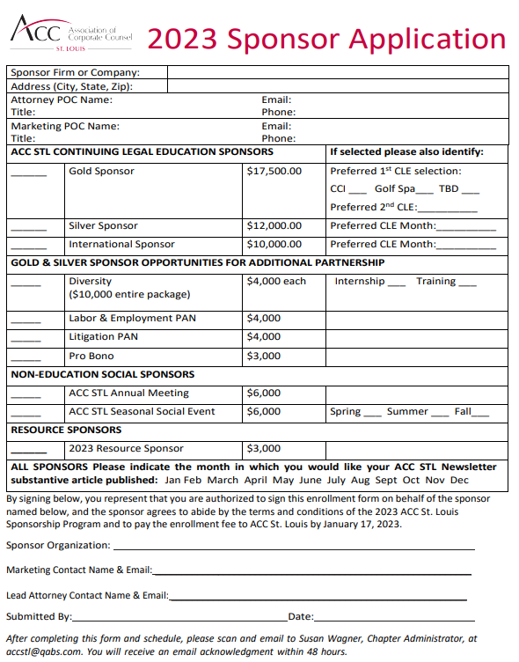

Slide 9
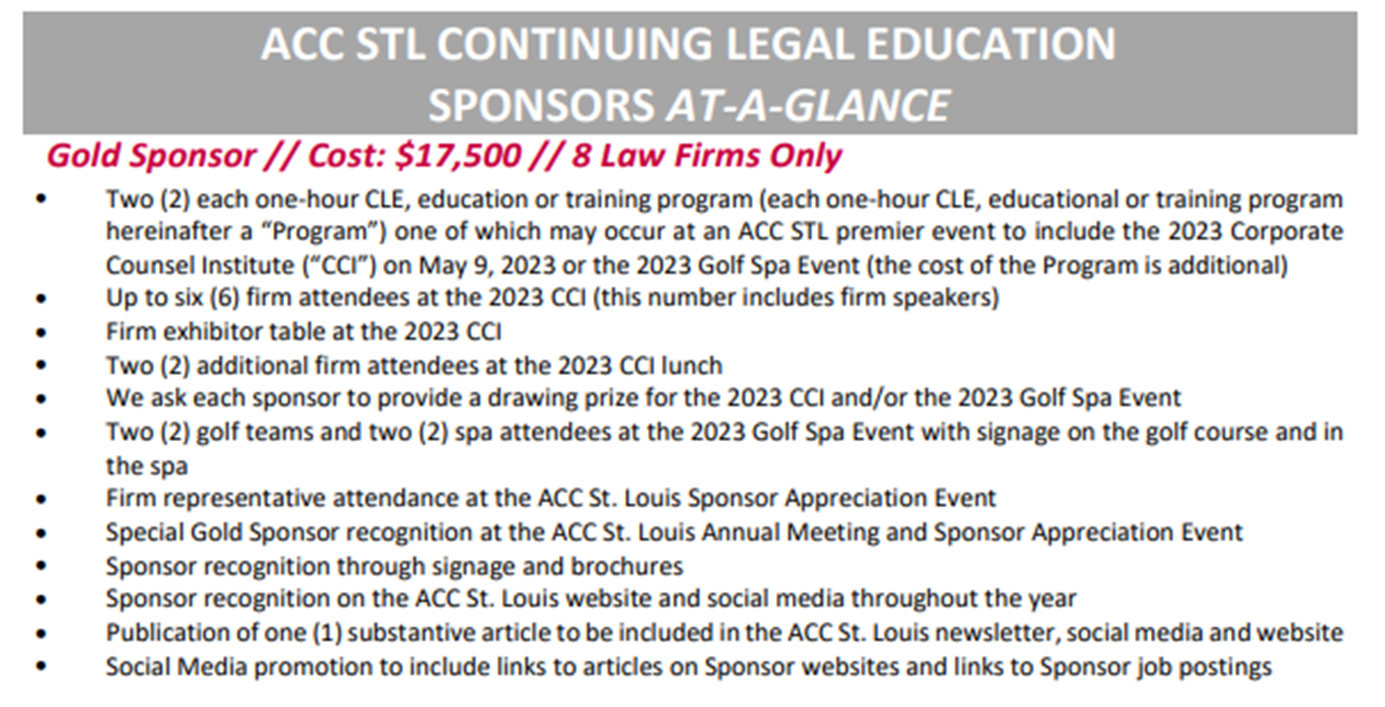
2023 Sponsorship Program

Slide 10
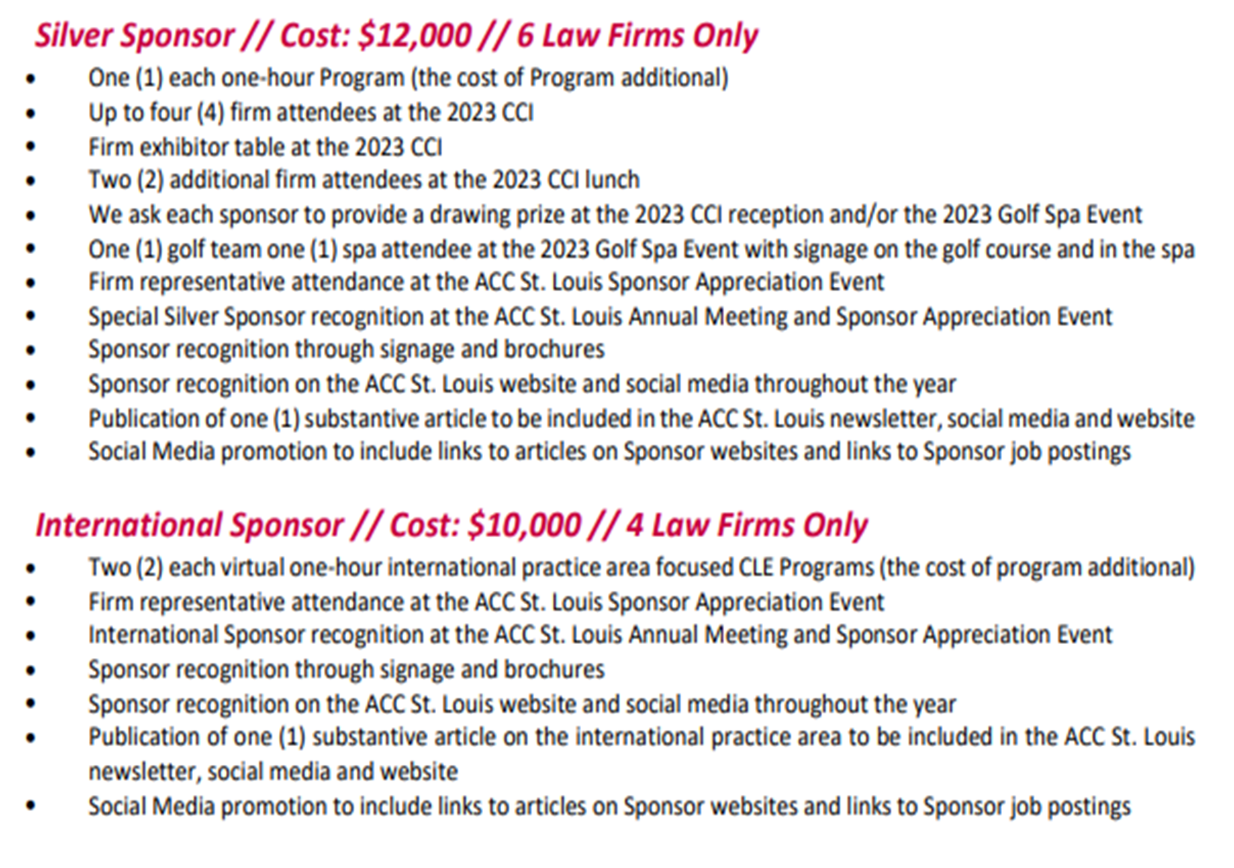

Slide 11
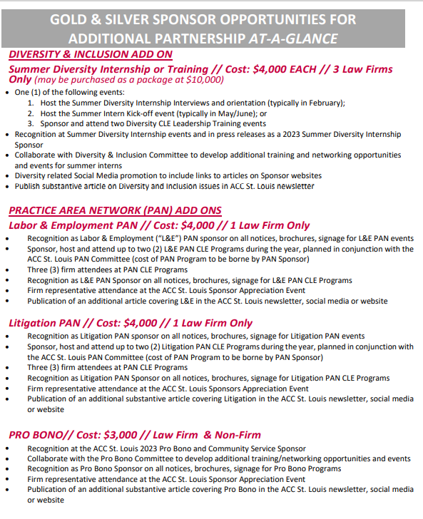

Slide 12
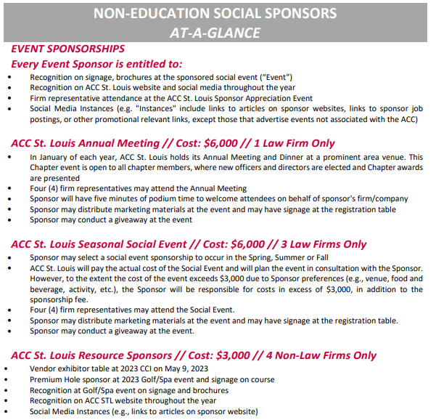

Slide 13
Annual Strategic Planning Meeting
August 19, 2022
Chase Park Plaza

Slide 14
MEETING AGENDA
11:30 – 12:15 pm LUNCH
12:15 – 1:00 pm Kate Krebel Call Board Meeting to Order
1:00 – 1:05 pm Jenny Herner Agenda Review
1:05 – 1:35 pm Kate Krebel 2022 Year-In-Review
1:35 – 1:50 pm BREAK
1:50 – 2:15 pm Beverly Garner Financial Review
2:15 – 3:00 pm Jenny Herner Mission, Vision & 2023 Strategies/Goals
3:00 – 3:15 pm BREAK
3:15 – 5:00 The A-Team Committee Annual Planning
5:00 – 6:00-ish Happy Hour!

Slide 15
Financial Review
Proposed Budget Contained in Packet
Includes <1% decrease in budgeted income
(-$700.00)
Increase income from Sponsorships
Includes 13% decrease in Expenses (primarily because the 2021-22 budget included two CCI events)
Notes:
Goes to National vision of promoting the value of in-house counsel. Example: Benjamin Moore

Slide 16
Financial Review Cont
Proposed Changes to Budget include:
Increased Chapter Administrator Fees
Generalized budget for Mound City Bar Sponsorship to be for Sponsorships of Diversity/Community Relations Events
Increased cost for Golf/Spa Event to reflect annual cost increase
Reduced cost for CCI to cover one event
Notes:
Goes to National vision of promoting the value of in-house counsel. Example: Benjamin Moore

Slide 17
Financial Review Cont
Moved $1,000 of the $1,500 earmarked for the Ambassador Program to the Member Appreciation Event line item for Membership Committee
Moved “In Transition” events from Membership Committee to Professional Development; Membership will target events for New to In-House, etc. and Professional Development will focus on In Transition (between jobs, career changes, planning for and entering retirement, etc.)
Notes:
Goes to National vision of promoting the value of in-house counsel. Example: Benjamin Moore

Slide 18
Mission & Vision
MISSION STATEMENT (Who we are, What we value):
ACC St. Louis is the region's bar association of choice for in-house counsel, promoting the common professional and business interest of its members through information, education, networking and professional development opportunities.
VISION STATEMENT (What we want to become):
ACC St. Louis will be the premier bar association in the region by anticipating, understanding and supporting the needs of its members and serving as a respected and influential voice advancing the interests of in-house counsel.
Notes:
Mission mirrors national.
Vision is missing “helping members deliver services to their clients efficiently” and “delivering a mix of relevant, timely services”. Included in (and strategies for) supporting the needs of its members.
Vision also is missing promoting the value of in-house counsel. Included in (and goal for) advancing the interests of in-house counsel.

Slide 19
Strategies
(How we achieve our vision):
Provide members with opportunities and relevant, timely information and services not available elsewhere
Continue to strengthen the chapter infrastructure to promote more efficient and effective utilization of chapter resources by board and membership
Continue member engagement efforts: surveys (including satisfaction), newsletter, committee recruiting, member profiles
Develop programs that speak to the needs of the next generation
Engage and market to prospective members
Continue sponsor satisfaction & recruiting efforts
Continue partnerships with other bar associations, courts, others
Notes:
Members – resources on website & elsewhere? to promote efficiency and transparency, satisfaction surveys, committee recruiting, next-gen programming (CD), prospective members (CD), relevant and timely services
Sponsors – recruiting, early engagement, litigation PAN, satisfaction surveys

Slide 20
Goals
(How we gauge our success):
The chapter meets the needs of in-house counsel, including the next generation and those new to in-house
The profile of in-house counsel within their companies and the community is elevated
The chapter is the voice of the St. Louis area in-house community
Members are engaged and satisfied
Increased sponsorship and sponsor satisfaction
The chapter retains recognition at the national level
Notes:
Goes to National vision of promoting the value of in-house counsel. Example: Benjamin Moore

Slide 21
Membership Strategies
Continue to deliver a mix of relevant, timely services
Example: Russian trade compliance CLE
Continue to promote efficiency and effective use of chapter resources by board and members
Scorecard and use of Egnyte by Board
Website resources for membership
Highlighting National and Sponsor resources
Continue member engagement
DE&I programming
Surveys
Satisfaction surveys
Committee recruiting (website?)
Newsletter
Member (and dog!) profiles
Next-gen programming (Chapter of Distinction)
Example: New to in-house program
Recruiting prospective members (Chapter of Distinction)
Social events!
Notes:
Goes to National vision of promoting the value of in-house counsel. Example: Benjamin Moore

Slide 22
Sponsorship Strategies
Sponsor recruiting
Current openings (Bridges, Annual meeting, Litigation, Pro Bono)
New categories?
Non-legal sponsors (e.g. CCI & Golf/Spa)
New law firms
Small firm engagement (continued)
Use of website?
Continue sponsor satisfaction efforts
1:1
Events
Use of surveys?
Sponsor profiles?
Continue early (and year-round) engagement
Notes:
Goes to National vision of promoting the value of in-house counsel. Example: Benjamin Moore

Slide 23
Partnership Strategies
Advocacy (Courts, Government)
Street Law
Law School Relations (SLU, Wash U)
Pro Bono (LSEM, local charities)
BAR ASSOCIATIONS
BAMSL
Women’s Lawyers’ Association of Greater St. Louis
South Asian Bar Association of Metropolitan St. Louis
Hispanic Bar Association of St. Louis
Mound City Bar Association
Mid-America Bar Association
OTHER (SHRM)
Notes:
Goes to National vision of promoting the value of in-house counsel. Example: Benjamin Moore

