Slide 1
Privacy and Security 101
Presented by: Alex Cox
October 30, 2024

Slide 2
Agenda
Privacy and Security Threats and Challenges
Security Awareness
Legal and Regulatory Requirements
Common Incidents and Mitigation Checklist
State Breach Laws (General Applicability)
What exactly is Personal Information?
Definition of a “Breach”
State Insurance Breach Laws
What is a risk of harm standard?
Special laws (Bulletins, NAIC Model, NY DFS)
HIPAA
Definition of a “Breach”
Risk Assessments

Slide 3
Basic Understanding of Privacy and Cybersecurity Challenges and Threats
Privacy and Cybersecurity issues differ based on
Jurisdiction: U.S. federal and state; EU and others
Type of Information: Personal Information, Nonpublic Personal Information, Personally Identifiable Information, Protected Health Information, Payment Cardholder Data, Consumer Reports, data about children, …
Also, confidential company and third party information
Context: direct and indirect collection, website collection, third-party “observers,” gov’t v. private, Big Data, Internet of Things, …

Slide 4
Basic Understanding of Privacy and Cybersecurity Challenges and Threats
Privacy and Cybersecurity Challenges and Threats
What Threats?
Insider
Negligence (Common)
Including loss of data by vendors
Malicious
Outsider
Malicious
Average cost of a 2020 US data breach: $8.65mm (IBM Cost Survey)
Post-Ukraine shift, moving back to business as usual now
Hacking of companies by state-sponsored actors
Ransomware and Cryptojacking
Both Indiscriminate and Targeted Intrusions

Slide 5
Risks and Reputation
Risks to the Company
Reputational Harm in a Privacy Violation or Cybersecurity Incident
First Party Costs in Addressing a Cybersecurity Incident
Forensics costs
Remediation costs to restore systems and data
Legally Required Notifications
Affected Third Parties
Government Agencies
Credit Monitoring and Restoration Costs
Settlements of Enforcement Actions and Litigation

Slide 6
Be The Human Firewall
Most breaches are tied to email
Know Normal
Thoughtful Pauses
See Something, Say Something
Recognize Social Engineering
Be Less Social
Recognize Phishing
Use The Right Address
Strong/Different Passphrases
Mobile Smart
Recognize and Report Fraud

Slide 7
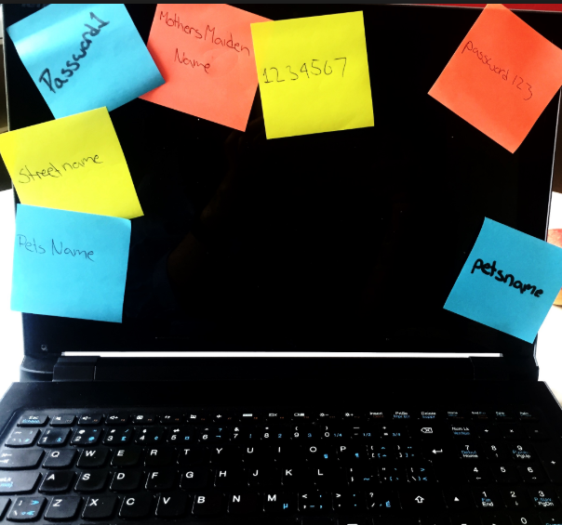
Stop Using Passwords
Complex Passwords are complex
P(m>N/2)=n∑2nd
So we write them down
Or we make minor changes when forced to
P@ssw0rd P@55word
Summer2020 Winter2020
And Passwords are easy to crack

Slide 8
Passphrases Are Better
Length Adds Strength
Passphrases Are Easy To Remember
Use a lyric or goal
I will Read 1 Book a Week!
Captcha, I Am not A Robot!
Still need help with a passphrase?
https://www.useapassphrase.com/

Slide 9
Passphrase /Account Checklist
Use different passphrases for different sites
Use 4 character sets:
Always couple MFA with your Passphrase
Treat your passphrase like your toothbrush
Don’t share
Change every 90 days
Don’t use public computers
Be skeptical of websites requiring personal information
No need to be truthful when answering identity questions
Delete accounts you no longer use
Upper Case
Lower Case
Numbers
Special Characters

Slide 10
Use The Right Address
Keep the Company digital footprint small
Company email address for Company use only
Not a login to Facebook, Amazon, banking, shopping,…
Only use Company email for Company business
Webmail accounts are not confidential
Be a customer, not a product
Use different email accounts for:
Personal Confidential
Personal Social Networks
Spam Catchers

Slide 11
10 Ways to Catch More Phish (and Fraud)
Report Phishing – Leverage machine learning system
Check the Address – Consistent with name/sender
Why Me? – Is this email relevant?
Avoid Urgent – Take a thoughtful pause
Avoid Appeals – Too good to be true, fear, negative consequence
Be Skeptical – Stop and check links and attachments
Phone It In – Pick up the phone and call the sender/requester
Spelling Matters – Typos/bad grammar are warning signals
Hover to Discover/Press and Hold on Mobile
Don’t Unsubscribe – Add to junk senders

Slide 12
Phone Hacking Video Segment
Phone network is based on access to “SS7”
Your phone can be spoofed easily, so do not rely on your phone for important security verification
https://youtu.be/wVyu7NB7W6Y?si=SaBGMjcQ-rDdwh-c&t=788
Demonstration starts at 13:08
3-minute demonstration segment

Slide 13
Legal and Regulatory Requirements
Federal Privacy Requirements
Sector-based requirements
Financial Services: GLBA, Fair Credit Reporting Act (FCRA)
Healthcare: HIPAA
Currently, no federal privacy law of general applicability, while there have been numerous proposals, but in the meantime:
Consumer protection laws act as a stand-in for the lack of a general federal privacy law
FTC Act §5 “unfair or deceptive acts or practices”

Slide 14
Legal and Regulatory Requirements
State Privacy Requirements
CCPA (California Consumer Privacy Act)
“Consumer” means California resident (Employee / b2b included)
“Personal information” means any information reasonably identifiable to a consumer or household
Requirements:
Assessments, Security & Processing (pending regs)
Consumer rights
Contracting with third parties / service providers
Disclosures, training, others
Other states . . .

Slide 15
Legal and Regulatory Requirements
Other State Requirements in, CT, CO, VA, UT.
Texas and Oregon Effective 7/1/24
Montana Effective 10/1/24
Applicability changes
GLBA entity exemption nuances, new pattern.
GDPR Comparison

Slide 16
Legal and Regulatory Requirements
State Cybersecurity Requirements
Sector-based
Financial Services
NY Department of Financial Services Cybersecurity Regulation 23 NYCRR Part 500
Requires protection of critical operating systems as well as information systems and nonpublic information
National Association of Insurance Commissioners Insurance Data Protection Model Law
Adopted in 24 states, so far
AL, CT, DE, HI, IL, IN, IA, KY, LA, ME, MD, MI, MN, MS, NH, ND, OH, OK, PA, SC, TN, VT, VA, WI

Slide 17
Legal and Regulatory Requirements
NY DFS Update
Effective November 1, 2023, Compliance began Dec 1, 2023.
30 days (December 1, 2023) new requirements for the annual certification of compliance, and notices of extortion payments (Section 500.17).
One year (November 1, 2024) new governance requirements (Section 500.4), encryption (Section 500.15), and incident response and business continuity (Section 500.16); and for the changes to the limited exemptions (Section 500.19(a)).
18 months (May 1, 2025) vulnerability scans (Section 500.5(a)(2)), access privileges (Section 500.7), and monitoring and training (Section 500.14(a)(2) and (b)).
Two years (November 1, 2025) multi-factor authentication (Section 12), asset management and data retention (Section 500.13(a)).
Requirements overhaul, changes to limited exemptions
Notification changes
Ransomware and extortion payments

Slide 18
Legal and Regulatory Requirements
State Cybersecurity Requirements
General Applicability
Breach Notification Laws began in CA, now in all states
Often include requirement to provide reasonable security
Apply to Personal Information or Personally Identifiable Information
Usually electronic format; some include paper
Definitions vary, but generally,
Name (first, or first initial, and last name) plus any of
Social Security number, driver’s license or other state issued ID,
Payment card number, or
Financial account number (usually with access code or PIN)
Increasingly, health and medical, date of birth, biometric data, online account credentials, precise geolocation
Often “harm” threshold

Slide 19
Legal and Regulatory Requirements
State Cybersecurity Requirements
Massachusetts Data Security Regulation (201 CMR 17) (March 1, 2010)
First in the nation
General applicability
Specifically requires
Written Comprehensive Information Security Program
Administrative, Technical and Physical Safeguards
Risk Assessment
Vendor Risk Management
Computer Security Requirements
Encryption
Authentication protocols
Access controls
Monitoring of systems
Education and training
Applies to
Personal Information in any format, unencrypted

Slide 20
Incident Analysis Issues
Uncommon Incidents -> Escalate & Follow Process
Common Causes of Incidents
Mailing error (direct or following internal administration)
Mistaken disclosure over the phone
Fax sent to incorrect recipient
Email sent to incorrect recipient
Mitigation Checklist for Common Incidents
Clearly identify the individuals who have handled or accessed the information inappropriately disclosed
Determine exactly what identifiers of “Personal Information” were included in the information
Determine the scope of any onward disclosures (if any)
Obtain adequate assurance that information inappropriately disclosed is returned or destroyed

Slide 21
Common Exit Ramps
Is this “Personal Information”?
in the state of residence of the individual affected
Is this a “Breach”?
(in the state of residence of the individual affected)
In the background, consider insurance laws & HIPAA.

Slide 22
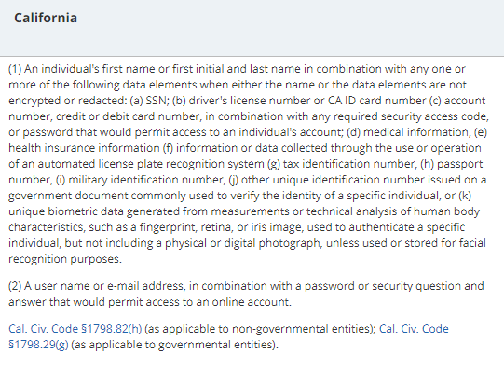
State Breach Law PI Definition (What is Personal Information?)

Slide 23
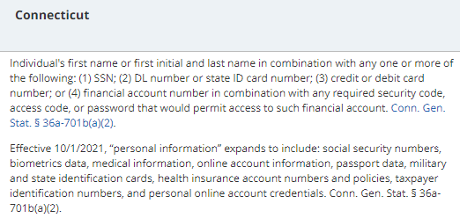
State Breach Law PI Definition (What is Personal Information?)

Slide 24
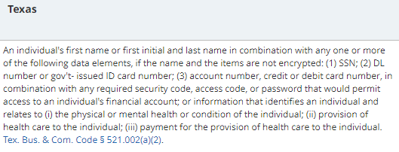
State Breach Law PI Definition (What is Personal Information?)

Slide 25
State Breach Law Breach Definition (What is a Breach?)

Slide 26
Mitigation Checklist (Again)
Creating the exit ramp
Mitigation Checklist for Common Incidents
Clearly identify the individuals who have handled or accessed the information inappropriately disclosed
Determine exactly what identifiers of “Personal Information” were included in the information
Determine the scope of any onward disclosures (if any)
Obtain adequate assurance that information inappropriately disclosed is returned or destroyed

Slide 27
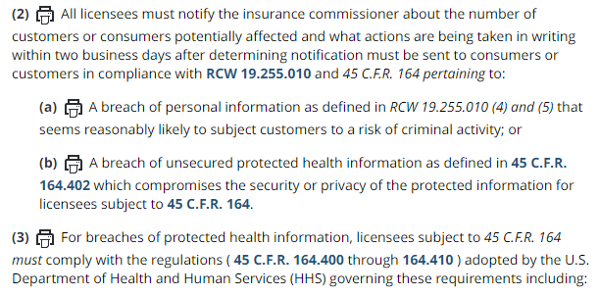
State Insurance Breach Requirements (Laws & Regs)
Washington State law

Slide 28
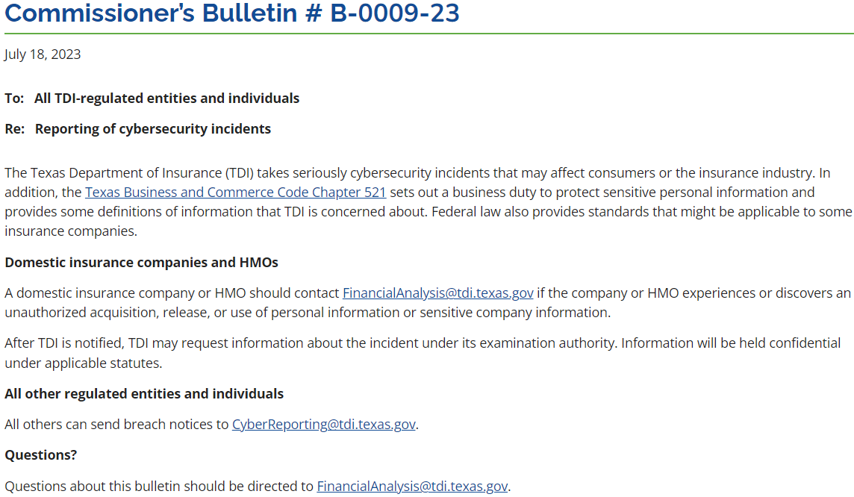
State Insurance Breach Requirements (Bulletins)
Texas Bulletin

Slide 29
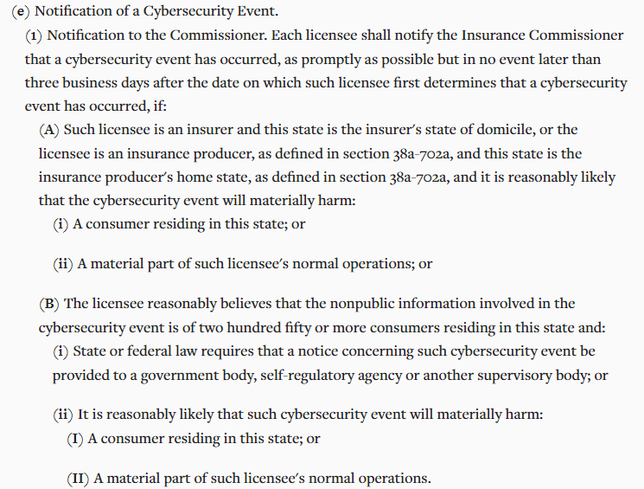
State Insurance Breach Requirements (NAIC)
Connecticut Insurance Data Security Law
(NAIC Model)

Slide 30
State Insurance Breach Requirements (NY DFS)
New York Department of Financial Services Cybersecurity Regulation
“Cybersecurity incident” means a cybersecurity event that has occurred at the covered entity, its affiliates, or a third-party service provider that:
impacts the covered entity and requires the covered entity to notify any government body, self-regulatory agency or any other supervisory body;
has a reasonable likelihood of materially harming any material part of the normal operation(s) of the covered entity; or
results in the deployment of ransomware within a material part of the covered entity’s information systems.
“any government body”
If any regulator needs to be notified, New York requires notice. VA, similar.

Slide 31
A Breach Under HIPAA
Under the Rule, a breach is defined as: “the acquisition, access, use, or disclosure of protected health information in a manner not permitted under subpart E of this part which compromises the security or privacy of the protected health information.
(1) Breach excludes:
(i) Any unintentional acquisition, access, or use of protected health information by a workforce member or person acting under the authority of a covered entity or a business associate, if such acquisition, access, or use was made in good faith and within the scope of authority and does not result in further use or disclosure in a manner not permitted under subpart E of this part.
(ii) Any inadvertent disclosure by a person who is authorized to access protected health information at a covered entity or business associate to another person authorized to access protected health information at the same covered entity or business associate, or organized health care arrangement in which the covered entity participates, and the information received as a result of such disclosure is not further used or disclosed in a manner not permitted under subpart E of this part.
(iii) A disclosure of protected health information where a covered entity or business associate has a good faith belief that an unauthorized person to whom the disclosure was made would not reasonably have been able to retain such information.

Slide 32
HIPAA Risk Assessment
(2) Except as provided in paragraph (1) of this definition, an acquisition, access, use, or disclosure of protected health information in a manner not permitted under subpart E is presumed to be a breach unless the covered entity or business associate, as applicable, demonstrates that there is a low probability that the protected health information has been compromised based on a risk assessment of at least the following factors:
(i) The nature and extent of the protected health information involved, including the types of identifiers and the likelihood of re-identification;
(ii) The unauthorized person who used the protected health information or to whom the disclosure was made;
(iii) Whether the protected health information was actually acquired or viewed; and
(iv) The extent to which the risk to the protected health information has been mitigated.”

Slide 33
Questions?
Alexander R. Cox
Associate
Hartford
860-541-7756
alex.cox@lockelord.com

