Slide 1
Unlocking the Future: An Introduction to Artificial Intelligence
ACC In-house Paralegal Conference
Regina Graziani, Esq.
October 30, 2024

Slide 2
Importance of this Conversation
If the only tool you have is a hammer, you tend to see everything problem as a nail.
- Maslow
I skate to where the puck is going, not where it has been.
- Wayne Gretzky

Slide 3
Why this Conversation is Important
ABA Model Rules of Professional Conduct
Require: “to maintain the requisite knowledge and skill, a lawyer should keep abreast of changes in the law and its practice, including the benefits and risks associated with relevant technology”
ABA Task Force on Law and Artificial Intelligence
“make recommendations and articulate principles to help ensure that the creation and incorporation of AI is done in accordance with the law and well-accepted standards”

Slide 4
What Lawyers Are Saying
GenAI use on the rise:
  Corporate legal
    2023: 30% considering
    2024: 41% considering
  Corporate tax, accounting, and audit
    2023: 21% considering
    2024: 31% considering
    *Thomson Reuters Institute 2024 Generative AI in Professional Services study

Slide 5
What is Artificial Intelligence?
Innovation is taking two things that exist and putting them together in a new way.
- Tom Freston (cofounder of MTV)

Slide 6
What is AI?
the simulation of human intelligence in machines
A goal of AI is to mimic human cognitive activity
AI systems leverage intelligent algorithms that classify, analyze, and make predictions from large data collections

Slide 7

What is AI?
AI first appeared in the 1950s
  Scientists, mathematicians, and philosophers began to develop programs designed to mimic problem-solving skills of a human
  Integrated into technology, banking, marketing, and entertainment

Slide 8

What is AI?
  Large part of our lives:
    Siri, Alexa
    Email spam filters
    Netflix recommendations
    Facebook recommendations
    Word predictors on phone and Word
    Self-driving cars
    Google searches

Slide 9
What Is Generative AI?
GenAI is a form of AI that can create a wide variety of data, such as images, videos, audio, text, and 3D models.
Learns patterns from existing data and then uses this knowledge to generate new and unique outputs
Gained notoriety in 2022 with OpenAI’s launch of ChatGPT

Slide 10
AI Tools in Legal Practice
The secret of change is to focus all of your energy not on fighting the old but building on the new.
-Socrates

Slide 11
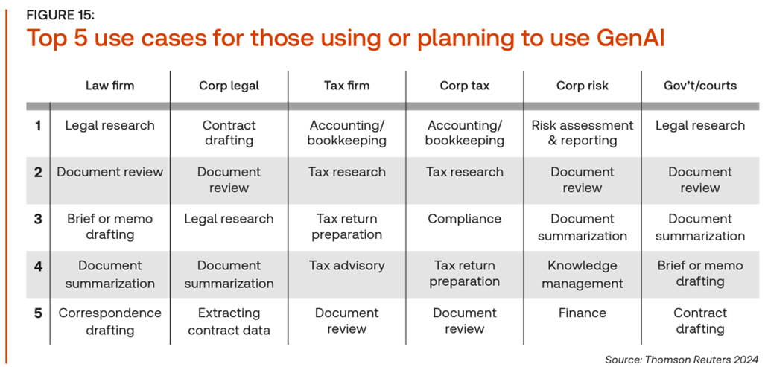
GenAI in Use

Slide 12
Lawyer’s Skills v. Artificial Intelligence
Lawyer’s skills | AI | Lawyer’s skills | AI
Analysing | X | Problem solving
Attention to detail |  | Reasoning
Commercial acumen |  | Relationship building
Communication – oral and listening |  | Research | X
Communication – written | X | Resilience | X
Contextualising information |  | Reviewing | X
Decision making |  | Summarizing | X
Drafting | X | Tasks done at scale | X
Emotional intelligence |  | Tasks done concurrently
Experience |  | Tasks done to deadlines | X
Extracting information | X | Teamwork
Independence |  | Time management
Initiative |  | Think abstractly
Judgment |  | Think critically
Negotiating |  | Think logically

Slide 13
Legal Research and Case Analysis
Quick Summaries: quickly summarize case law, statutes, and regulations, helping to efficiently grasp the essential elements of complex legal texts.
Case Precedent Search: by generating summaries of similar cases and identifying key judicial reasoning, can assist attorneys and paralegals in finding relevant precedent faster.
Contextual Searches: provide answers to specific legal questions by scanning through large volumes of legal documents, offering concise responses based on current laws and case precedents.

Slide 14
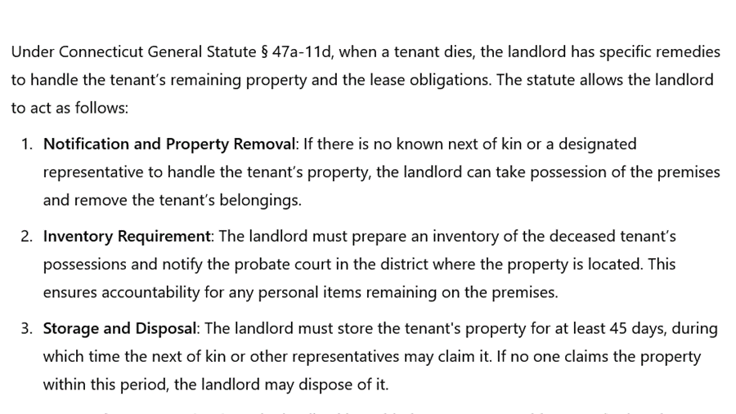
Summary of a Statute
Query: please summarize the landlord’s remedies upon the death of a tenant under Connecticut General Statute § 47a-11d

Slide 15
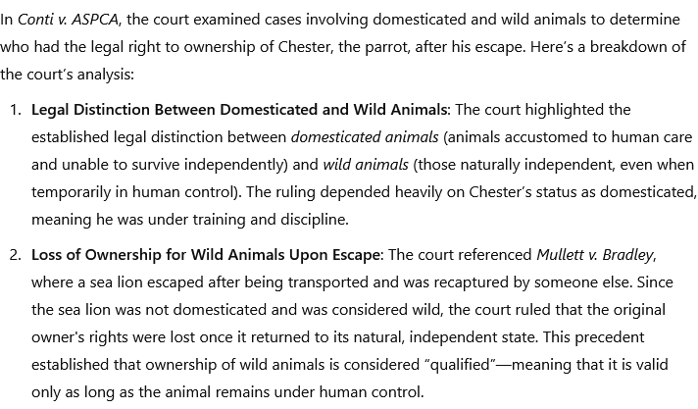
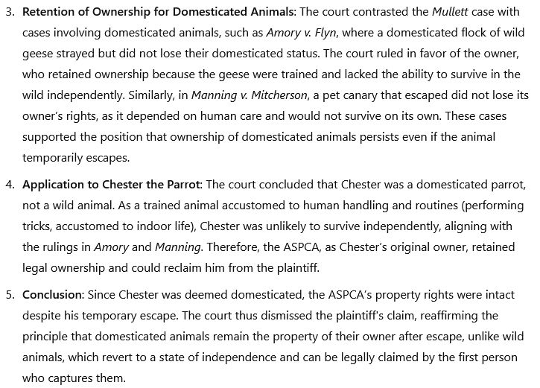
Summary of a Case
Query: please explain the court’s analysis of the cases regarding domesticated and wild animals using the uploaded case opinion (Conti v. ASPCA).

Slide 16
Contract Review and Drafting
Automated Contract Drafting: draft initial versions of legal documents, such as contracts, agreements, NDAs, and wills, based on specific inputs from the user. This speeds reduces drafting time.
Clause Comparison: highlight differences between contract clauses, helping review terms and conditions more efficiently, ensuring consistency, and spotting potential red flags.
Contract Summaries: summarize lengthy contracts into concise points, enabling attorneys, paralegals, or clients to review key terms quickly.

Slide 17
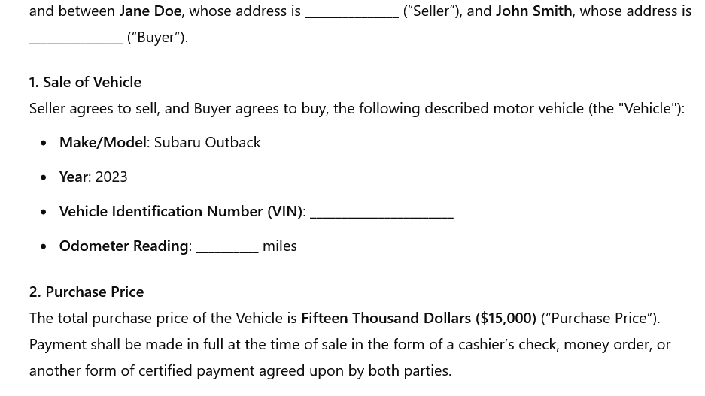
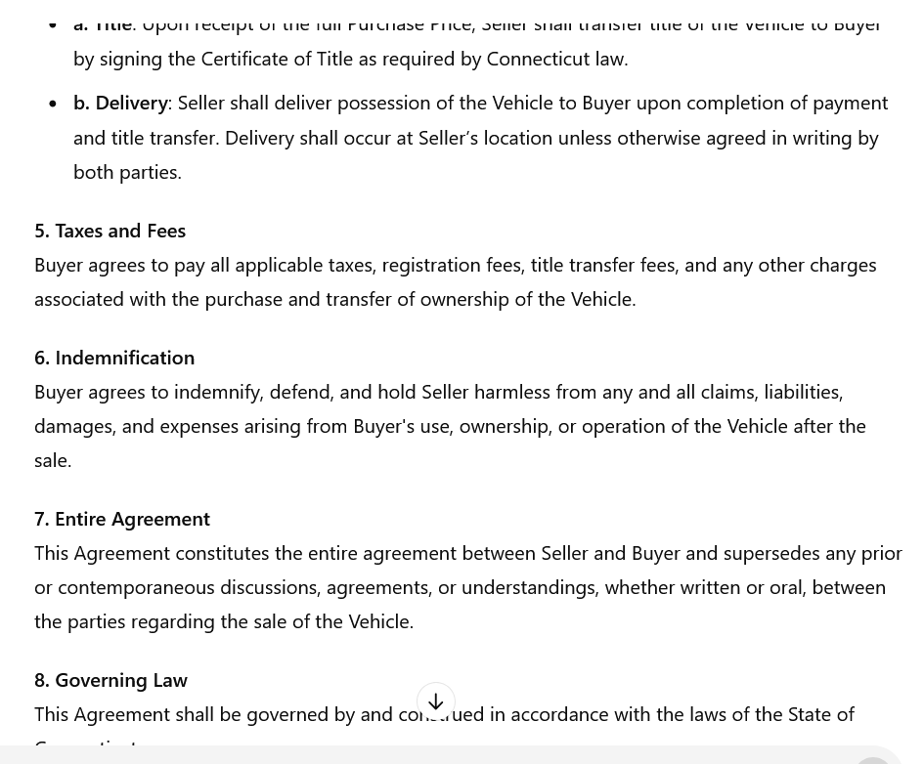
Contract Drafting
Query: create a contract for the same of a 2023 Toyota Prius from Jane Doe to John Smith in Connecticut for the sale price of $15,000. The contract should contain the usual representations and warranties for such a sale.

Slide 18
Litigation Support
Deposition Preparation: suggest deposition questions based on case facts or generate lists of questions for different stages of the litigation process.
Evidence Review: help organize and review large sets of evidence by extracting relevant information, identifying themes, and summarizing witness statements.
Discovery Document Analysis: analyze documents produced during discovery, helping attorneys identify significant facts, patterns, and key evidence within massive volumes of information.

Slide 19
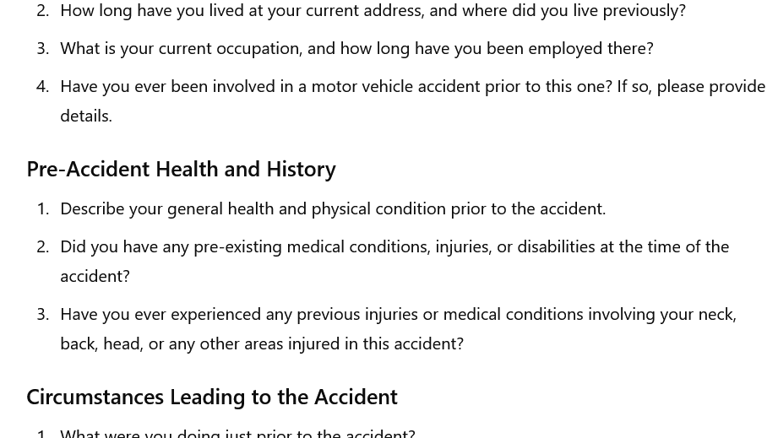
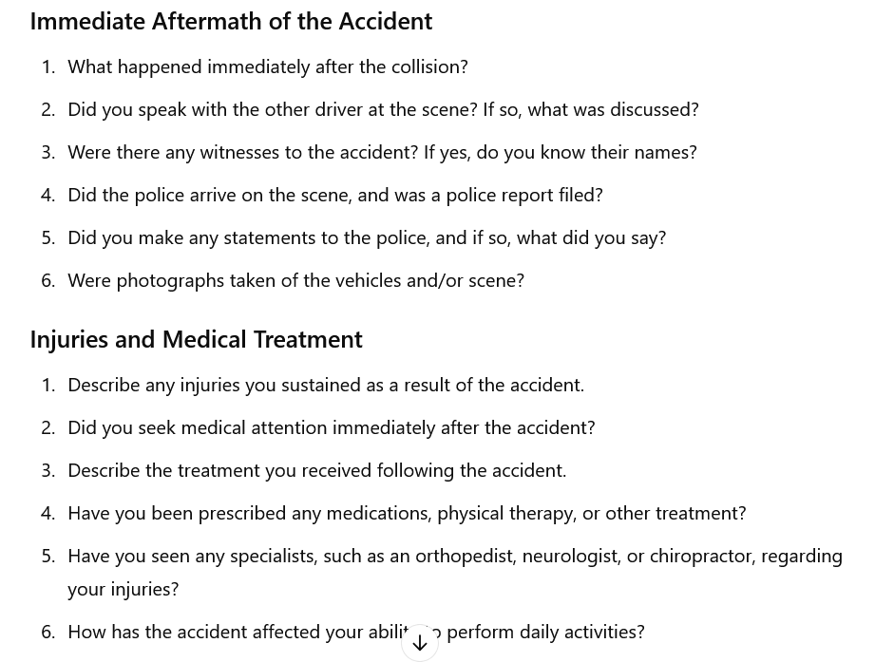
Deposition Preparation
Query: develop a list of deposition questions for the plaintiff in a routine motor vehicle accident in Connecticut.

Slide 20
Compliance and Regulatory Monitoring
Compliance Assistance: In heavily regulated industries, can aid in developing compliance frameworks, updating protocols, and drafting regulatory reports.
Automated Alerts: monitor legal developments in specific areas, providing alerts and summaries on new rulings, laws, or regulations relevant to the firm’s clients.
Policy Analysis: help review and interpret regulatory changes, compare new policies with existing ones, and highlight relevant differences or impacts on clients’ operations.

Slide 21
Drafting and Editing for Legal Communications
Proofreading and Formatting: suggest corrections, improve grammar, check for legal citation formats, and ensure that documents are consistent in style and presentation.
Simplifying Language for Clients: For attorneys working with clients who may not be familiar with legal terminology, GenAI can translate complex legal terms and jargon into more accessible language.
Legal Memos and Briefs: generate drafts or outlines for legal memos, briefs, and letters, saving time on initial drafting.

Slide 22
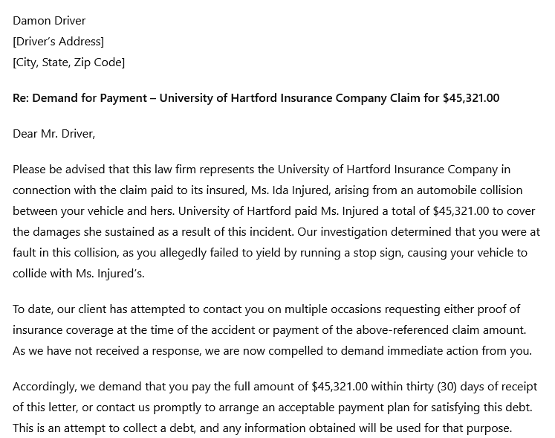
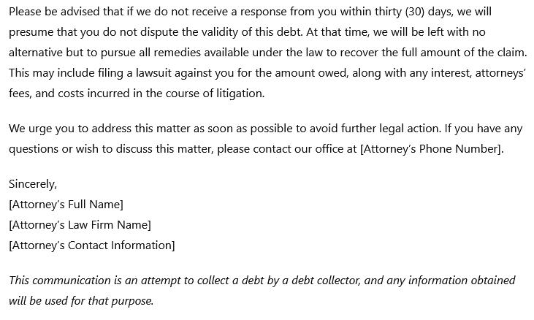
Drafting Legal Communication

Slide 23
Predictive Analytics in Litigation
Outcome Prediction: assist in predicting case outcomes by analyzing past case data, helping lawyers estimate the likelihood of success based on case characteristics.
Settlement Valuations: based on historical settlement data, can help attorneys assess likely settlement values for various types of cases, providing insights into risk assessment.
Strategy Recommendations: suggest litigation strategies based on analysis of prior cases with similar legal issues, potentially informing decisions on whether to settle or proceed to trial.

Slide 24
Document Automation and Management
Template Generation: for routine documents like motions, briefs, and discovery requests, can create templates that can be customized for specific cases.
Text Extraction from PDFs: extract and organize information from scanned PDFs or unstructured documents, saving time on data entry and analysis.
Data Categorization: categorize documents in a case by type (e.g., correspondence, pleadings, contracts) or topic, making it easier to manage case files.

Slide 25
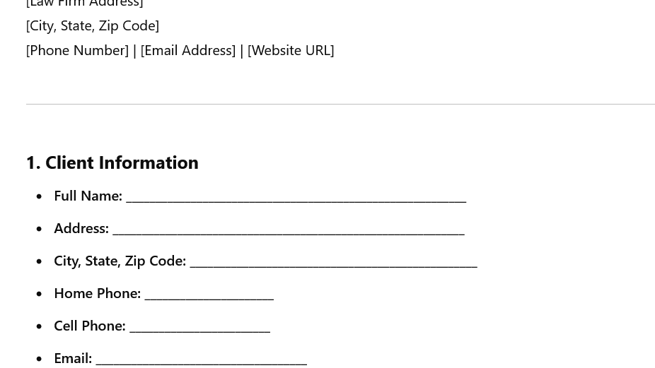
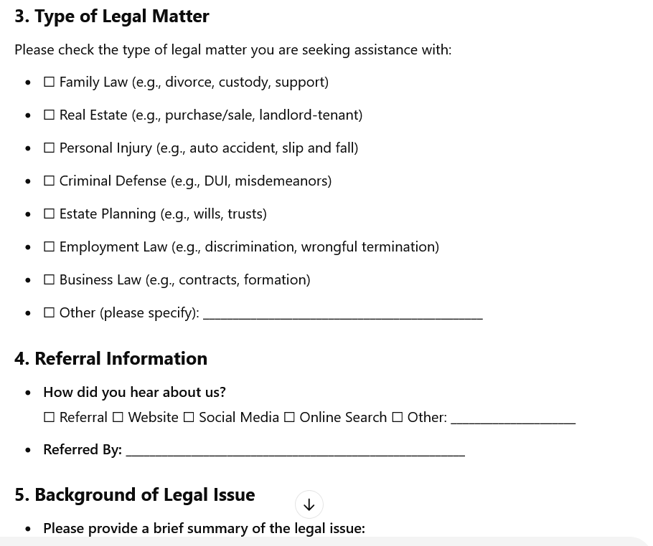
Document Automation
Query: draft a client intake template for a small general practice law firm in Connecticut.

Slide 26
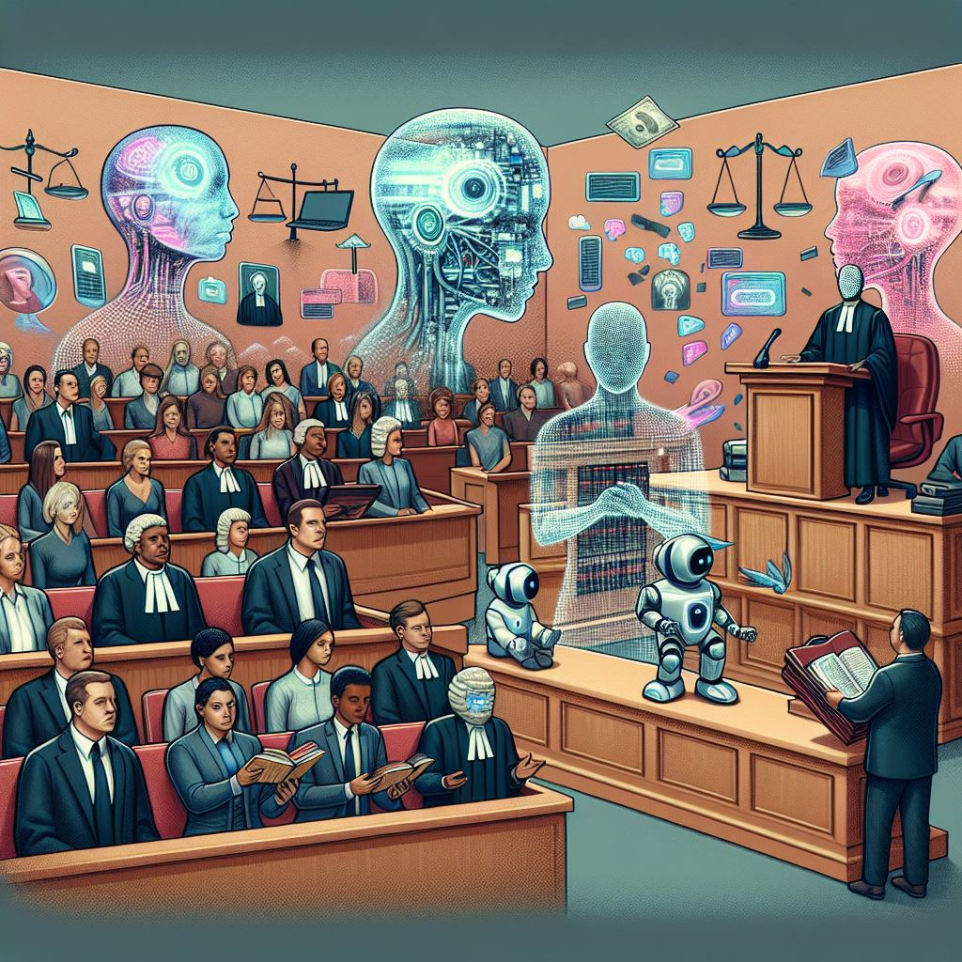
GenAI Challenges/Risks
Hallucinations
  Produce text that appears credible, but isn’t
  Make up facts, cases, create erroneous outcomes

Slide 27

GenAI Challenges/Risks
Incompleteness
  Failure to address the user’s query properly
  Failure to provide proper case (or other) citations
  Inconsistency in responses

Slide 28
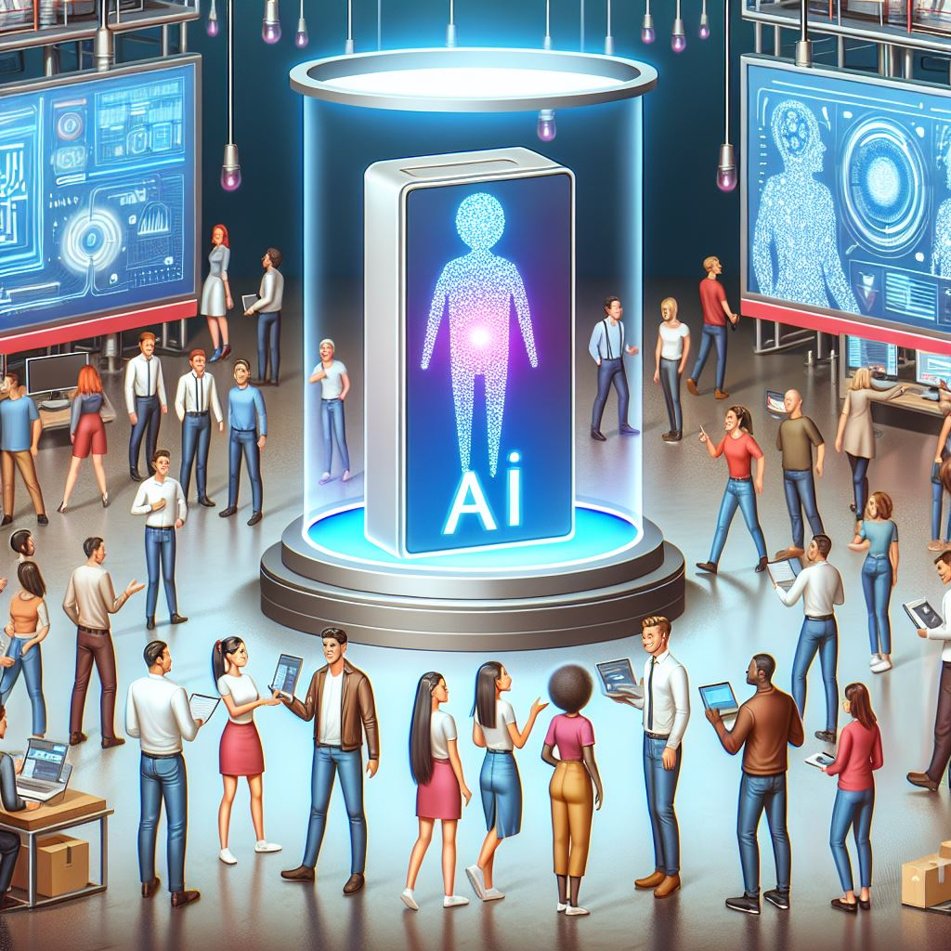
GenAI Challenges/Risks
Bias
  Misconception: with removal (or reduction) of human decision making comes a decision clean from implicit bias
  Reality: AI algorithms can collect biases historical data – AI system may also inadvertently produce biased results

Slide 29
Ethical Considerations/Concerns
Competent representation/competence
Client communication
Client informed consent
Risks to client confidential data, inadvertent waiver of attorney-client and attorney work product privileges

Slide 30
What Does This Mean for Paralegals?
Enhanced Research Capabilities: quickly summarize case law, statutes, and legal precedents, allowing paralegals to retrieve essential information more efficiently. This reduces time spent on repetitive research and enables them to provide faster, high-quality support to attorneys
Streamlined Document Review: assist paralegals in reviewing large volumes of documents, such as discovery materials, by identifying key themes, organizing evidence, and categorizing files. This increases productivity and gives paralegals more time to focus on higher-value tasks
Client Communication Support: simplify complex legal language for client communications, helping paralegals draft letters and summaries that are easy for clients to understand. This improves client interactions and ensures effective communication without requiring extensive rewrites
Efficient Contract Drafting and Review: By generating contract templates and suggesting revisions, paralegals can participate more actively in contract management. They can ensure compliance, catch errors, and provide initial drafts for attorney review, adding value to their role in the contract lifecycle

Slide 31
Key Takeaways for Paralegals
AI Skills and Knowledge Needed
  Identification and assessment of what GenAI to use and for what purposes
  Familiarity with AI concepts and models
  Prompt engineering for law
  Data literacy and ethics

Slide 32
Thank you!
Questions?

