Slide 1
Generative AI & the Law: Overview of the Key Legal & Ethical Issues
April 9, 2024

Slide 2
Google Worldwide Search Queries for “Artificial Intelligence”

Slide 3
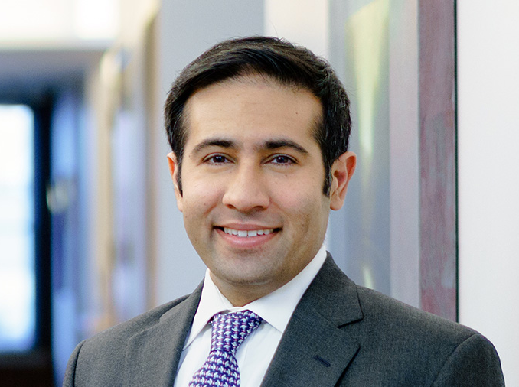
Presenters
Tammy Zhu tammy@runwayml.com
Paven Malhotra pmalhotra@keker.com
Matan Shacham mshacham@keker.com
Julia Greenberg jgreenberg@keker.com

Slide 4
Agenda
Introduction to Artificial Intelligence & Machine Learning
Overview of Government Regulations, Legislation & Enforcement
Overview of Private Litigation
Ethical Considerations

Slide 5
Agenda
Introduction to Artificial Intelligence & Machine Learning
Overview of Government Regulations, Legislation & Enforcement
Overview of Private Litigation
Ethical Considerations

Slide 6
What’s new? Generative AI
Artificial Intelligence
Set of analytical approaches to problem solving, including natural language processing and machine learning
Generative AI
AI system capable of generating new content (text, images, sound, video, and more)
Large language models (LLMs) like ChatGPT, Claude
Generative pre-trained transformers (GPTs)
Diffusion models
Synthetic data generation that matches a target distribution

Slide 7
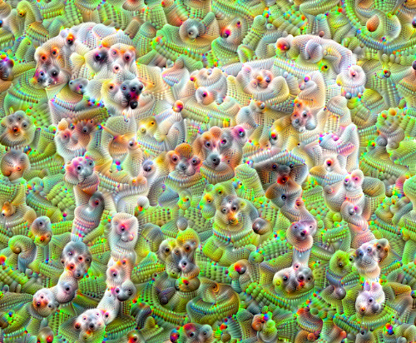
Generative AI’s capabilities have evolved rapidly
How did we get from this…
to this?

Slide 8
Why now?
High volume of potential training data
Everything on the internet!
Advancements in hardware
Cloud provides scalable computing on demand
GPUs
Decreasing compute costs
Breakthroughs in NN architecture
Landmark papers introducing transformer-based architecture has led to the LLMs we see today
Similar innovation in diffusion models

Slide 9
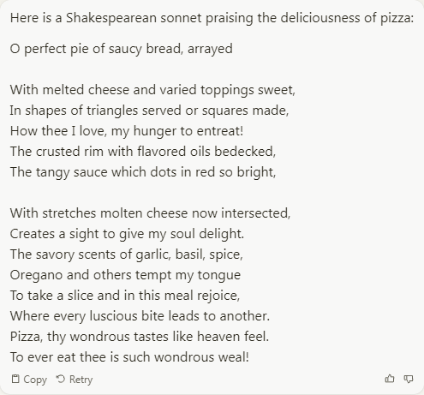
Advancements in AI: Text

Slide 10
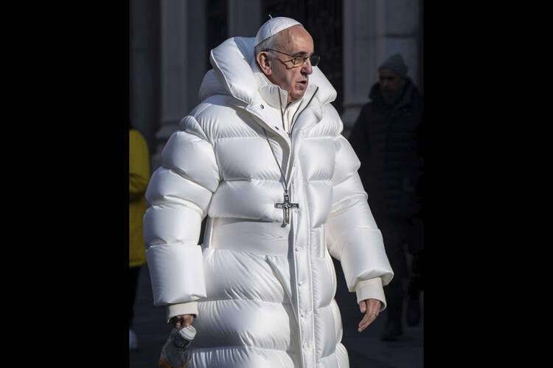
Advancements in AI: Images
Prompt: “The Pope in Balenciaga puffy coat, Moncler, walking the streets of Rome, Paris.”
Prompt: “Cinematic, off-center, two-shot, 35mm film still of a 30-year-old french man, curly brown hair and a stained beige polo sweater, reading a book to his adorable 5-year-old daughter, wearing fuzzy pink pajamas, sitting in a cozy corner nook, sunny natural lighting, sun shining through the glass of the window, warm morning glow, sharp focus, heavenly illumination, unconditional love --ar 16:9”

Slide 11
Agenda
Introduction to Artificial Intelligence & Machine Learning
Overview of Government Regulations, Legislation & Enforcement
Overview of Private Litigation
Ethical Considerations

Slide 12
Global Overview
Country | Status | Coverage
United States | No comprehensive national AI law Dozens of bills introduced | N/A
Canada | In Progress Artificial Intelligence and Data Act (AIDA) November 2023: amendments to draft AI bill published | “High-Impact” system obligations: Assessing, mitigating and monitoring risk Maintaining records Publishing description of AI systems in use Providing notice of harm Align with EU AI Act and OECD Frameworks
European Union | In Progress Artificial Intelligence Act Passed by European Parliament in March 2024; expected to come into force in May or June 2024; fully implemented over the next 2-3 years | Establishes EU AI Office (Feb. 2024) for oversight and enforcement Impose transparency and copyright regulations on generative AI Prohibits certain AI practices Imposes stringent restrictions on certain “high-risk” AI systems Gives citizens right to lodge complaints Sanctions for violations
China | In effect Artificial Intelligence Regulations Three PRC-wide regulations implemented in 2022-2023 | Cyberspace Administration of China issued regulations concerning: Algorithm recommendations Deep synthesis Generative AI

Slide 13
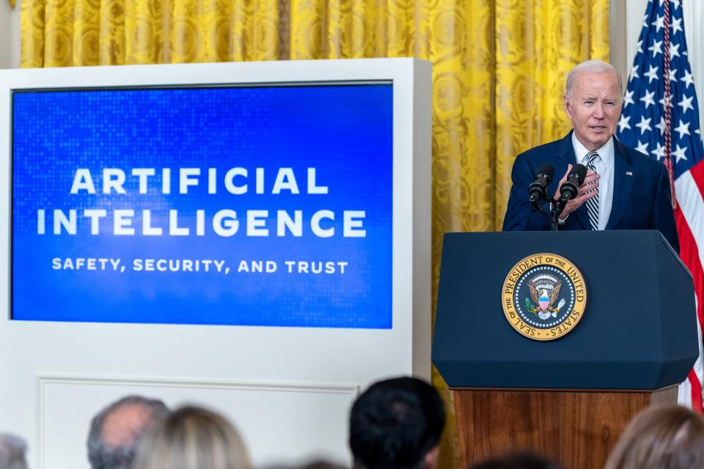
White House: Executive Order (October 2023)
Standards and Regulations
The Executive Order calls upon over 20 government agencies to develop standards and issue regulations.
New Requirements on Private Companies
Private companies that develop “dual-use foundation models” must provide the US Commerce Department regular reports explaining how they will protect their technology, their red-team testing results, and safety measures implemented before any such model is made public.
“Dual-use foundation model” is defined as an “AI model that is trained on broad data; generally uses self-supervision; contains at least tens of billions of parameters; is applicable across a wide range of contexts; and that exhibits, or could be easily modified to exhibit, high levels of performance at tasks that pose a serious risk to security, national economic security, national public health or safety, or any combination of those matters.”
Private companies that acquire, develop, or possess large-scale computing clusters must also report to the Commerce Department information about the location of clusters and their computing powers.

Slide 14
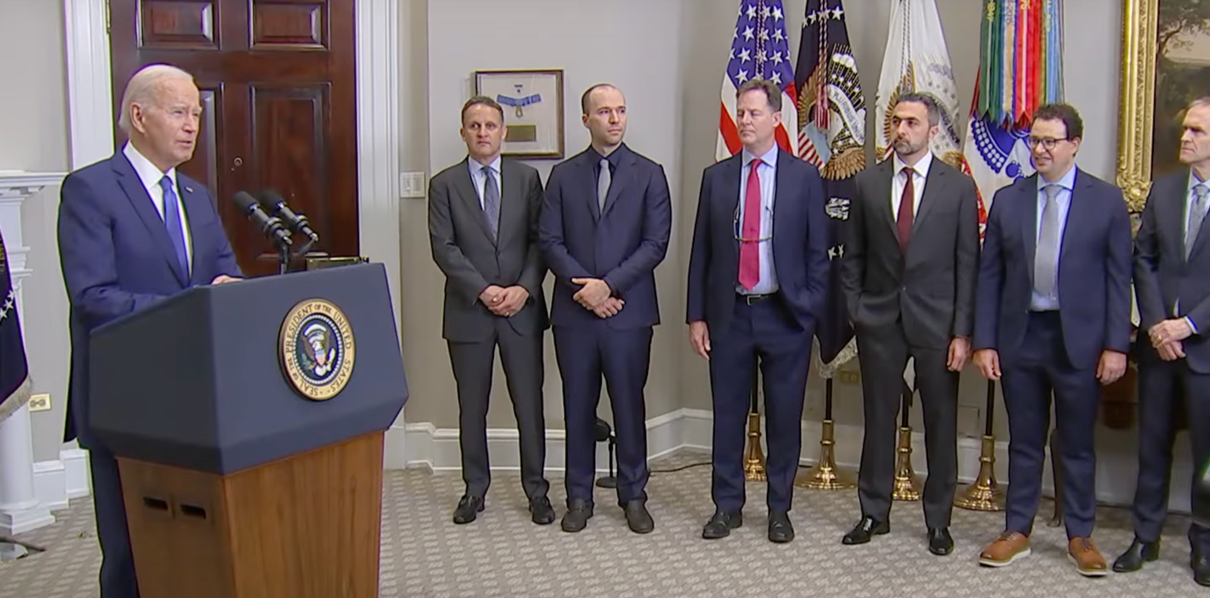
White House: Voluntary Industry Commitments
Safety
Internal and external security testing of AI systems before release
Share information to manage AI risk
July 2023
Security
Protect proprietary and unreleased model weights through investments in cybersecurity and insider threat safeguards
Facilitate third-party discovery and reporting of vulnerabilities in AI systems
Trust
Enable users to identify AI-generated content
Publicly report AI system capabilities, limitations, and permissible use
Prioritize research on societal risks including bias, discrimination and privacy
Deploy AI to help address society’s greatest challenges (health care, climate change, etc.)
Signatories: Adobe, Amazon, Anthropic, Cohere, Google, IBM, Inflection, Meta, Microsoft, Nvidia, OpenAI, Palantir, Salesforce, Scale AI, and Stability AI.

Slide 15
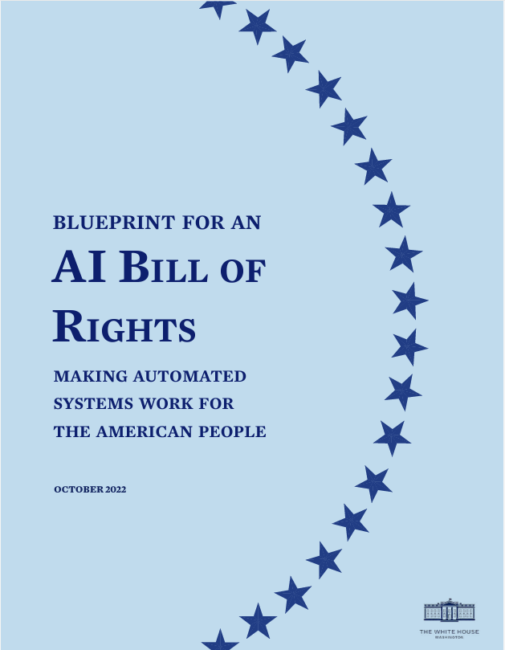
White House: Blueprint for AI Bill of Rights (Oct. 2022)
Safe and Effective Systems: Protects consumers from unsafe or ineffective systems.
Algorithmic Discrimination Protections: Consumers should not face discrimination by algorithms and systems should be used and designed in an equitable way.
Data Privacy: Consumers should be protected from abusive data practices via built-in protections and consumers should have agency over how data about them is used.
Notice and Explanation: Consumers should know that an automated system is being used and understand how and why it is contributes to outcomes that impact them.
Human Alternatives, Considerations and Fallback: Consumers should be able to opt-out, where appropriate, and have access to a person who can quickly consider and remedy problems you encounter.

Slide 16
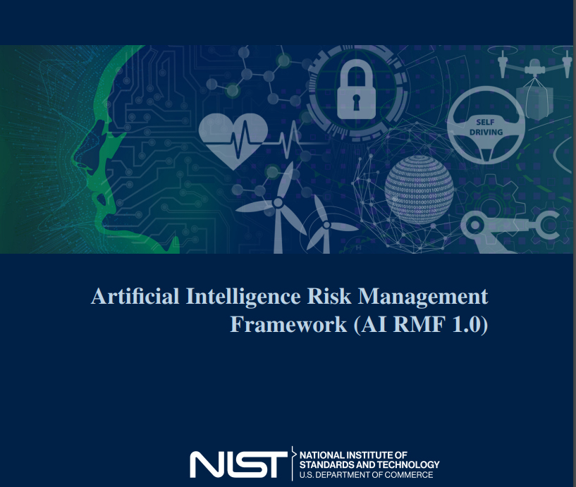
Commerce Department: NIST AI Framework
Trustworthy AI systems
Safe
Secure and Resilient
Explainable and Interpretable
Privacy-Enhanced
Fair with Harmful Bias Managed
Valid and Reliable
Accountable and Transparent

Slide 17
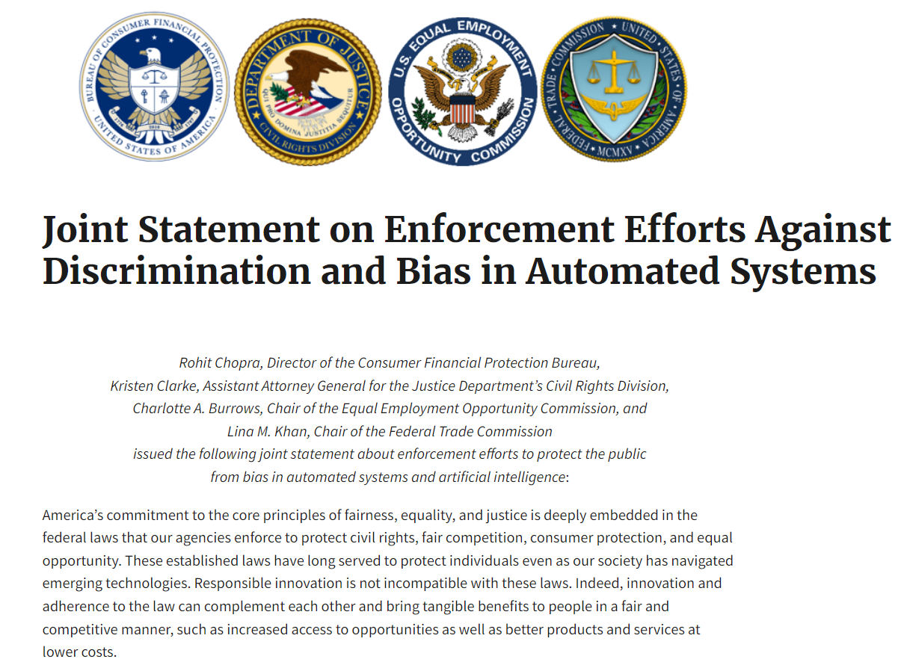
Federal Agencies

Slide 18
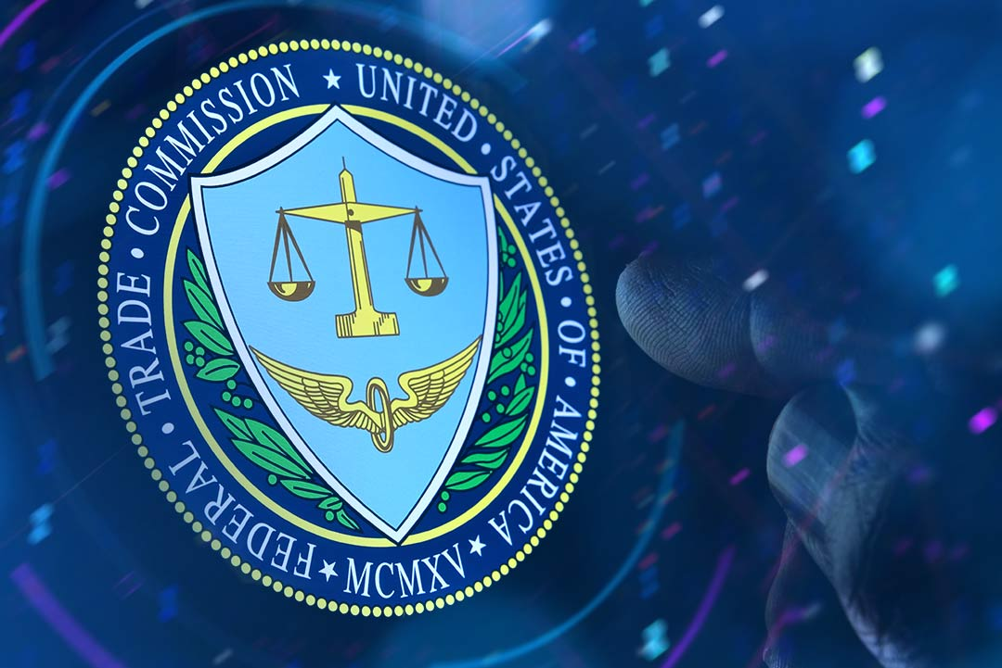
FTC
Violations of consumer privacy and use of consumer data
Alexa and Ring usage of audio and video to train AI systems
Ever mobile app usage of facial recognition technology
July 2023 investigation of OpenAI: mishandling user data and causing reputational harm to consumers
Discrimination and bias resulting from automated systems
Deceptive practices “turbocharged” via AI
Imposter Schemes
False Representations regarding AI

Slide 19
Copyright Office & Patent and Trademark Office
Stephen Thaler

Slide 20
Copyright Office & Patent and Trademark Office
AI cannot be the author on a copyrighted work Thaler v. Perlmutter (D.D.C. 2023)
AI cannot be the inventor of a patented claim
Thaler v. Hirshfeld, 558 F. Supp. 3d 238 (E.D. Va. 2021), aff’d sub nom.,
Thaler v. Vidal, 43 F. 4th 1207 (Fed. Cir. 2022), cert. denied, 143 S. Ct. 1783 (2023)

Slide 21
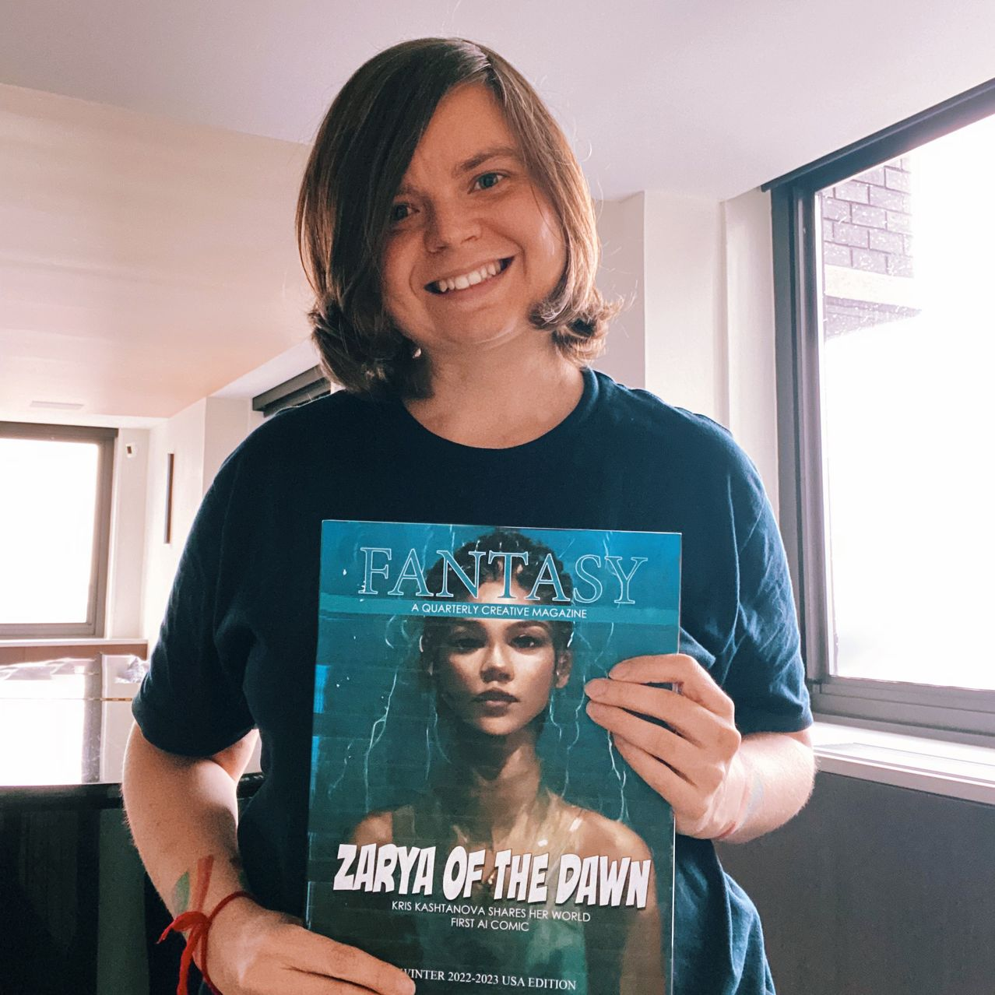
Copyright Office
Comic book by Kris Kashtanova illustrated using Midjourney.
Kashtanova sought to register the work.
No registration for images generated by Midjourney.

Slide 22
State Regulation
Mandatory transparency laws around “profiling” and automated decisions in California, Colorado, Texas, Virginia and others.
New York and Illinois have specific laws around the use of AI in hiring decisions.
Utah implements Artificial Intelligence Amendments in March 2024; establishes Office of Artificial Intelligence Policy

Slide 23
State Regulation
Nov 2023: California Privacy Protection Agency released first draft of rulemaking on automated decision-making technologies (ADMT) under California Consumer Privacy Act
ADMT defined as “any system, software, or process—including one derived from machine-learning, statistics, or other data-processing or artificial intelligence—that processes personal information and uses computation as whole or part of a system to make or execute a decision or facilitate human decision making.”

Slide 24
Agenda
Introduction to Artificial Intelligence & Machine Learning
Overview of Government Regulations, Legislation & Enforcement
Overview of Private Litigation
Ethical Considerations

Slide 25
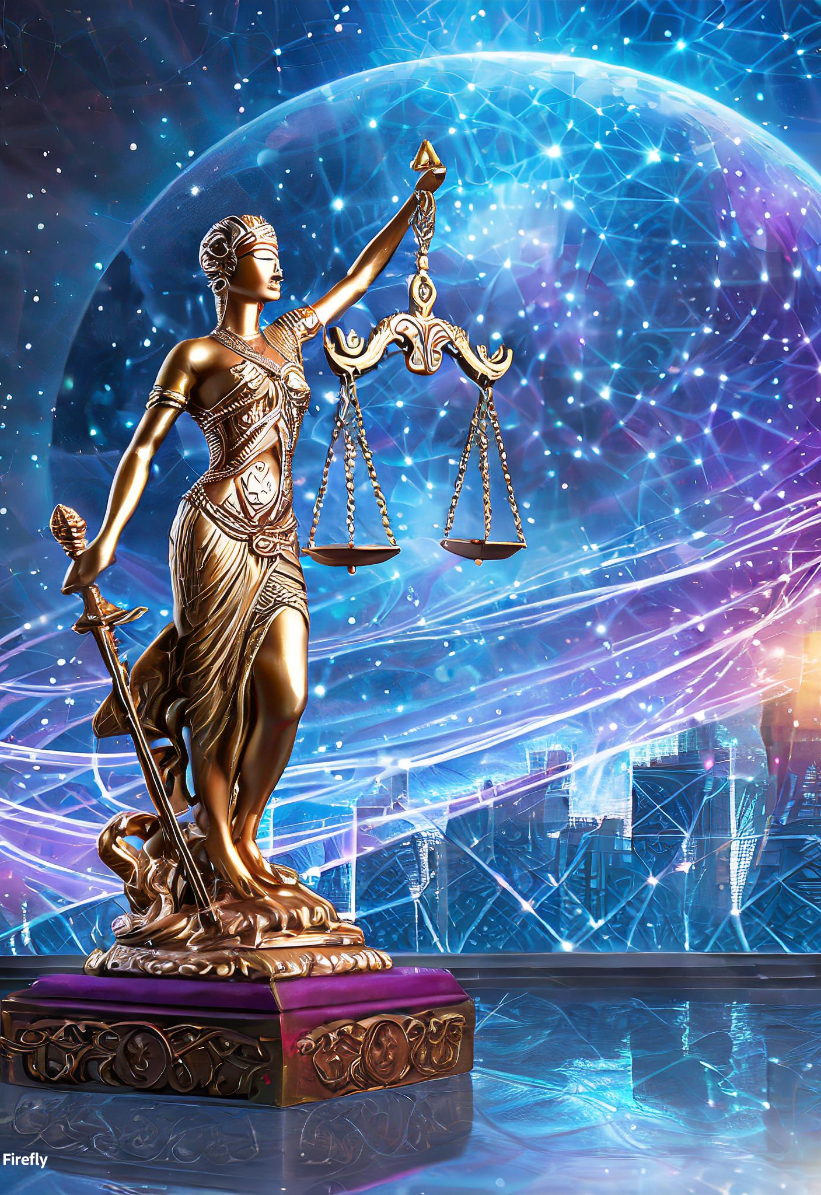
Private Litigation: Big Picture
Litigation against AI companies is growing
Lawsuits provide first look into novel issues
Litigants are bringing claims related to:
Copyright & Digital Millennium Copyright Act
Trademark
Right of Publicity
Invasion of Privacy
Libel & Defamation
Other Federal & State Laws
Source: Adobe Firefly

Slide 26
Copyright
Kinds of Plaintiffs
Authors, comedians, journalists, politicians
Artists, cartoonists, photographers
News, legal, and music publishers
Kinds of Claims
Direct copyright infringement
Training models using copies of copyrighted works
Reproducing and distributing copies or derivative works as model outputs
Models themselves as infringing derivative works
Vicarious and contributory copyright infringement

Slide 27
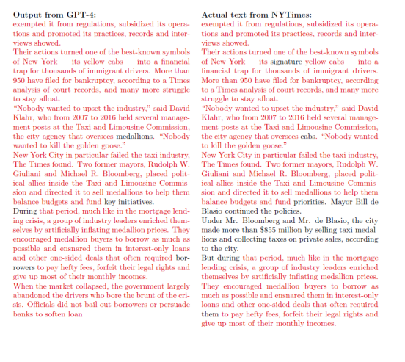
Copyright: New York Times v. Microsoft Corp., et al.
New York Times sued OpenAI & Microsoft in high-profile case in SDNY
Alleged direct copyright infringement
Reproducing NYT works in training
Embodying unauthorized reproductions
Unauthorized public display of works
Unauthorized retrieving and disseminating of current news
Alleged vicarious & contributory infringement
Source: Complaint, New York Times v. Microsoft Corp., et al.

Slide 28
Copyright Defense: Fair Use
Factors:
purpose and character of use
nature of copyrighted work
amount or substantiality of use
effect of the use on potential market for or value of the work

Slide 29
Copyright Defense: Thomson Reuters, et al. v. Ross Intelligence Inc.
Deciding whether the public’s interest is better served by protecting a creator or a copier is perilous, and an uncomfortable position for a court. Copyright tries to encourage creative expression by protecting both. Here, we run into a hotly debated question: Is it in the public benefit to allow AI to be trained with copyrighted material?
The value of any given AI is likely to be reflected in the traditional factors: How transformative is it? Can the public use it for free? Does it discourage other creators by swallowing up their markets? So an independent evaluation of the benefits of AI is unlikely to be useful yet, even though both the potential benefits and risks are huge. Suffice it to say, each side presents a plausible and powerful account of the public benefit that would result from ruling for it.
Mem. Op. on Cross-MSJs (Dkt. 547), No. 1:20-cv-613-SB, 2023 WL 6210901, at 11 (D. Del. Sept. 25, 2023).

Slide 30
Digital Millenium Copyright Act (DMCA)
Content management information (“CMI”)
“Information conveyed in connection with copies . . . of a work . . ., including in digital form,” such as title, author’s name, copyright owner, terms (§ 1202(c))
§ 1202(a) – no knowingly false CMI
“No person shall knowingly and with the intent to induce, enable, facilitate, or conceal infringement (1) provide copyright management information that is false, or (2) distribute or import for distribution copyright management information that is false.”
§§ 1202(b)(1), (3) – no knowing removal/alteration of CMI
“No person shall . . . (1) intentionally remove or alter any copyright management information, . . . or (3) distribute . . . copies of works. . . knowing that copyright management information has been removed or altered . . . , knowing . . . that it will induce, enable, facilitate, or conceal an infringement of any rights under this title.”

Slide 31
Trademark
Source: Instagram @mochapom, @puggpickles, @sapphie_the_pomsky, @daisythedachshund__

Slide 32
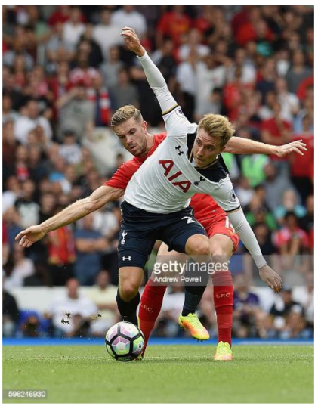
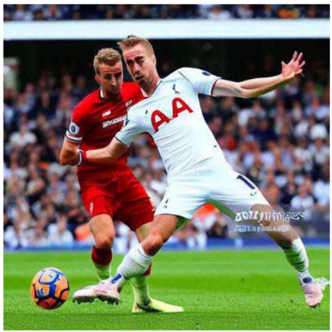
Trademark: Getty Images v. Stability AI
Source: First Amended Complaint, Getty Images (US) v. Stability AI

Slide 33
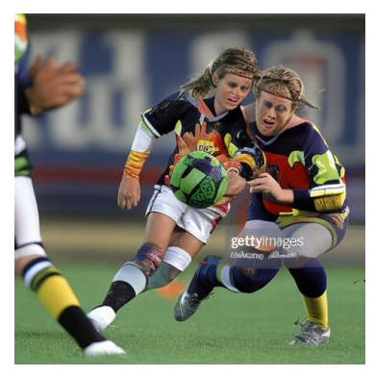
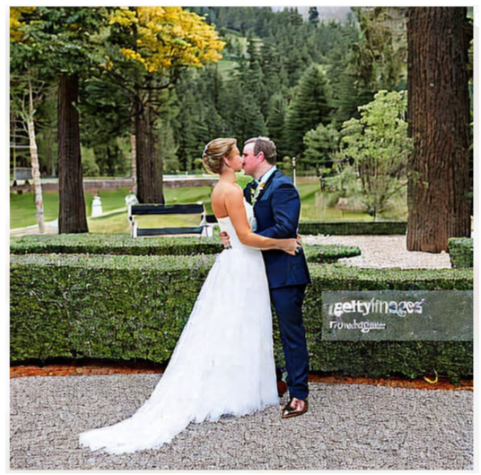
Trademark: Getty Images v. Stability AI
Source: First Amended Complaint, Getty Images (US) v. Stability AI

Slide 34
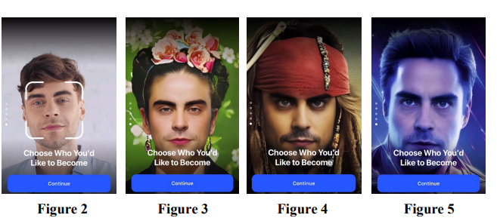
Right of Publicity: Young v. NeoCortext, Inc.
Source: Complaint, Young v. NeoCortext, Inc.

Slide 35
Invasion of Privacy
Sources: (1) Reuters, (2) CNBC, (3) Reuters

Slide 36
Defamation
Source: KFMO
Source: Variety

Slide 37
Other Claims
Breach of Contract
Sources of training data are governed by licensing agreements & violate terms of service
Computer Fraud and Abuse Act (CFAA)
Intentionally accessing protected computers without authorization through AI plug-ins
Other State Laws
Competition Laws
E.g., California Unfair Competition Law
Consumer Protection Laws
E.g., Illinois Consumer Fraud and Deceptive Business Practices Act
Unjust enrichment, negligence, conversion, & more

Slide 38
Private Litigation: What’s Next?
It is still early days
So far, courts largely approach claims with skepticism, but many defenses untested
Without broad federal legislation or regulation, law will be made by the courts and could shape AI development
But innovation will continue
Plaintiffs’ bar focused on AI companies now, but may expand to those that adopt or use AI products
Source: Runway AI

Slide 39
Agenda
Introduction to Artificial Intelligence & Machine Learning
Overview of Government Regulations, Legislation & Enforcement
Overview of Private Litigation
Ethical Considerations

Slide 40
Potential Uses for AI in Legal Work (Eventually)
Legal research
Document review
Summarization
Fact research or investigation?
Risk prediction?
Drafting pleadings?
Numerous companies are already working on all of these…

Slide 41
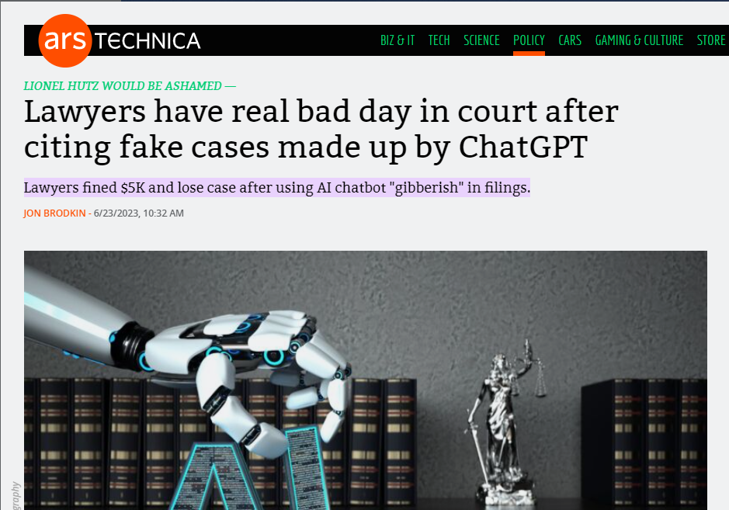
What are the risks of using AI in legal work?
It can get things horribly —but very confidently—wrong

Slide 42
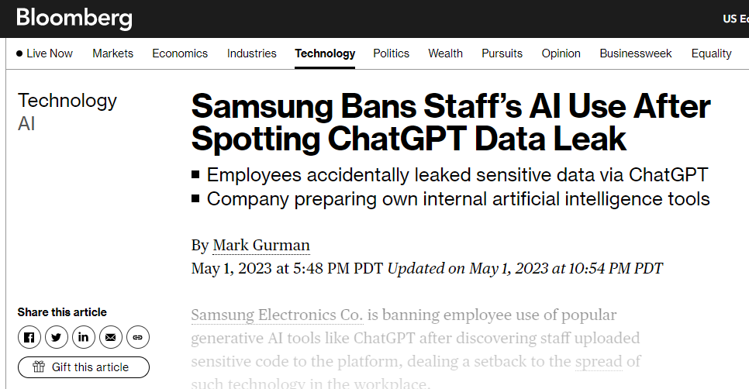
What are the risks of using AI in legal work?
The information you put into chatbots may not stay confidential

Slide 43
What are the ethical implications of using AI in legal work?
Duty of Competence
Rule 1.1
A lawyer shall not intentionally, recklessly, with gross negligence, or repeatedly fail to perform legal services with competence.
Competence in any legal service shall mean to apply the (i) learning and skill, and (ii) mental, emotional, and physical ability reasonably necessary for the performance of such service.

Slide 44
What are the ethical implications of using AI in legal work?
Duty of Confidentiality
Rule 1.6
Lawyers must protect information relating to the representation and take steps to prevent unintended disclosure or unauthorized access to that information
Supervision and Unauthorized Practice
Rules 5.1, 5.3
Lawyer with supervisory authority over non-lawyer must make reasonable efforts to ensure non-lawyer’s compliance and may be responsible for non-compliance
Rule 5.5
Lawyer cannot “knowingly assist a person in the unauthorized practice of law”

Slide 45
Duty of Confidentiality Bus. & Prof. Code § 6068(e) Rule 1.6
“A lawyer must not input any confidential information of the client into any generative AI solution that lacks adequate confidentiality and security protections.”
“A lawyer or law firm should consult with IT professionals or cybersecurity experts to ensure that any AI system in which a lawyer would input confidential client information adheres to stringent security, confidentiality, and data retention protocols.”
“A lawyer who intends to use confidential information in a generative AI product should ensure that the provider does not share inputted information with third parties or utilize the information for its own use in any manner, including to train or improve its product.”

Slide 46
Duties of Competence and Diligence Rule 1.1 Rule 1.3
“It is possible that generative AI outputs could include information that is false, inaccurate, or biased.”
“A lawyer must critically review, validate, and correct both the input and the output of generative AI to ensure the content accurately reflects and supports the interests and priorities of the client in the matter at hand…The duty of competence requires more than the mere detection and elimination of false AI-generated results.”
“A lawyer’s professional judgment cannot be delegated to generative AI and remains the lawyer’s responsibility at all times.”

Slide 47
Duty to Supervise Lawyers & Non-Lawyers Rules 5.1-5.3
“Managerial and supervisory lawyers should establish clear policies regarding the permissible uses of generative AI and make reasonable efforts to ensure that the [organization] adopts measures that give reasonable assurance that the [organization’s] lawyers and non-lawyers’ conduct complies with their professional obligations when using generative AI.”
“A subordinate lawyer must not use generative AI at the direction of a supervisory lawyer in a manner that violates the subordinate lawyer’s professional responsibility [] obligations.”
These issues are non-exhaustive; the Practical Guidance document addresses additional issues

Slide 48
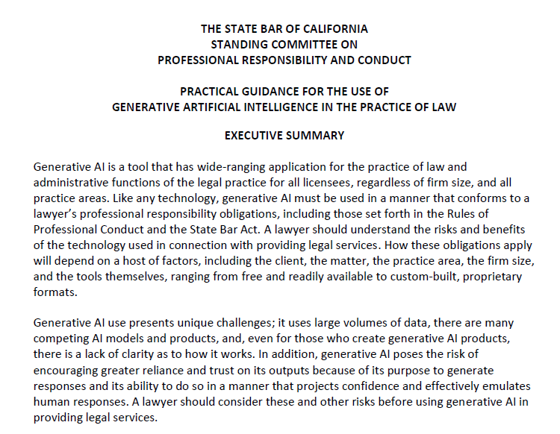
What does the California State Bar have to say?

Slide 49
Takeaways
Ethical use of AI in legal practice
Do not put confidential, privileged, or non-public information into chatbots
If you use AI for legal work, do so with extreme caution and full duplication through other means
Cannot delegate your professional judgment to generative AI
Set policies and conduct trainings
Keep track of developments and guidance—things will change fast

Slide 50
Thank you!

