Slide 1
Navigating the Privacy Minefield: Litigation Trends and Case Strategy
Association of Corporate Counsel September 27, 2022

Slide 2
Presenters
Ben Berkowitz Partner
Keker, Van Nest & Peters bberkowitz@keker.com
415.773.6689
Tom Gorman Partner
Keker, Van Nest & Peters tgorman@keker.com
415.676.2292
Christina Lee Associate
Keker, Van Nest & Peters clee@keker.com
415.962.8844
Emily Jones Partner, Digital Business Simmons + Simmons, US +44 7866 949065 emily.jones@simmons-simmons.com
Raza Rizvi Partner, Digital Business Simmons + Simmons, Middle East +971 4 709 6634 raza.rizvi@simmons-simmons.com

Slide 3
Agenda
U.S. Privacy Litigation Trend: Big Data in the Crosshairs
UK/EU Enforcement Trends
Cross-border Enforcement Cooperation
Overview of Claims Asserted: U.S. and California
Status of UK / EU Privacy Class Actions
Key Defenses & Practical Takeaways

Slide 4
U.S. Privacy Litigation Trends

Slide 5
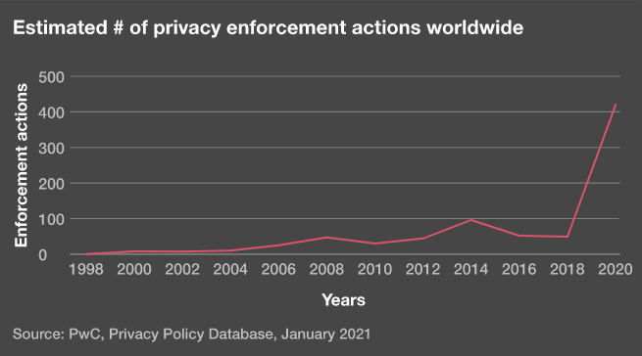
U.S. Litigation Trend: Increasing Enforcement
Source: https://www.pwc.com/us/en/services/consulting/cybersecurity-risk-regulatory/library/seven-privacy-megatrends/rise-privacy-enforcement.html

Slide 6
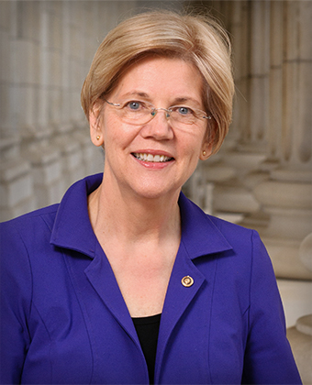
Bipartisan Scrutiny of “Big Tech”
“[T]ech firms collect and exploit sensitive personal information -- often threatening national security, harming our emotional health, and discriminating against vulnerable groups.”
“We should have a conversation about what data is appropriate to collect, what limits should be placed on the groups that data is collected on, and restrictions on how that data is sold or transferred to other parties.”
Notes:
December 7, 2021 hearing (Promoting Competition, Growth, and Privacy Protection in the Technology Sector), U.S. Senate Committee on Finance Subcommittee on Fiscal Responsibility and Economic Growth – Senators Warren & Bill Cassidy.

Slide 7
Big Data in the Crosshairs
Rise in suits targeting Big Tech
Increased litigation targeting not only data breaches, but also collection and use of personally identifying information

Slide 8
Notable Recent Settlements
In re: Tiktok Consumer Privacy Litigation (N.D. Ill.) - $92m
Allegations of surreptitious harvesting and profiting from biometric data, geolocation information, other PII, and unpublished digital recordings
In re: Zoom Privacy Litigation (N.D. Cal.) - $85m
Allegations of sharing PII with third parties without permission, misrepresenting encryption protocol, failure to prevent “Zoombombing”
In re Plaid Inc. Privacy Litigation (N.D. Cal.) - $58m
Allegations of obtaining consumer banking data, including log-in information, and selling information to third parties

Slide 9
In re Facebook, Inc. Internet Tracking Litig., 956 F.3d 589 (9th Cir. 2020)
Privacy class action alleging:
Collection: using cookies to track users’ browsing histories when they visited third-party sites after they had logged out of the platform
Use: compiling information into personal profiles sold to advertisers
Asserted claims:
Wiretap Act, Stored Communications Act (SCA), California statutes (California Invasion of Privacy Act; Computer Data Access and Fraud Act), and California common-law claims
Notes:
CL

Slide 10
In re Facebook, Inc. Internet Tracking Litig., 956 F.3d 589 (9th Cir. 2020)
Ninth Circuit reversed dismissal on 12(b) grounds
Nature of collection:
Concluded that plaintiffs plausibly pleaded that a Help Center page “set an expectation that logged-out user data would not be collected,” when it was in fact “collected…anyway”
Sensitivity of the collected information
Found that “the amount of data allegedly collected was significant,” as was the use of an “enormous amount of individualized data” to “compile highly personalized profiles”
Post-In re Facebook, plaintiffs are increasingly asserting claims based on compilation of data.
Notes:
CL

Slide 11
Emerging Trend: Enforcement Targeting Dark Patterns
What are dark patterns?
“[A] user interface designed or manipulated with the substantial effect of subverting or impairing user autonomy, decision-making, or choice…” Cal. Civ. Code 1798.140; Colo. SB 190 § 6-1-1303 (9)
Examples:
Fake countdown timers
Misdirection
Obscured renewing subscription
Fake activity messages
Messages indicating low stock or high demand
Obstruction—making sign up easy and cancellation hard

Slide 12
Emerging Trend: Enforcement Targeting Dark Patterns
The FTC is stepping up enforcement regarding dark patterns.
Enforcement policy statement (Oct. 28, 2021) re: disclosures, consent, and cancellation terms
“Firms that deploy dark patterns and other dirty tricks should take notice.” – Samuel Levine
Enforcement action against Age of Learning, Inc. (ABC Mouse) re: cancellation terms resulting in a $10 million settlement
Samuel Levine, Director, Bureau of Consumer Protection, FTC

Slide 13
Emerging Trend: State Laws Targeting Dark Patterns
State legislators are passing laws regarding dark patterns.
AB 390 (October 2021)
Strengthens protections under California’s Auto Renewal Law by ensuring that consumers can cancel automatic renewal and continuous service subscriptions online.
Cal. Consumer Privacy Act (CCPA) regulations (Cal. Code Regs. Tit 11, Div. 1, Chp. 20, Section 999.315(h))
Bans the use of dark patterns to subvert or impair the process for consumers to opt out of the sale of personal information
Cal. Privacy Rights Act (takes effect January 1, 2023)
“Consent obtained through dark patterns does not constitute consent.”

Slide 14
Enforcement trends – UK / EU (1)
Divergence in GDPR enforcement, activity and fines
Regulators’ use of powers
Cookies (transparency and consent)
Appeals
Cross-border data transfers

Slide 15
Enforcement trends – UK / EU (2)
Top 10 fines across the EU
Controller / Processor | Country | Fine (€) | Breach / type of data | Date
Amazon Europe Core S.à r.l. | Luxembourg | 746,000,000 | Non-compliance with general data processing principles / customer data | July, 16 2021
Meta Platforms Inc (Instagram) | Ireland | 405,000,000 | Non-compliance with general data processing principles / children’s data | September, 5 2022
WhatsApp Ireland Ltd. | Ireland | 225,000,000 | Insufficient fulfilment of information obligations / customer data | August, 20 2021
Google LLC | France | 90,000,000 | Insufficient legal basis for data processing / cookies | December, 31 2021
Facebook Ireland Ltd. | France | 60,000,000 | Insufficient legal basis for data processing / cookies | December, 31 2021
Google Ireland Ltd. | France | 60,000,000 | Insufficient legal basis for data processing / cookies | December, 31 2021
Google LLC | France | 50,000,000 | Insufficient legal basis for data processing / customer data | January, 21 2021
H&M Hennes & Mauritz Online Shop A.B. & Co. KG | Germany | 35,258,708 | Insufficient legal basis for data processing / customer data | October, 1 2020
TIM (telecommunications operator) | Italy | 27,800,000 | Insufficient legal basis for data processing / customer data | January, 15 2020
Enel Energia S.p.A | Italy | 26,500,000 | Insufficient legal basis for data processing / customer data | January, 21 2022

Slide 16
Enforcement trends – UK / EU (3)

Slide 17
Enforcement trends – UK / EU (4)
‘Overview on resources made available by Member States to the Data Protection Supervisory Authorities’ published by the European Data Protection Board September, 5 2022

Slide 18
Enforcement trends – UK / EU (5)
‘Overview on resources made available by Member States to the Data Protection Supervisory Authorities’ published by the European Data Protection Board September, 5 2022

Slide 19
Cross-border enforcement cooperation
Clearview AI
Investigation opened in July 2020 by the office of the Australian Information Commissioner and the ICO
Article 50 GDPR
2021 adequacy decision
Council of Europe Convention on Data Protection
Provides for the cooperation of supervisory authorities with the ICO
Global Cross Border Enforcement Cooperation Arrangement
16 authorities

Slide 20
Common Causes of Action: U.S. and California

Slide 21
Common Causes of Action: U.S. and California
Common-Law Privacy Claims
Intrusion Upon Seclusion, California Constitutional Right to Privacy
Statutory Privacy and Wiretapping Claims
Wiretap Act, Stored Communications Act, & Computer Fraud and Abuse Act
California Invasion of Privacy Act (CIPA) and Consumer Privacy Act (CCPA)
Consumer Claims
Unfair Competition Law, Consumers Legal Remedies Act, Common-Law Fraud, Breach of Contract, Unjust Enrichment

Slide 22
Claim Spotlight: California Invasion of Privacy Act
CIPA is a criminal statute that provides for civil penalties.
$5000 statutory damage penalty per violation.
CIPA is decades-old and addressed older wiretapping, eavesdropping, and surveillance technologies.
The core provisions were enacted in 1967, with additional provisions added over time.
Plaintiffs have attempted to wield CIPA in privacy litigation addressing new technologies.

Slide 23
Claim Spotlight: California Invasion of Privacy Act
CIPA claims alleging wiretapping:
Cal. Penal Code § 631 punishes a person who, “willfully and without the consent of all parties to the communication,” attempts to read or learn “the contents or meaning of any message, report, or communication” in transit over a wire.
McCoy v. Google (N.D. Cal.):
Plaintiff asserted that the defendant violated § 631 by collecting data about how often and for how long he used third-party apps.
The court dismissed plaintiff’s CIPA claim because it was premised on the alleged collection of “record information.”

Slide 24
Claim Spotlight: California Invasion of Privacy Act
CIPA claims targeting collection of geolocation information:
California Penal Code § 637.7 prohibits “us[ing] an electronic tracking device to determine the location or movement of a person.”
An “electronic tracking device” is defined as “any device attached to a vehicle or other movable thing that reveals its location by the transmission of electronic signals.”

Slide 25
Claim Spotlight: California Invasion of Privacy Act
In re Google Location History Litigation (N.D. Cal.):
Plaintiffs asserted § 637.7 claim, alleging that the defendant used their mobile devices to determine their location.
The court dismissed plaintiffs’ CIPA claim under a plain-language reading of the statute.
The defendant’s software services did not constitute a “device.” Nor did the hardware components of plaintiffs’ phones, which could not track location on their own.
Plaintiffs failed to plead that an “electronic tracking device” was “attached” to a “vehicle or other movable thing.”

Slide 26
Privacy class actions – UK
Still no direct equivalent in the UK for US-style data privacy class actions
The UK Supreme Court decision in Lloyd v Google stopped the sudden surge in representative actions – most have since been discontinued.
Created difficulties for claimants in proving ‘same interest’, calculating measure of damages and establishing a high de minimus threshold. Data claims are now unlikely to be group actions.
Also led to challenges to data protection actions brought through other collective mechanisms (particularly group litigation orders, previously used to bring claims against British Airways, Ticketmaster and Marriott).
‘Misuse of private information’ tort as an alternative means of redress – Andrew Prismall v Google and DeepMind.

Slide 27
Privacy class actions – EU
Not yet a direct equivalent in the EU for US-style data privacy class actions
In April 2022, the Court of Justice of the EU (CJEU) ruled that the GDPR does not preclude national legislation enabling consumer protection associations a right to pursue data protection claims on a representative basis
An increase in ‘forum shopping’ - consumer associations looking to start a lawsuit in the jurisdiction with more favourable consumer protection laws.
In all member states, qualified entities and consumer organisations will soon be able to use all the instruments that are included in the Representative Actions Directive, including injunctions and collective redress – including the GDPR.

Slide 28
Key Defenses & Practical Takeaways

Slide 29
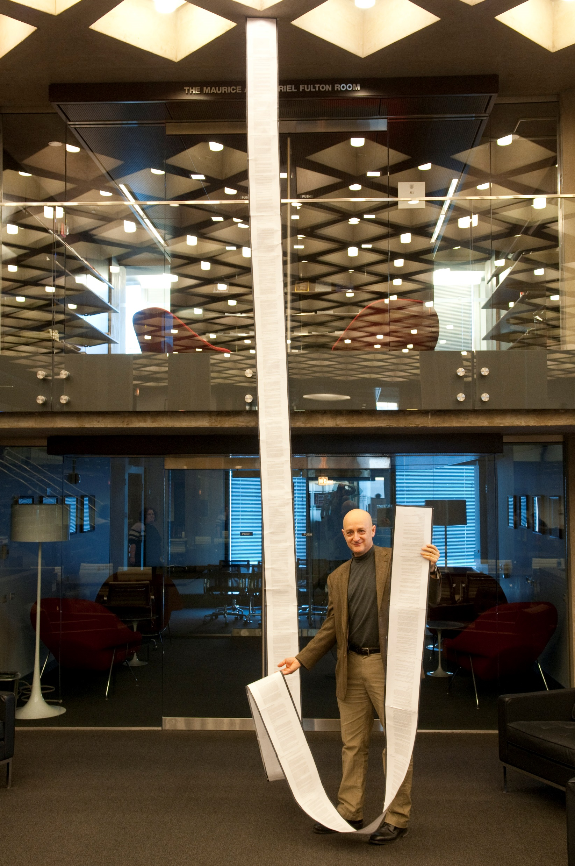
Terms of Service & Privacy Policies
Front line of defense
Relevant to consent and disclosure-based defenses
Disclosures can be used to defeat elements of common claims (e.g., expectation of privacy, reliance) at the pleadings stage and at class certification
E.g., In re Google Inc. Gmail Litig., No. 13-MD-02430-LHK, 2014 WL 1102660 (N.D. Cal. Mar. 18, 2014) (declining to certify class alleging Wiretap Act violations because of the “panoply of sources from which email users could have learned of,” and thus impliedly consented to, the alleged interceptions)
Online contract formation
Broad and clear disclosures in plain English are the most defensible

Slide 30
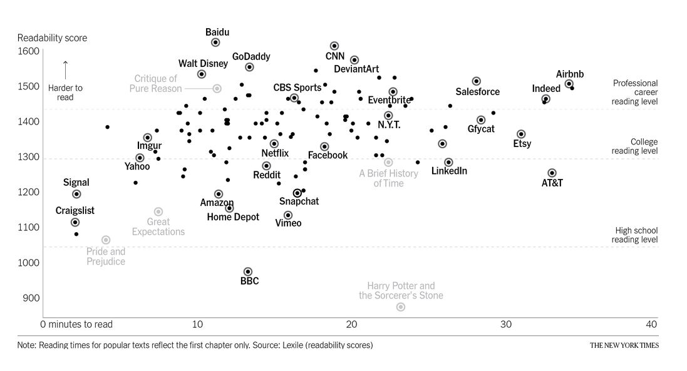
Terms of Service & Privacy Policies
“We Read 150 Privacy Policies. They Were an Incomprehensible Disaster.”
--Kevin Litman-Navarro, The New York Times
Critique of
Pure Reason
A Brief History of Time
Great
Expectations
Pride &
Prejudice
Harry Potter and the Sorcerer’s Stone

Slide 31
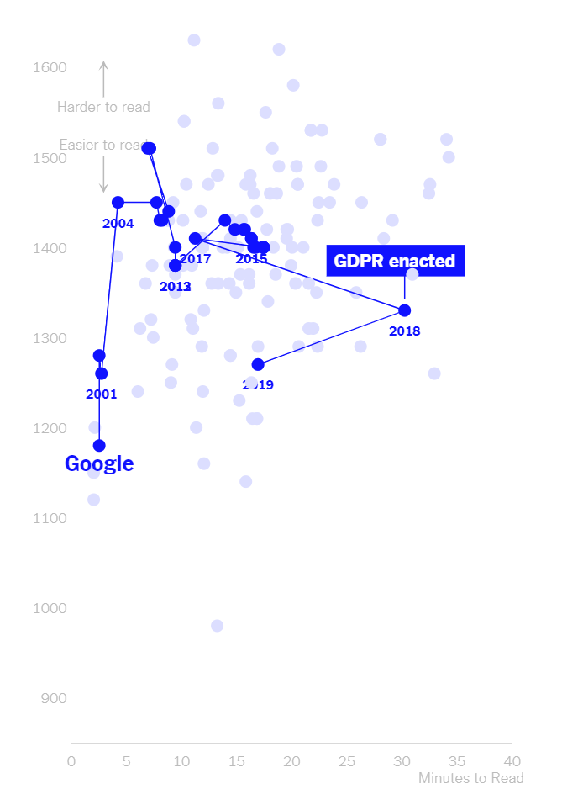
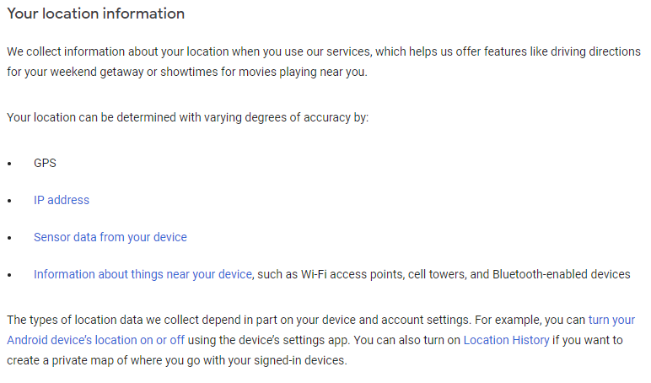
Terms of Service & Privacy Policies
2010:
2019:
Harder to Read
Easier to Read
Minutes to Read

Slide 32
Terms of Service & Privacy Policies
A word of caution:
Courts have increasingly looked at statements made outside of Terms of Service and Privacy Policies that might give rise to a reasonable expectation of privacy
Ads
Device pop-ups
Help center / support pages
See, e.g., In re Facebook, 956 F.3d at 602 (finding that a Help Center page created an expectation of privacy)

Slide 33
Article III Standing
TransUnion LLC v. Ramirez, 141 S. Ct. 2190 (2021)
Follows Spokeo, Inc. v. Robins, 578 U.S. 330 (2016), which held that procedural violations of the Fair Credit Reporting Act, without concrete harm, cannot satisfy the injury-in-fact requirement of Article III.
Courts have been resistant to Spokeo-type standing arguments in the context of traditional privacy claims.
Transunion recognized “disclosure of private information” and “intrusion upon seclusion” as “intangible harms” that have been “traditionally recognized as providing a basis for lawsuits in American courts.” 141 S. Ct. at 2204 (2021).
But under the right circumstances, courts may be receptive.
E.g., Abdulaziz v. Twitter, Inc., No. 19-CV-06694-LB, 2020 WL 6947929 (N.D. Cal. Aug. 12, 2020)

Slide 34
Practical takeaways (1)
Top tips
Review
Ensure to review the latest guidance and enforcement activity – the same principles are being breached for the same reasons time and time again
Don’t delay
Uncertainty in the regulatory landscape is not a good reason to drag heels
Educate
Ensure that the relevant individuals know what to do if the worst happens – and have tested the systems and controls in place

Slide 35
Practical takeaways (2)
Top tips
WFH
Working remotely requires paying close attention to security – especially if you’re working with personal data
Management engagement
GDPR compliance involves commitment and culture change- senior management need to be engaged
Continuous review
Carry out a data protection audit/gap analysis to identify compliance levels and any gaps that need to be addressed – set reminders to repeat the exercise

Slide 36
Questions?

Slide 37
Presenter Bios
Ben Berkowitz Partner bberkowitz@keker.com
415.773.6689
Tom Gorman Partner tgorman@keker.com
415.676.2292
Christina Lee Associate clee@keker.com
415.962.8844
Ben is an experienced trial and appellate lawyer who has a track record of successfully defending major technology companies in high-profile privacy, intellectual property, and class action litigation. He currently serves as lead counsel for Google in multiple nationwide privacy class actions, including In re Google Location History Litigation and Hammerling et al. v. Google. He also led Twitter’s successful defense of two recent federal lawsuits involving allegations of foreign espionage by the Kingdom of Saudi Arabia.
Tom’s practice focuses on high-stakes litigation for a variety of technology clients, including Google, Waymo, Lyft, Kitty Hawk, and Taiwan Semiconductor Manufacturing Company. He is representing Google in multiple nationwide privacy class actions regarding its Android operating system, including In re Google Location History Litigation and McCoy v. Google. For several years Tom has successfully defended challenges to Major League Baseball’s exemption to U.S. antitrust laws.
Christina represents clients in high-stakes commercial disputes, including in privacy and patent litigation. She is representing Google in several nationwide privacy class actions. She was a member of the firm’s trial team that obtained a judgment of over $80 million in a post-merger dispute that was unanimously affirmed by the Delaware Supreme Court. She previously served as a law clerk to Judge Milan D. Smith, Jr. of the U.S. Court of Appeals for the Ninth Circuit and to Judge Gonzalo P. Curiel of the U.S. District Court for the Southern District of California.

Slide 38
Presenter Bios
Emily Jones Partner, Digital Business US +44 7866 949065 emily.jones@simmons-simmons.com
Raza Rizvi Partner, Digital Business Middle East +971 4 709 6634 raza.rizvi@simmons-simmons.com
Emily is a partner at international law firm Simmons & Simmons. She is an English qualified attorney who has worked in Silicon Valley for over five years advising fast growth technology, fintech and healthcare companies on data privacy, cyber security and technology laws as they grow their businesses globally. Emily has been advising on data privacy and security issues for over 15 years and works with US companies entering new markets and launching new products and services especially involving emerging technologies, such as AI. Emily is an active member of the Simmons global data privacy team which publishes regular guidance on data privacy developments and delivers the firm’s international data transfer assessment solution tool, CtrlTransfer. She is CIPP/E certified and regularly speaks at conferences on data privacy and security matters.
Raza is a partner at international law firm Simmons & Simmons and co-founded the first technology law focussed practice in the Middle East over 15 years ago. He is an English qualified Dubai-based attorney with over two decades of experience on matters concerning the commercialization, protection and regulation of data, particularly in the context of emerging technology. He has supported a wide range of international businesses on strategic projects in the Middle East and is a CIPP/E certified privacy professional, regularly advising on the policy and regulatory issues underpinning emerging data laws in the Middle East.

Slide 39
Thank you

