Slide 1
Creating and Sustaining
The Drama-Free Workplace
Patti Perez
October 2, 2019

Slide 2
THE HIGH COST OF DRAMA
Turnover
Lower productivity and morale (poisoning of well, constant talk)
Loss of opportunity to resolve conflicts early (more cheaply)
Legal costs
Talent acquisition/management disruption (especially bad for D&I efforts)
Reputational damage

Slide 4
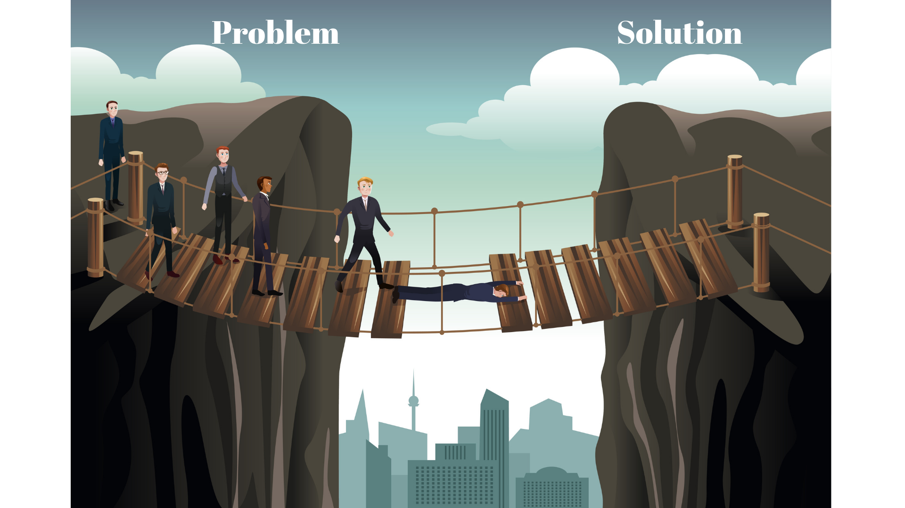

Slide 5
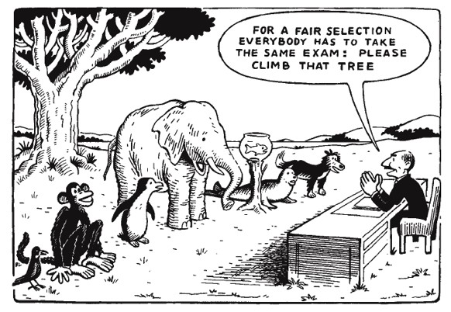

Slide 7
SO WHAT?
Bias/Diversity/Inclusion/Belonging/Equity: Authenticity and Fairness
Forward-looking/innovative problem-solving: GenZ, Accommodations

