Slide 1
AM I COVERED FOR . . .?
A DISCUSSION OF
INSURANCE COVERAGE ISSUES
December 6, 2024
Steven J. Pudell, Luma S. Al-Shibib

Slide 2
Disclaimer
The views expressed by the participants in this program are not those of the participants’ employers, their clients, or any other organization. The opinions expressed do not constitute
legal advice, or risk management advice. The views
discussed are for educational purposes only and
provided only for use during this session.

Slide 3
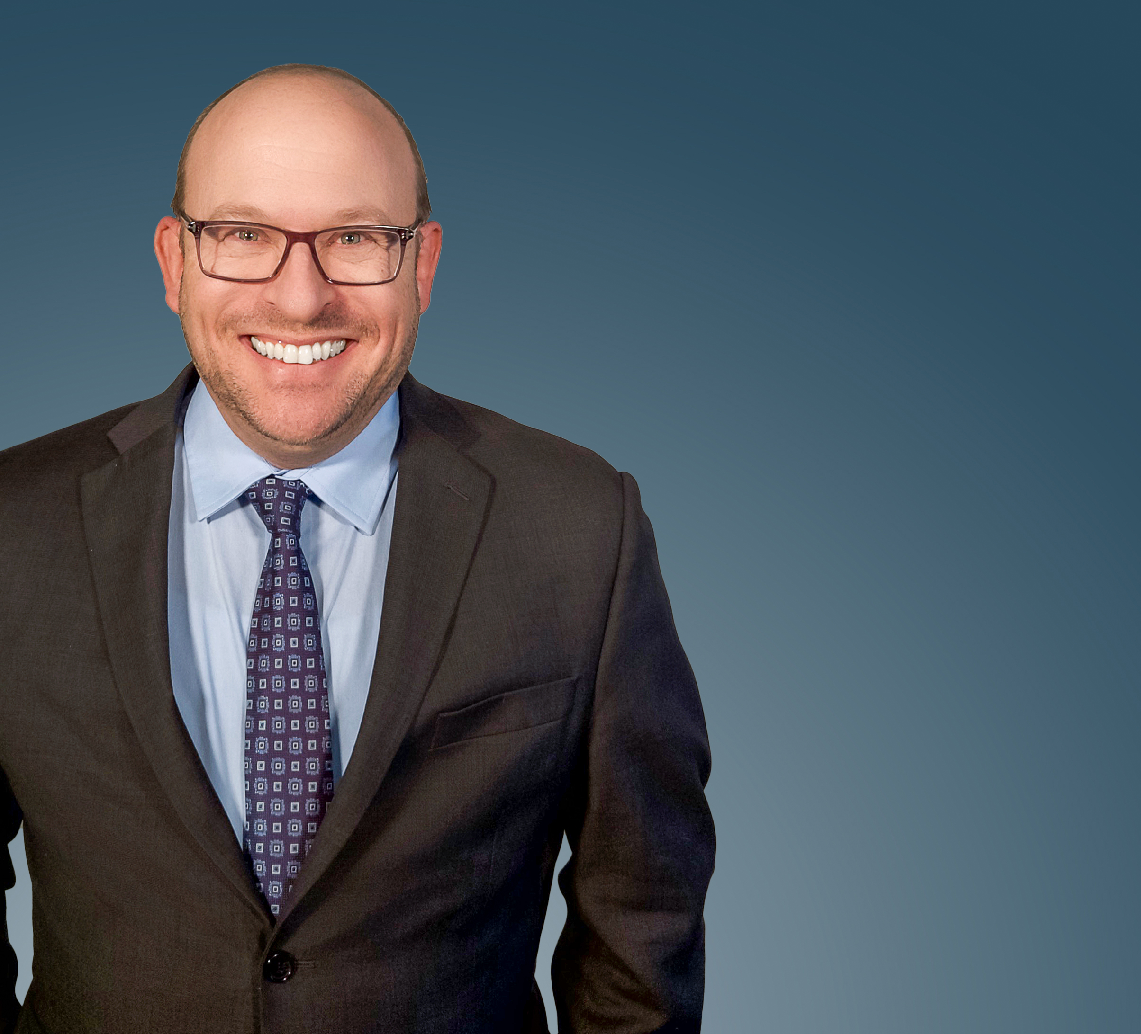
Steven Pudell
973.642.5877 / spudell@andersonkill.com
Steven J. Pudell has been the managing shareholder in Anderson Kill's Newark office since 2008. Steve's practice concentrates on insurance recovery, exclusively on behalf of policyholders, as well as on commercial litigation. He is also a member of the firm's COVID Task Group.
Steve has represented food industry companies, chemical manufacturers, pharmaceutical companies and real estate developers in insurance recovery matters.
Since 2011, Steve has been recognized by Chambers USA as one of New Jersey's top insurance recovery lawyers, which cited a client's assessment that "he is an expert in the field of insurance litigation" who "quickly analyzed the case" and was "a pleasure" to work with.
Since 2013, he has been selected by his peers for inclusion in Best Lawyers in America for Insurance Law. Since 2017, Steve has been recognized by The Legal 500 United States for Insurance - Advice to Policyholders.
Steve often writes and speaks about insurance coverage matters. In 2018, he was selected as a member of Law360’s insurance editorial advisory board.
After graduating from the University of Pennsylvania Law School in 1995, he clerked for the Honorable David Landau in the New Jersey Superior Court, Appellate Division.
He was the co-chair of the ADR/Settlement Subcommittee of the American Bar Association, Litigation Committee (2012-2016). He has also served on the New Jersey Supreme Court Model Civil Jury Charge Committee (2009-2014) and was a member of the Risk/Safety Commission of the Associated General Contractors of America (2009-2013).
3

Slide 4
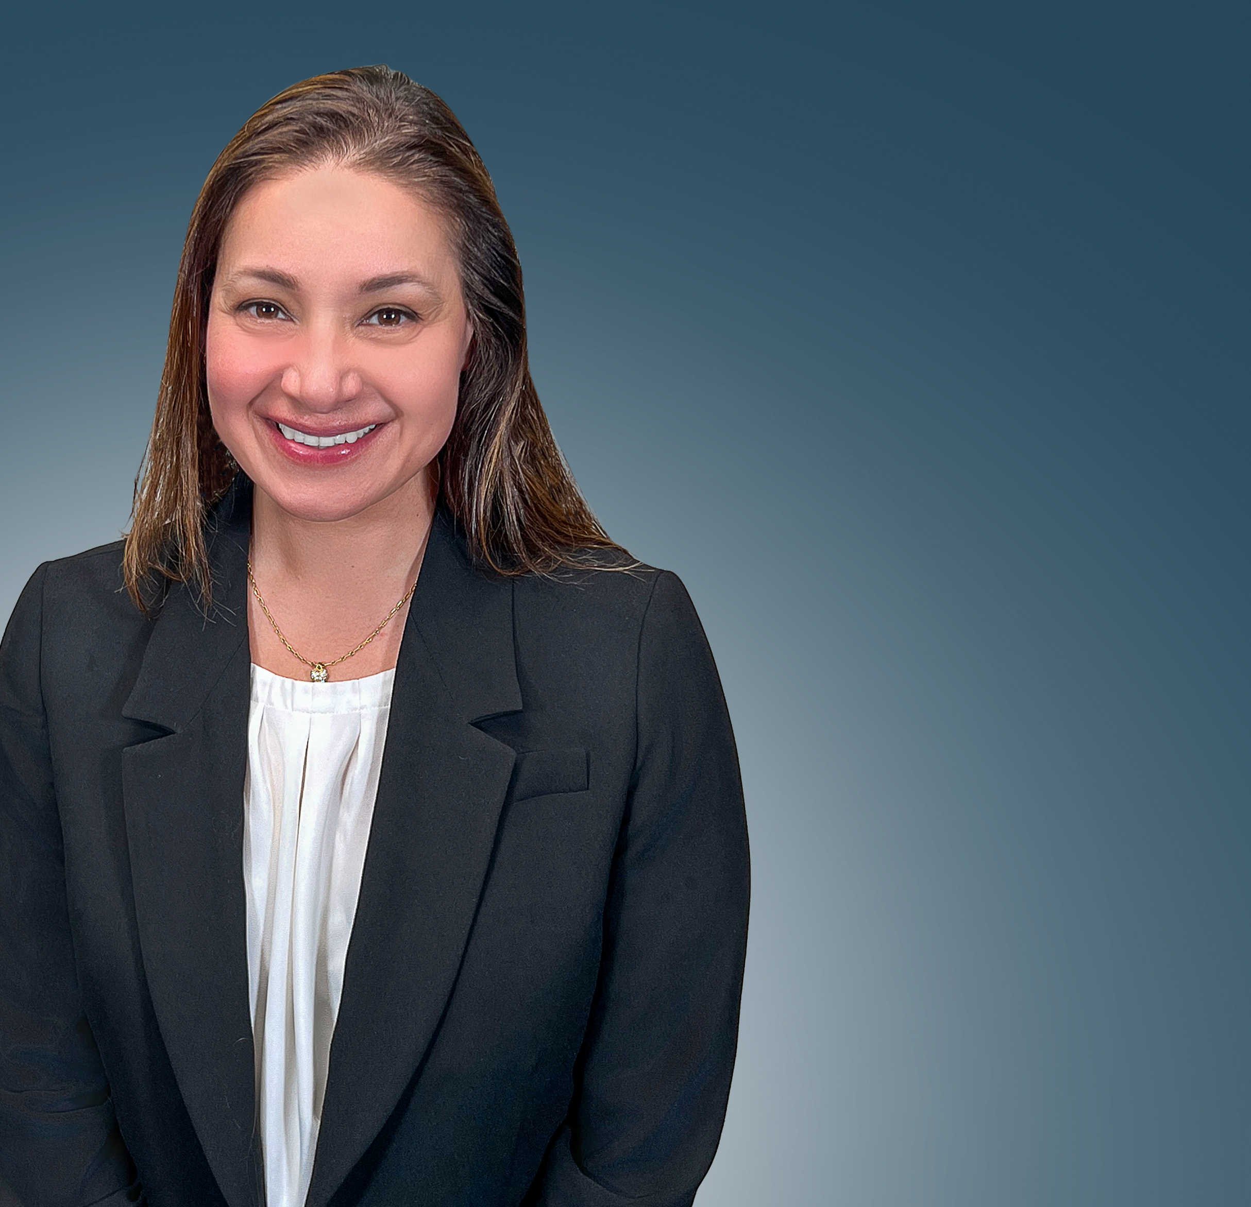
Luma S. Al-Shibib
212.278.1048 / lal-shibib@andersonkill.com
Luma S. Al-Shibib is a shareholder in the New York office of Anderson Kill and Co-Chair of the firm’s Cyber Insurance Recovery Practice Group. She focuses her practice on insurance recovery for corporate policyholders, with an emphasis on cyber liability insurance, crime insurance, directors & officers liability insurance, and other claims-made professional liability insurance.
Luma has secured hundreds of millions of dollars in recoveries for corporate clients in both litigation and pre-litigation matters. She has obtained recoveries for losses from data breaches, ransomware and phishing attacks under all-risk and fidelity crime policies as well as cyber policies.
Luma also has a background in bankruptcy and has represented clients in bankruptcy cases involving insurance claims, particularly in the context of claims under directors and officers liability insurance policies.
Luma is an active member of the ABA’s Torts, Insurance, and Trial Practice Committee and serves as a Vice-Chair of the ABA TIPS Cybersecurity Committee.
While in law school, Luma interned as a student law clerk for the Honorable Laura Taylor Swain of the United States District Court for the Southern District of New York.
4

Slide 5
INSURANCE POLICIES
Commercial General Liability Policies (“CGL”)
Property Policies
Directors & Officers Liability (“D&O”)
Errors & Omissions Liability (“E&O”)
Employment Practices Liability (“EPL”)
Commercial Crime or Fidelity Policies
Cyber Liability Policies
Contamination and Recall Policies
5

Slide 6
Commercial General Liability Policies:
What is Covered?
Third party claims for:
Bodily injury
Property damage
Personal and advertising injury (disparagement, copyright infringement, invasion of privacy, et al.)
Does not cover pure economic loss
(Usually) Unlimited duty to defend
6

Slide 7
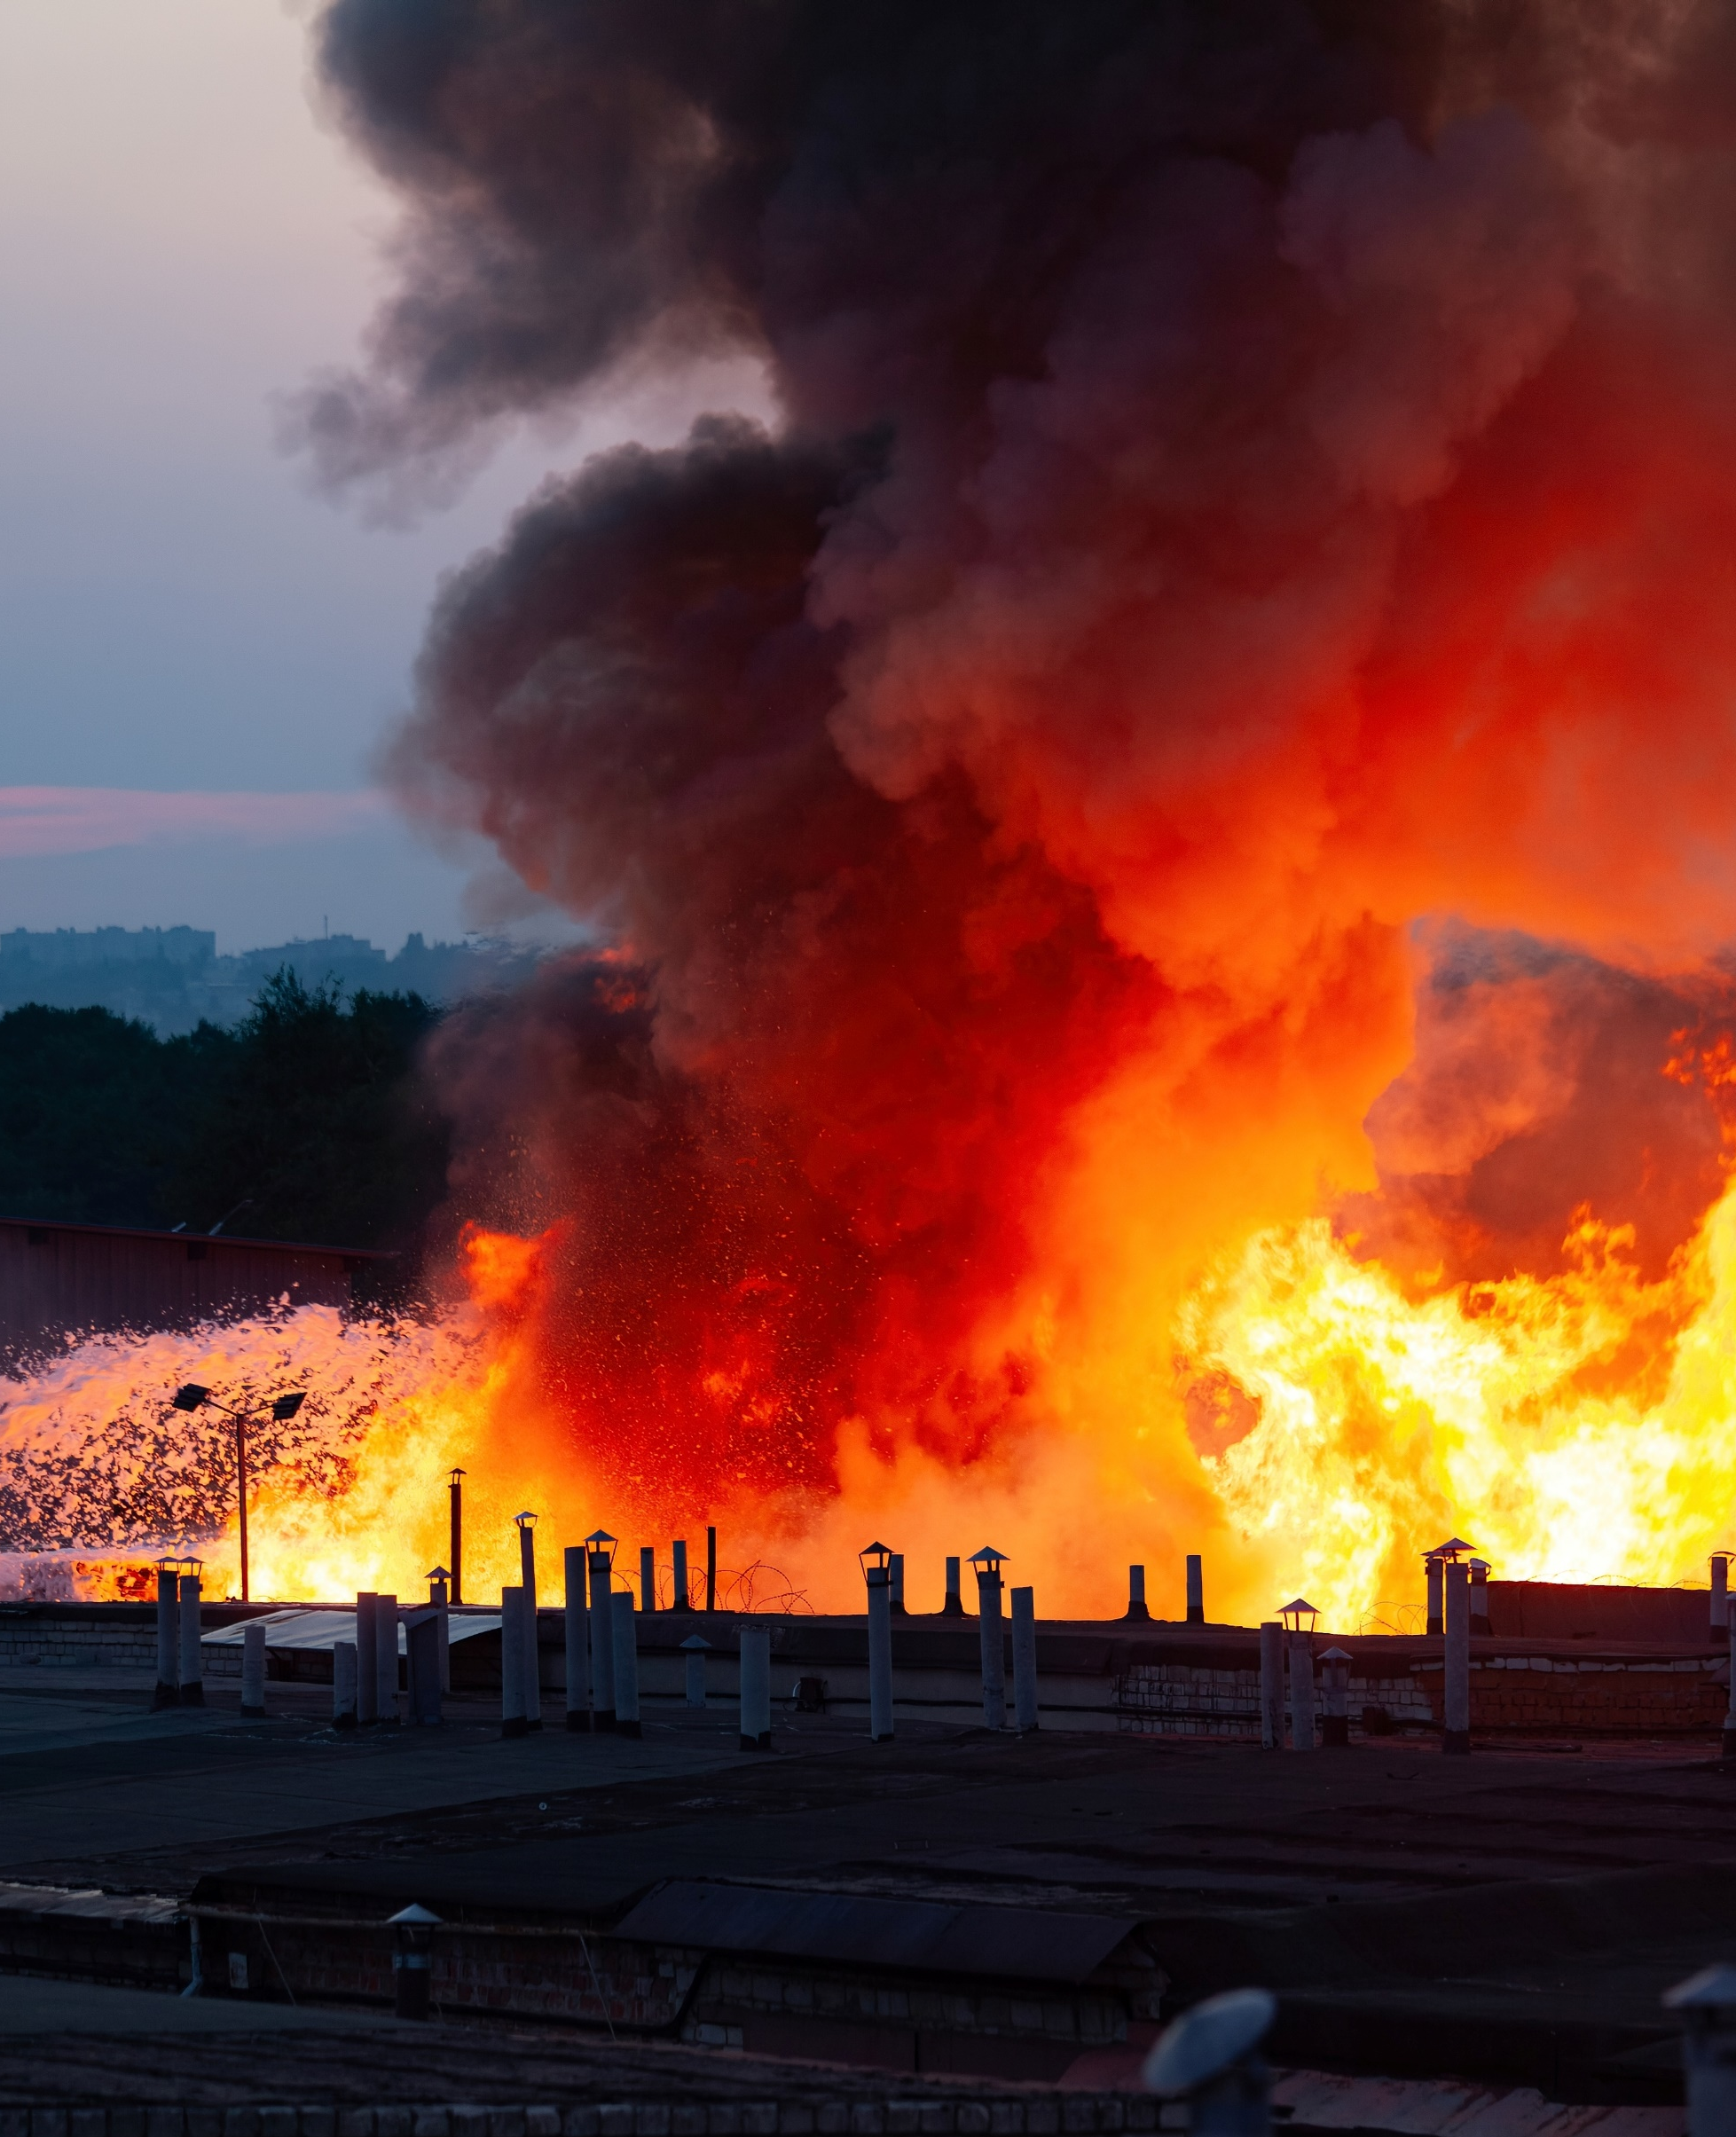
Property Policies: What is Covered?
First Party Claims for:
Physical Damage to Property
Loss of Use or Functionality of Property
Business Interruption
Covers:
Building
Office Furniture/Equipment
Inventory
Common Covered Perils: Fire, Theft, Vandalism, Explosions, Lightening
7

Slide 8
D&O and E&O Policies: What is Covered?
(Usually) the Company and its Management, Executives and Employees
Pays Settlements or Judgments for Third Party Liability
D&O: Wrongdoing
E&O: Mistakes in Rendering Client Services (Negligence/Malpractice)
Defense Costs Coverage (Even if Damages Are Excluded)
8

Slide 9
EPLI Policies: What is Covered?
Claims By Employees Against the Company
Wrongful Termination
Discrimination
Harassment
Retaliation
Demotions/Failure to Promote
Negligent Hiring/Supervision
Breaching Terms of Employment Contract
9

Slide 10
Commercial Crime/Fidelity Policies: What is Covered?
Theft of Company’s Money or Property
Involving an Employee (as a Perp or Victim)
Theft on Insured Premises or In Transit
Computer Fraud
Fraudulent Wire Transfers
Forgery/Counterfeit Currency/Check Fraud
Embezzlement
10

Slide 11
Cyber Liability Policies: What is Covered?
Hybrid – Covers Both First-Party and Third-Party Losses
Forensic Investigatory Costs
Costs to Restore Digital Assets/Rebuild the System
Incident Response Professional Fees (Public Relations and Lawyers)
Credit Monitoring for Affected Individuals
Business Interruption
Ransom and Extortion Costs
Fines and Penalties (State Privacy Laws, State and Federal Cybersecurity Regulations)
Lawsuits/Third Party Claims
11

Slide 12
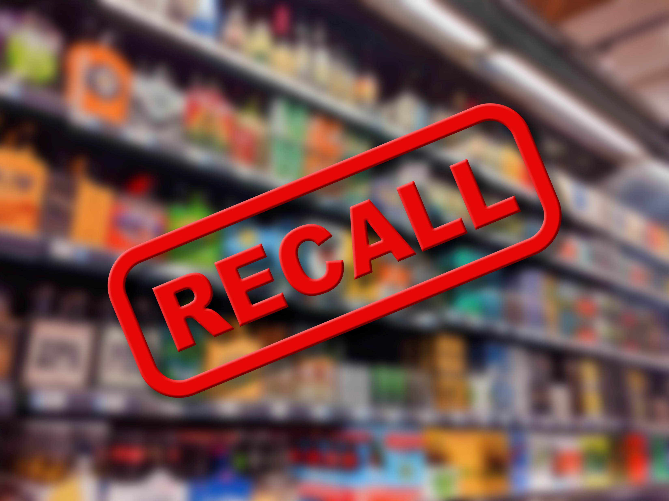
Contamination and Recall Policies: What is Covered?
Recall – Communication and logistics
Destruction and Replacement Expenses
Lost Profits due to loss of demand or inability to produce product
Brand and Sales Rehabilitation costs
Third Party Recall Liability – 3rd Party consequential damages
12

Slide 13
ARE YOU COVERED FOR…?
Source: istock.com

Slide 14
“Foreign Objects” In Your Product
Nestle Tollhouse Cookies
August 10, 2023
Recall resulting from wood-fragments in “break and bake” products.
Shade Foods, Inc. v. Innovative Prod, Sales and Mktg., 93 Cal. Rptr. 2d 364 (Ct. App. 2000)
Recall resulting from contaminated almonds being incorporated into nut clusters and cereal products
Your Product
Other People’s Product
Incorporation Doctrine
Impaired Property
14

Slide 15
A Word About “Your Work/ Your Product” Exclusions
Phibro Animal Health Corp. v. National Union Ins. Co., 142 A.3d 761 (N.J. App. Div. 2016)
Manufacturer of animal health feed additive sought coverage for adverse effects on its customers’ commercial poultry
15

Slide 16
ARE YOU COVERED FOR…?
Source: istockphoto.com

Slide 17
“Problems” in Your Facility
PBM Nutritionals v. Lexington Ins. Co., 724 S.E.2d 707 (Va. Supreme. Ct. 2012)
No coverage for product contamination
Leaking valve sent contaminated water to infant formula ingredients
No coverage — very broad pollution exclusion
Original policy would have provided coverage, but a total pollution exclusion added by endorsement negated it
Leprino Foods Co. v. Factory Mut. Ins. Co., 453 F.3d 1281 (10th Cir. 2011): Contamination Exclusion — was there third party damage to trigger property damage coverage?
Contamination of cheese in warehouse
Only covered if caused by 'other physical damage'
Damaged fruit in warehouse contaminated cheese
17

Slide 18
ARE YOU COVERED FOR…?
Source: petersoninsuranceservices.com

Slide 19
Claims You May
(Or May Not) Have Known About
Patriarch Partners v. AXIS Insurance Company, 758 Fed. Appx. 14 (2d Cir. 2018)
Held – SEC’s confidential investigation of company constituted a pre-policy claim that barred coverage even though company was not served with subpoena until after policy inception
What is a “claim”?
Prior Claim Exclusions
Warranties – Facts or circumstances that insured did or should have reasonably expected to result in a claim
Compare Treasure Valley Transit v. Philadelphia Indem. Co., 139 Idaho 925 (2004)
Held – Investigation of Medicaid Fraud by Dept. of Health coupled with suspension of payments was Not a “Claim”; “Claim” defined as any proceeding before administrative agency once it has concluded its investigation; because investigation was still ongoing there was no “Claim”
19

Slide 20
What is a Claim?
A Claim could be…
Subpoena
Government Investigations
Requests for Information
Civil Investigative Demands
Lawsuits
Letters Demanding Money to Redress a Wrong (Written Demands for Monetary or Non-Monetary Relief)
20

Slide 21
Issues that Commonly Arise with
Claims-Made Policies
Was Notice Timely Given
Was Notice Adequate?
F.D.I.C. v. St. Paul Fire & Marine Ins. Co., 993 F.2d 155 (8th Cir. 1993)
Notice of Circumstances
Prior and Related Claims
Interrelated Wrongful Acts
Prior and Pending Litigation Exclusion
Prior Notice Exclusion
Warranties
Policy Applications
21

Slide 22
ARE YOU COVERED FOR…?

Slide 23
Wiring Money To A Fraudster
Impersonating A Service Provider
Which Policy – Crime, Cyber, Other?
Coverages:
Computer Fraud Coverage
Social Engineering Coverage
Fraudulent Wire Transfer Instructions Coverage
Cases Offer Mixed Results
Ernst and Haas Mgmt. Co. v. Hiscox Inc., 23 F.4th 1195 (9th Cir. Jan. 2022)
SJ Computers, LLC v. Travelers Cas. & Sur. Co. of Am., 621 F. Supp. 3d 962 (D. Minn. 2022)
G&G Oil Co. of Indiana v. Cont'l W. Ins. Co., 65 N.E.3d 82 (Ind. 2021)
https://www.dreamstime.com/
23

Slide 24
Common Coverage Issues Arising from Business Email Compromise Claims
Other Insurance Provisions
Sublimits
Be Mindful of Policy Requirements and Incorporate them into your Business Operations
Customer verification through pin or security code to make wire request?
Call back verification to a pre-determined telephone number?
Contemporaneous record of the call back verification?
24

Slide 25
ARE YOU COVERED FOR…?

Slide 26
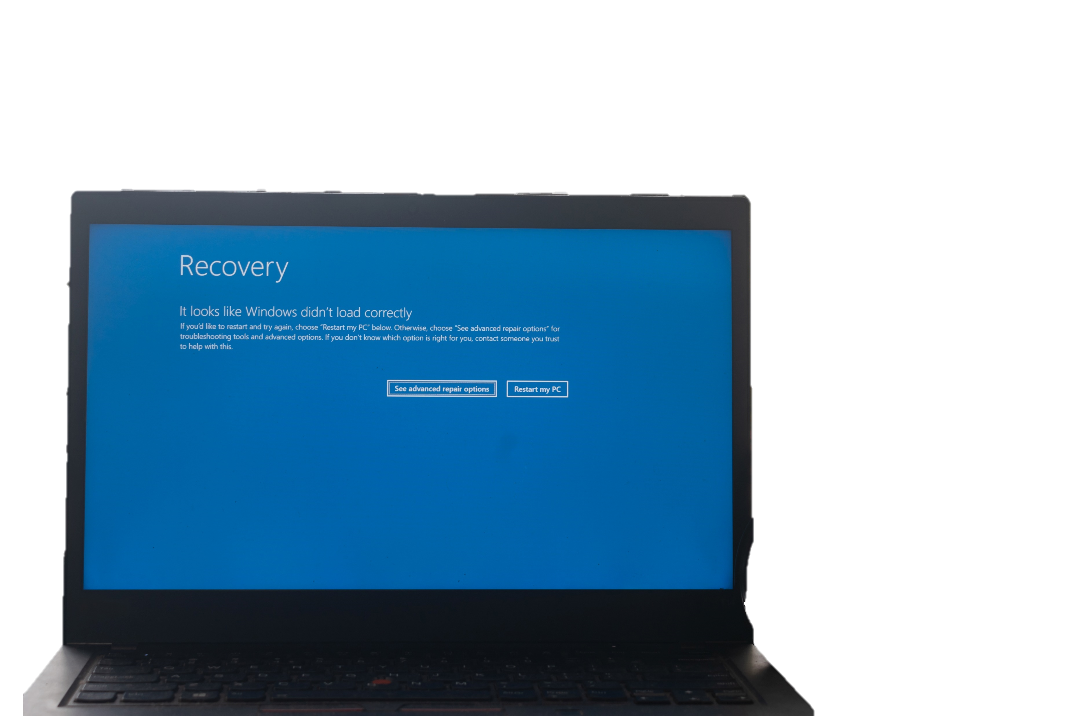
Computer System Failure Due to Non-Malicious Human Error By Service Provider
Cyber Policy: Does Coverage Include Negligent/ Accidental System Failure?
Many Cyber Policies Require Intentional Breach
Contingent Business Interruption Coverage
Be Aware of Temporal Limitations to Coverage
Waiting Periods
Period of Restoration
26

Slide 27
ARE YOU COVERED FOR…?
Source: condominiuminsurancelaw.com

Slide 28
Recall of Your Product
Wornick Company v. Houston Casualty Co., 2013 WL 1832671(S.D. Ohio 2013)
A recall of your product does not always trigger “contamination coverage”
Compare Netherlands Ins. Co. v. Main Street Ingredients, LLC 2013 WL 101876 (D. Minn. 2013)
Claim may be covered even when contamination is not shown
28

Slide 29
What Events Trigger Coverage?
Accidental Contamination
Malicious Product Tampering
Government Recall
Adverse Publicity
29

Slide 30
ARE YOU COVERED FOR…?

Slide 31
Theft from Your Office or Facility by Security Guards
An “inside job”
Crime Policy Coverage for Employee Theft
Who is an Employee?
Full time and Part time Employees only?
What about Temps?
What about Leased Employees?
What do you have to Prove and How do you Prove it?
Arrest?
Confession?
Circumstantial Evidence?
31

Slide 32
Some Final Thoughts…

Slide 33
A Word About “Notice”
Give notice early and broadly
Give notice of anything that even smells like it might be a claim
Late notice can be fatal!
General liability (occurrence) vs. specialty policies (claims-made)
33

Slide 34
A Word About “Limits of Liability”
Are they high enough?
Be aware of sublimits
Do defense costs erode your limits?
Are you sharing your policy with additional insureds?
Be mindful of high deductibles/SIRs
34

Slide 35
A Word About “The Application”
Grave Consequences for Application Misrepresentation
Even innocent mistakes may be actionable
Grounds for Coverage Denial or Policy Rescission
Do Your Diligence Before Completing
If you are not 100% sure start with “to the best of my knowledge as the” Risk Manager, Treasurer, etc.
Questions that require a misleading answer
Questions about any current fact or circumstance that may lead to a claim
35

Slide 36
Practice Pointers
Use an insurance broker who has expertise in food insurance.
Review your exposures.
Cooperate with your insurance company but protect your interests.
Do not take “CLAIM DENIED” as an answer from your insurance company.
36

Slide 37
THANK YOU!
Questions?
Steven J. Pudell, Luma S. Al-Shibib

