Slide 1
Hot Topics in Employment Law
Dean Bennett, Partner
Alex grande, Partner

Slide 2
Disclaimer
This presentation is designed to provide general information on pertinent legal topics. The information is provided for educational purposes only. Statements made or information included do not constitute legal or financial advice, nor do they necessarily reflect the views of Holland & Hart LLP or any of its attorneys other than the author.
This information contained in this presentation is not intended to create an attorney-client relationship between you and Holland & Hart LLP. Substantive changes in the law subsequent to the date of this presentation might affect the analysis or commentary. Similarly, the analysis may differ depending on the jurisdiction or circumstances. If you have specific questions as to the application of the law to your activities, you should seek the advice of your legal counsel.

Slide 3
Agenda
Department of Labor Developments
Non-Competition and Other Restrictive Covenants
Pregnant Worker Fairness Act
Spike in Wage Claims
Artificial Intelligence in the Workplace
Best Practices for ADA and FMLA Scenarios
DEI Policies – What is the Law
Questions?

Slide 4
DOL Developments: FLSA 2024 Final Rule
State of Texas v. Dep’t of Labor, Case No. 24-cv-468-SDJ
On November 15, 2024, the U.S. District Court for the Eastern District of Texas invalidated the Department of Labor’s (DOL) 2024 Final Rule, which increased salary thresholds for overtime exemptions under the Fair Labor Standards Act (FLSA).
Notes:
This decision in State of Texas v. Dep’t of Labor, Case No. 24-cv-468-SDJ, vacates the rule nationwide, halting its implementation and restoring the salary level in effect prior to July 1, 2024 ($35,586 per year, $684 per week) for executive, administrative, and professional (EAP) exemptions and ($107,432 per year) for the highly compensated employee exemption.

Slide 5
Department of Labor Developments
The Court’s Decision:
In its ruling, the court determined that the DOL exceeded its authority by allowing salary levels to overshadow the duties test central to the EAP exemption.
The court also cited the Supreme Court’s 2024 decision in Loper Bright Enterprises v. Raimondo, which clarified that courts must independently determine whether an agency acted within its statutory authority.
Notes:
The court found:
The FLSA requires that exemption eligibility be determined primarily by job duties, not salary.
The 2024 Rule’s salary thresholds effectively supplanted the duties test for millions of employees, contradicting the statute.
The automatic indexing mechanism, which allowed for future increases without additional rulemaking, was outside the DOL’s statutory authority.

Slide 6
DOL Developments: FLSA 2024 Final Rule
Key Takeaways:
Executive, Administrative, and Professional (EAP) Exemptions
The planned salary threshold increase to $844 per week (or $43,888 annually), effective July 1, 2024, is no longer valid.
Future staged increases, including the January 1, 2025 threshold of $1,218 per week and automatic updates starting July 1, 2027, are also void.
Highly Compensated Employee Exemption
The planned salary threshold increase to $132,964 effective July 1, 2024 is no longer valid.
Future staged increases, including the January 1, 2025 threshold increase to $151,164, is now void.

Slide 7
DOL Developments: FLSA 2024 Final Rule - Impact on Employers
Reversion to Previous Rules.
Compliance Considerations for Employers who Raised Salaries.
Appeal Uncertainty.
Duties Test Remains Critical.
Notes:
Pre-2024 Rule salary thresholds:
EAP exemption: $684 per week ($35,568 annually).
Highly Compensated Employee (HCE) exemption: $107,432 annually.
On November 26, 2024, the DOL filed a notice of appeal seeking to overturn the decision in Texas v. Department of Labor. The DOL’s appeal is likely to be impacted by the incoming presidential administration and a changeover in leadership at the DOL, which could choose to drop the appeal or take different action on the overtime thresholds.
This ruling underscores that meeting the salary threshold alone is insufficient for exemption. Employees must also satisfy the duties test to qualify as exempt under the FLSA.

Slide 8
Additional DOL Developments
Roll-Back of Biden-Era Regulations. The “new” Trump DOL will look much like the old.
Schedule F: Reinstatement of “Schedule F”—a 2020 executive order that would reclassify thousands of federal workers as “at-will” employees is very likely.
Immigration. A Trump DOL could potentially collaborate with other federal agencies on undocumented workers. This could result in worksite raids and heightened scrutiny on—and requirements for—employment eligibility.
Independent Contractors. Shortly before President Biden was inaugurated, then-President Trump’s DOL finalized easing the necessary requirements to classify workers as independent contractors.
Notes:
Schedule F: May result in a significant reduction in staff at the DOL and other federal agencies, which could have sweeping implications for regulatory or enforcement actions and priorities across the board.
Independent Contractors: But the Biden administration never implemented the rule and, accordingly, it never went into effect.
In all likelihood, President Trump’s DOL will reinstate the proposed rule and make it easier for persons to be classified as independent contractors.

Slide 9
Non-Competition and Other Restrictive Covenants: Legal and Regulatory Developments
Non-Competes Generally Under State Law
Non-competes are currently allowed, with some exceptions, in Idaho, Montana, and Utah.
Idaho Code § 44-2701 et seq.
Although Mont. Code § 28-2-703 technically prohibits non-competes, courts have interpreted the law to allow for partial or reasonable non-compete agreements.
Utah Code § 34-51-201 et seq.
However, other states—including California, Minnesota, and North Dakota—currently ban post-termination non-competes outright.

Slide 10
Non-Competition and Other Restrictive Covenants: Legal and Regulatory Developments
The New Federal Rule
In January 2024, the Federal Trade Commission (FTC) proposed a new rule to end the enforcement of employee non-compete agreements across the United States.
The rule generally bans an agreement that “prevents the worker from seeking or accepting employment with a person, or operating a business, after the conclusion of the worker’s employment with the employer.”

Slide 11
Non-Competition and Other Restrictive Covenants: Legal and Regulatory Developments
Application of the Rule
The rule applies to both current and future contracts and would prohibit employers from claiming or representing to an employee that they were bound by such an agreement.
The rule requires all employers that use any agreement with a non-compete clause to take action to rescind the clause and to provide written notice to the employee or former employee.

Slide 12
Non-Competition and Other Restrictive Covenants: Legal and Regulatory Developments
Exceptions to the Rule
The proposed ban is limited to traditional “pure” non-compete covenants. It’s not a wholesale prohibition on all restrictive covenants.
The FTC’s supplementary materials provide that other restrictive covenants—such non-solicitation agreements—are not expressly precluded.

Slide 13
Non-Competition and Other Restrictive Covenants: Legal and Regulatory Developments
Status of the Rule
On April 23, 2024, the FTC approved the rule banning non-compete agreements.
The rule was set to go into effect on September 4, 2024.
On August 20, 2024, a Texas Court issued a nationwide injunction preventing the FTC from enforcing the rule.
The FTC filed an Appeal to the Fifth Circuit on October 18, 2024 (likely to be decided 7-8 months from the filing).
So, now what…..

Slide 14
Pregnant Workers Fairness Act
Overview:
Passed in 2023, the federal PWFA was introduced to combat discrimination and promote workplace equality by requiring employers to provide reasonable accommodations to employees and applicants with known limitations related to pregnancy, childbirth, or related medical conditions. Retaliation against such workers is prohibited.

Slide 15
Pregnant Workers Fairness Act
The EEOC has been increasingly active in addressing compliance with regulations affecting pregnant workers.
State labor commissions, such as the Idaho Human Rights Commission and the Utah Antidiscrimination and Labor Division, have likewise seen an increase in charges by pregnant workers.
Notes:
This has been particularly evident in fiscal year 2024, as the EEOC has already filed five cases under the Pregnant Workers Fairness Act (PWFA), despite the law being in effect for just over a year.

Slide 16
Pregnant Workers Fairness Act
Some employers have been caught off guard since pregnancy-related leave, without extenuating medical complications, has largely been a function of company parental leave policies, particularly where a worker has not been employed long enough to qualify for other leave.
Employers need to take note that they are now required to engage in the interactive process to determine whether an employee is entitled to an accommodation for a pregnancy-related condition.
In October of this year, a federal judge in Florida approved a nearly $100,000 settlement where an employer was accused of violating both the PWFA and Americans with Disabilities Act.

Slide 17
Pregnant Workers Fairness Act
The incoming Trump Administration may also seek to limit the scope of protections afforded to employees under the PWFA.
Notes:
A former line cook at a beach resort and club gave birth to a stillborn baby.
The employee notified the resort of her need for leave, and provided a doctor’s notice stating that she would need six weeks to recover.
The next day, rather than providing the leave, the Resort fired her.
The EEOC took up her case and achieved a settlement on her behalf which included injunctive relief wherein the Resort agreed in the future not to “terminate or harass any employee on the basis of their pregnancy and/or disability,” to “provide reasonable accommodations to applicants’ and employees’ known limitations related to pregnancy, childbirth, or related medical condition,” and to not “retaliate against any person for requesting a reasonable accommodation under the PWFA or ADA.” Andrea Lucas, the sole Republican appointee to the EEOC is widely thought to be President-elect Trump’s nomination to chair the Commission and has publicly voiced criticism of the EEOC’s broad interpretation of the PWFA, which includes accommodations for abortion and conditions like menopause and infertility.

Slide 18
Wage Claims and Bonus, Incentive, and Commission Based Compensation
Offer Letters, Compensation Plans, Employment Contracts
Employee is eligible for an annual bonus of (x)
Employee will be paid (x)% of gross profits
Employee will be paid a quarterly bonus as set forth in the company bonus plan
Employee will be paid a bonus based on amounts above revenue targets as set out in the following formula . . .
Employee will be paid a commission in the amount of (x) if Employee achieves the following benchmarks . . .

Slide 19
Wage Claims and Bonus, Incentive, and Commission Based Compensation
Review your Offer Letters, Compensation Plans, Employment Contracts
When is the compensation earned?
When is the compensation due?
What conditions precedent must occur for the employee to receive the compensation?

Slide 20
Artificial Intelligence in the Workplace
An employer’s use of AI must comply with existing employment laws.
Both federal and state laws prohibit disparate treatment discrimination in the workplace (i.e., intentional discrimination of members of a protected class) and disparate impact discrimination (i.e., facially neutral practices or policies that may disproportionately affect members of a protected class).
Notes:
Including the following that prohibit discrimination:
Title VII of the Civil Rights Act of 1964 (Title VII) — on the basis of race, color, religion, sex or national origin.
Americans With Disabilities Act (ADA) — against individuals with disabilities.
Age Discrimination in Employment Act — against applicants and employees who are 40 years of age or older.
Similar state and local laws.

Slide 21
Artificial Intelligence in the Workplace – State Law Developments
Colorado. In May, Colorado became the first US state to enact comprehensive AI legislation. Effective February 1, 2026, the law applies to both developers and deployers (i.e., users) and requires the use of reasonable care to avoid algorithmic discrimination.
Illinois. In August, Illinois passed a law (HB 3773) impacting employer use of AI technology. This law will go into effect on January 1, 2026. Employers will be required to notify employees when they use AI for employment decisions which include recruitment, hiring, promotion, renewal of employment, selection for training, discharge, discipline, tenure or the terms, privileges or conditions of employment.
Notes:
To comply with the law, employers must implement a risk management policy and program, complete an annual impact assessment, notify employees or applicants about the employer’s use of AI where AI is used to make a decision about the employee or applicant, make a publicly available statement summarizing the types of high-risk systems that the employer currently deploys, and disclose to the Colorado attorney general the discovery of algorithmic discrimination within 90 days of discovery The law targets “high-risk artificial intelligence systems,” which is any AI system that “makes, or is a substantial factor in making, a consequential decision.” A “consequential decision” is a decision that has “a material legal or similarly significant effect” on the provision or denial to Colorado residents of services, including those related to employment.

Slide 22
Best Practices for ADA and FMLA Scenarios
These claims, more than any other, are a record keeping contest
Get Employee requests to HR or your Administrator
Don’t grant informal leaves (no good deed goes unpunished)
Train Supervisors and Managers
Timely FMLA Certification (lets you start the clock)
ADA Accommodation Questionnaire (have one on hand ready for use)
Documentation of Undue Hardship, which can include a test period
***Remember leave can be an accommodation

Slide 23
Scenario # 1
Manager has Employee that asks for some time off for a personal health or family health matter. Manager allows the employee the time off. A further request happens and is granted. Soon, Employee has taken weeks of leave, but none is counted against the FMLA 12 weeks.

Slide 24
Scenario # 2
Employee is on FMLA. 12 weeks expired. Employer terminates employment without any thought of Employer’s obligations under the ADA.

Slide 25
Scenario # 3
Employee informally requests an accommodation (although they don’t call it that). Employer allows the request for a duration but grows weary of the arrangement. Employer later engages appropriate ADA accommodation steps, and Employer wants to claim, “undue hardship.” But Employer allowed the arrangement for a long period of time with no set limitations or parameters.

Slide 26
Scenario # 4
Employer has an under performing Employee. Employer has internally made the decision to terminate Employee on a date certain but has not documented the decision. Employee seeing the writing on the wall, requests FMLA leave.

Slide 27
Scenario # 5
Employer believes Employee has a disability, and unilaterally limits the Employee’s duties or work hours, thinking they are doing what is best for the Employee.

Slide 28
DEI Policies – What is the Law?
Students for Fair Admissions, Inc. v. President and Fellows of Harvard College, 600 U.S. 181 (2023).
“Eliminating racial discrimination means eliminating all of it.” -Roberts (majority)
“The pursuit of racial diversity will go on.” - Sotomayor (dissent)

Slide 29
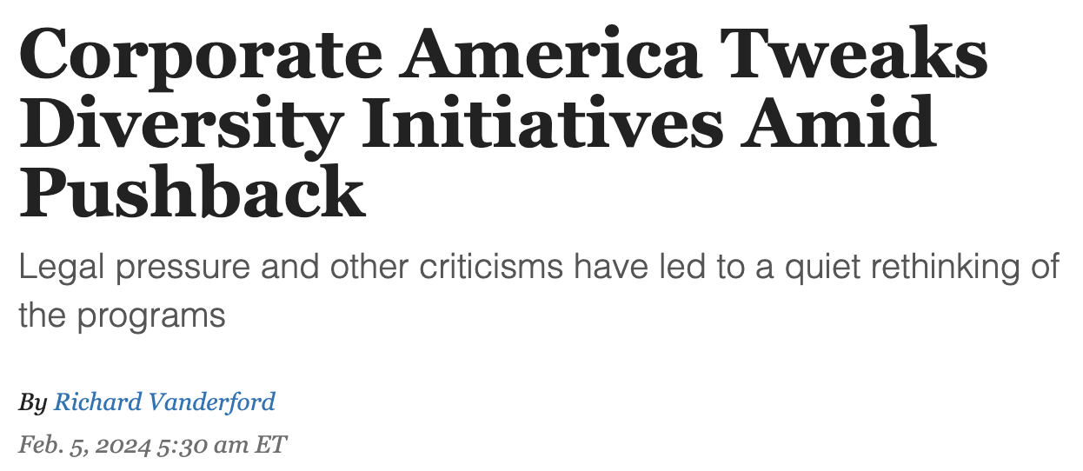
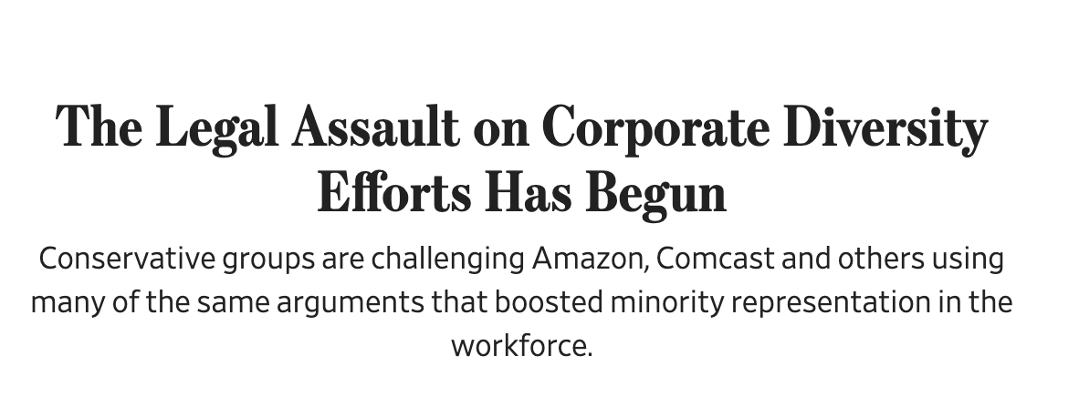
Uncertainty Abounds

Slide 30
The DEI Optimists Versus the DEI Pessimists
The Optimistic Take: SFFA has nothing to do with workplace DEI. Keep calm and carry on.
The Pessimistic Take: Workplace DEI is now illegal.

Slide 31
The Optimists are Wrong
Laws at issue in SFFA
Equal Protection Clause: “No State shall . . . deny to any person within its jurisdiction the equal protection of the laws.”
Title VI: “No person in the United States shall, on the ground of race, color, or national origin, be excluded from participation in, be denied the benefits of, or be subjected to discrimination under any program or activity receiving Federal financial assistance.”
Laws affecting workplace DEI
Title VII: “It shall be an unlawful employment practice for an employer . . . to discriminate against any individual . . . because of such individual’s race, color, religion, sex, or national origin.”
42 U.S. Code § 1981: “All persons within the jurisdiction of the United States shall have the same right in every State and Territory to make and enforce contracts . . . and to the full and equal benefit of all laws . . . as is enjoyed by white citizens.”

Slide 32
The Pessimists Are Wrong

Slide 33
Think About the 3 P’s

Slide 34
What does “palpable” mean? Muldrow v. City of St. Louis, 601 U.S. 346 (2024).
To make out a Title VII claim, a plaintiff “must show some harm respecting an identifiable term or condition of employment.”
“Terms or conditions” are not limited to contractual terms, and cover “more than the ‘economic or tangible’”
While a plaintiff must show some harm, the harm does not need to be “significant,” “serious,” “substantial,” “or any similar adjective suggesting that the disadvantage to the employee must exceed a heightened bar.”

Slide 35
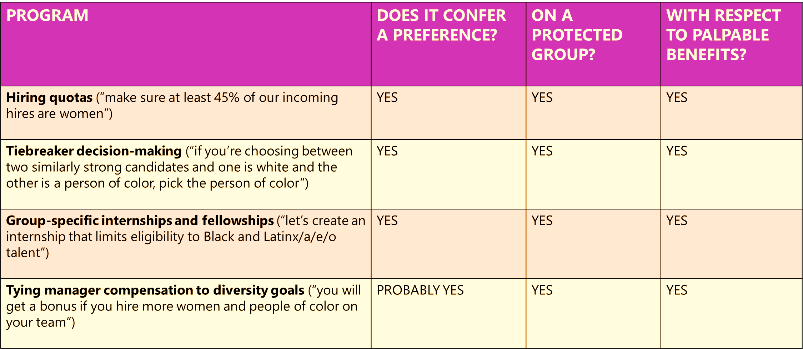
Examples of Red Programs

Slide 36
Examples of Green Programs

Slide 37
Examples of Yellow Programs

Slide 38
DEI Risk Assessment
Consider Risk
Conduct a self-audit with your client to divide programs into risk zones of red, green, and yellow
Factor in legal risks
Factor in social and business risks
Consider Impact
Factor in the impact of the programs in achieving your client’s DEI goals
Decide How to Proceed
All things considered, decide whether to maintain the program with awareness of risk, abandon the program with awareness of risk, or adjust the program to safeguard it

Slide 39
Recommended Shifts
Avoid Preferences. From lifting to leveling - Rather than giving “preference” to some groups over others, think about DEI actions that are identity-neutral but help level the playing field:
Creating a structured recruitment and promotion process with clear, transparent, merit-based criteria
Purging stereotypical language from job descriptions and evaluation processes
Reviewing employee benefits policies to ensure they are being applied equitably
Putting managers through unconscious bias training before they consider candidates

Slide 40
Recommended Shifts
Avoid Protected Groups.
From cohorts to content
Example: Expanding a racial equity program to welcome anyone who is committed to racial equity, regardless of their identity
From cohorts to character
Example: Asking candidates to write an essay explaining “how race affected [their] life, be it through discrimination, inspiration, or otherwise”
From cohorts to cohorts
Example: Developing initiatives that advance diversity and inclusion along lines of non-protected status, like socioeconomic status

Slide 41
Recommended Shifts
Avoid Palpable Benefits.
From adverse to ambient - rather than directly affecting people’s conditions of employment (e.g., hiring and promotion), think about DEI programs that improve the overall culture of the organization, such as:
Conducting employee education on topics such as bias, allyship, or inclusive leadership
Creating a more physically inclusive office environment, such as through all-gender bathrooms, nursing rooms, and childcare facilities
Building relationships with diverse professional groups (e.g., National Association of Black Accountants, Society of Hispanic Professional Engineers)
Support community organizations focused on DEI issues, such as through volunteerism and philanthropy

Slide 42
Questions?

Slide 43
Thank You – Any Questions?
Dean bennett
Partner | Employment & Labor
ADBennett@hollandhart.com
Alex grande
Partner | Employment & Labor
ASGrande@hollandhart.com

