Slide 1
Marketing, Communications and Legal Strategies: Working In Tandem in the Viral Media World Association of Corporate Counsel, Austin Chapter May 23, 2018

Slide 2
Panelists
Travis Thomas: Partner, The Monument Group, LLC
Kevin Brown: Partner, Waller Lansden Dortch & Davis LLP
Andrew Vickers: Associate, Waller Lansden Dortch & Davis LLP

Slide 3
Overview of Topics
Corporate counsel’s role in public affairs/brand crisis
Leveraging legal disputes for public affairs/brand benefit
Combating “Fake News” in the Information Apocalypse

Slide 4
Public Affairs Crisis

Slide 5
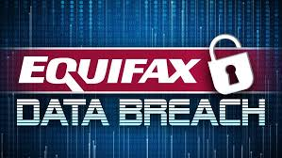
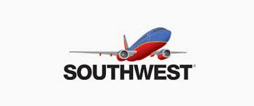
Grading Responses
Equifax (privacy breach)
Starbucks (Philly – racial profiling)
Southwest (Passenger death)
Yeti (no business with NRA)
United (passenger incident)

Slide 6
In-House Counsel’s Role
The social media spiral: need for speed
Lawyers’ “no comment” alternative not viable
Response plan: prepare during peacetime
Assemble the team
Engage outside counsel (A/C privilege)
Stand-by influencers/brand supporters

Slide 7
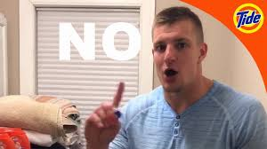
Stand-by Influencers
https
https://www.youtube.com/watch?v=-DrC_PF_3Lg

Slide 8
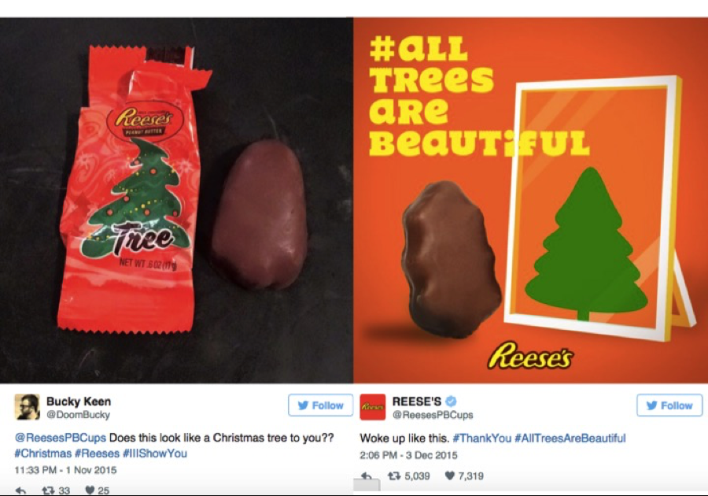
Post-Crisis Restoration

Slide 9
Lemons to Lemonade: Leveraging Legal Disputes for Corporate Goodwill

Slide 10
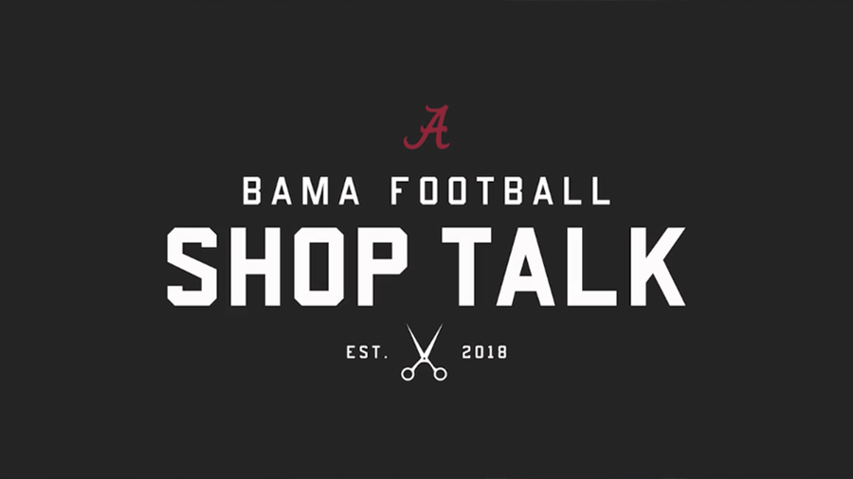
LeBron James: cease and desist letter leaked for promotional purposes

Slide 11
Whole Foods: Going on the Offensive!

Slide 12
Litigation Milestones and Communications Opportunities
Cease and desist letters (we’re cool!)
Initial filings – public affairs vetting
Basic court appearances – are the outside lawyers “brand-conscious”?
Protective orders – are you hiding something?
Trial publicity: victory or defeat

Slide 13
Combating Fake News: Strategies in the Post-Truth Era
4810-5634-9230

Slide 14
Brand Disinformation: Words and Images
Notes:
Six days after Philly arrest, coupon circulated on social media (originally from 4Chan)
Says - limited to persons of African American heritage and/or identity
Baristas instructed to use discount code 1488 – combo of two numbers that are symbols of white supremacy
QR code linked to a website – that translates code to n-word
Lesson: monitor social media!

Slide 15
Limitations of Traditional Legal Strategies
Sue for defamation/business disparagement?
Slow, Costly
Limited ability for temporary injunctive relief
Unintended consequences (a media platform)
Difficulties in tracking down source
Procedural hurdles: (1) Texas Defamation Mitigation Act and (2) Texas Citizens Participation Act (SLAPP Statutes)

Slide 16
Non-Legal Strategies
Regulatory remedies: let the government decide
Industry Self-Regulation: YouTube and Facebook
Counter-Technologies: Attacking the Bots
Blockchain (transparency)
Natural Language Processing (NLP)
FactMata (AI powers fact-checking)
New Knowledge (tracking early indicators of brand attacks on social media)

Slide 17
Questions?
Kevin Brown
512.685.6405
kevin.brown@wallerlaw.com
Travis Thomas
512.344.2600
travis@monumentgroupllc.com
Andrew Vickers
512.685.6413
andrew.vickers@wallerlaw.com

